Slide 1

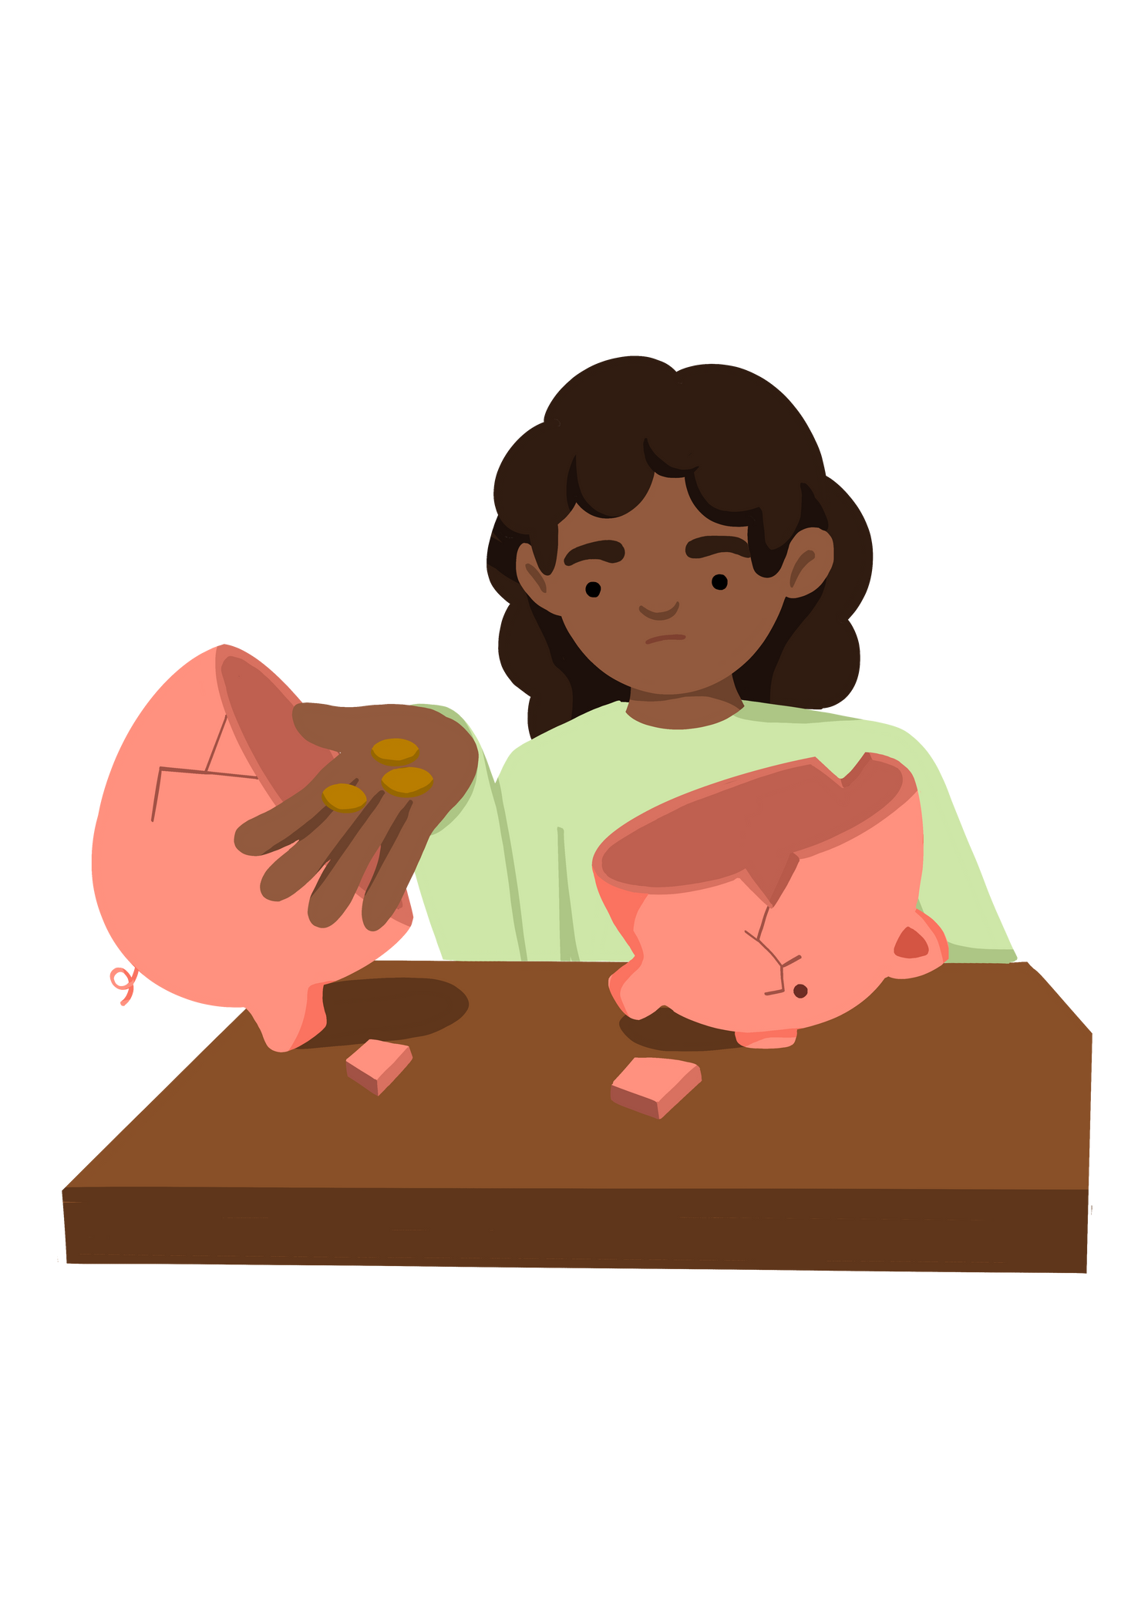
Why Does Poverty Exist?
Notes:
Put the pupils in groups.
A3 Sheets of paper - Pens.
The objective of this activity is for the teams to remember as many items on the two slides as they can.
They can look at them in any order, however, they must only look at each slide twice and for a minute at a time (adjust this accordingly for your class).
The teams must not write anything down when the slides are being shown.
Discussion points:
After one view, encourage your teams to think strategically & discuss these points:
How can we work as a team to remember all the items?
Are there any methods we can use to remember all the items?
When the activity is complete, ask them:
What type of communication was used in attempting to solve the problem?
Did we communicate well as a team? Why? Why not?

Slide 2




Lesson Objective | Skills Objective
To understand the potential causes of poverty | I understand teamwork and the importance of working together.
 | National Curriculum: PE, English, Geography and Science
Notes:
Put the pupils in groups.
A3 Sheets of paper - Pens.
The objective of this activity is for the teams to remember as many items on the two slides as they can.
They can look at them in any order, however, they must only look at each slide twice and for a minute at a time (adjust this accordingly for your class).
The teams must not write anything down when the slides are being shown.
Discussion points:
After one view, encourage your teams to think strategically & discuss these points:
How can we work as a team to remember all the items?
Are there any methods we can use to remember all the items?
When the activity is complete, ask them:
What type of communication was used in attempting to solve the problem?
Did we communicate well as a team? Why? Why not?

Slide 3
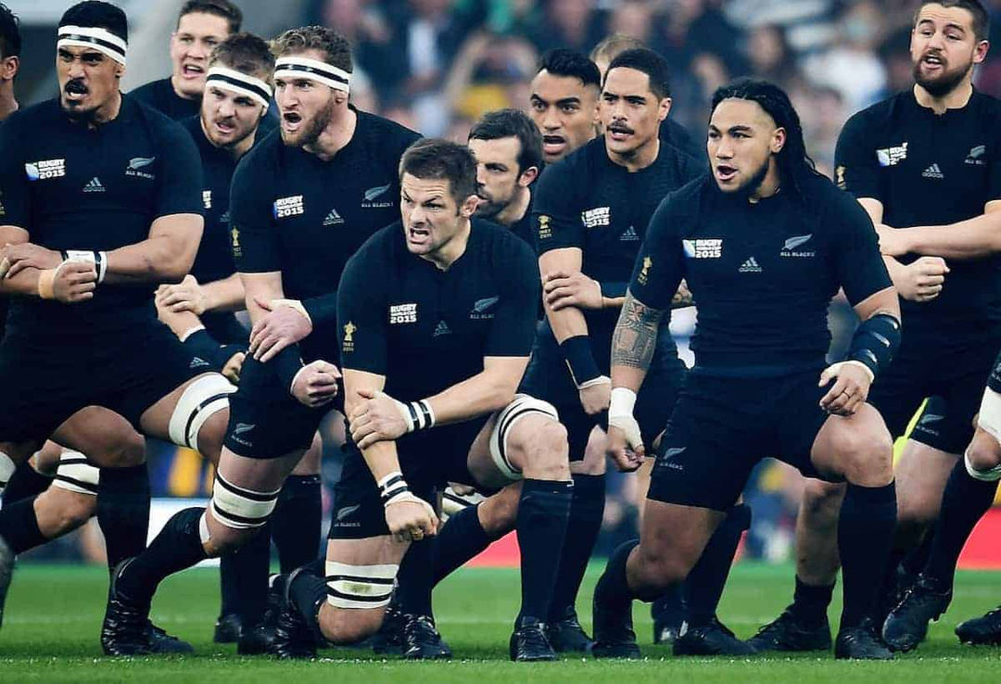

Notes:
Put the pupils in groups.
A3 Sheets of paper - Pens.
The objective of this activity is for the teams to remember as many items on the two slides as they can.
They can look at them in any order, however, they must only look at each slide twice and for a minute at a time (adjust this accordingly for your class).
The teams must not write anything down when the slides are being shown.
Discussion points:
After one view, encourage your teams to think strategically & discuss these points:
How can we work as a team to remember all the items?
Are there any methods we can use to remember all the items?
When the activity is complete, ask them:
What type of communication was used in attempting to solve the problem?
Did we communicate well as a team? Why? Why not?

Slide 4
All blacks are the world's most successful team, undefeated in over 75% of their international matches over the last 100 years.
The New Zealand All Blacks are known for the Haka, and it has a powerful meaning. It is about strength, power, working together. The business world uses its approach to sports and working as a team.
The Haka is a type of ceremonial Māori dance or challenge. Haka are usually performed in a group and typically represent a tribe's pride, strength, and uni y. Actions include foot-stamping, tongue protrusions and rhythmic body slapping to accompany a loud chant.
Haka is also used to challenge opponents on the sports field. The New Zealand rugby team, the All Blacks, perform the Haka before each match in a stunning show of strength and physical prowess.
https://www.newzealand.com/uk/feature/haka
Notes:
Put the pupils in groups.
A3 Sheets of paper - Pens.
The objective of this activity is for the teams to remember as many items on the two slides as they can.
They can look at them in any order, however, they must only look at each slide twice and for a minute at a time (adjust this accordingly for your class).
The teams must not write anything down when the slides are being shown.
Discussion points:
After one view, encourage your teams to think strategically & discuss these points:
How can we work as a team to remember all the items?
Are there any methods we can use to remember all the items?
When the activity is complete, ask them:
What type of communication was used in attempting to solve the problem?
Did we communicate well as a team? Why? Why not?

Slide 5
Notes:
Put the pupils in groups.
A3 Sheets of paper - Pens.
The objective of this activity is for the teams to remember as many items on the two slides as they can.
They can look at them in any order, however, they must only look at each slide twice and for a minute at a time (adjust this accordingly for your class).
The teams must not write anything down when the slides are being shown.
Discussion points:
After one view, encourage your teams to think strategically & discuss these points:
How can we work as a team to remember all the items?
Are there any methods we can use to remember all the items?
When the activity is complete, ask them:
What type of communication was used in attempting to solve the problem?
Did we communicate well as a team? Why? Why not?

Slide 6

Why do you think does poverty exist?

Slide 7
War
Big companies taking land
Climate Change
Notes:
Put the pupils in groups.
A3 Sheets of paper - Pens.
The objective of this activity is for the teams to remember as many items on the two slides as they can.
They can look at them in any order, however, they must only look at each slide twice and for a minute at a time (adjust this accordingly for your class).
The teams must not write anything down when the slides are being shown.
Discussion points:
After one view, encourage your teams to think strategically & discuss these points:
How can we work as a team to remember all the items?
Are there any methods we can use to remember all the items?
When the activity is complete, ask them:
What type of communication was used in attempting to solve the problem?
Did we communicate well as a team? Why? Why not?

Slide 8
Pick one of these areas and Investigate how they contribute to poverty.
Greenhouse Gas
Natural Cause
Man-made Cause
What can you do to make a difference share one action with the group?
Notes:
Put the pupils in groups.
A3 Sheets of paper - Pens.
The objective of this activity is for the teams to remember as many items on the two slides as they can.
They can look at them in any order, however, they must only look at each slide twice and for a minute at a time (adjust this accordingly for your class).
The teams must not write anything down when the slides are being shown.
Discussion points:
After one view, encourage your teams to think strategically & discuss these points:
How can we work as a team to remember all the items?
Are there any methods we can use to remember all the items?
When the activity is complete, ask them:
What type of communication was used in attempting to solve the problem?
Did we communicate well as a team? Why? Why not?

Slide 9
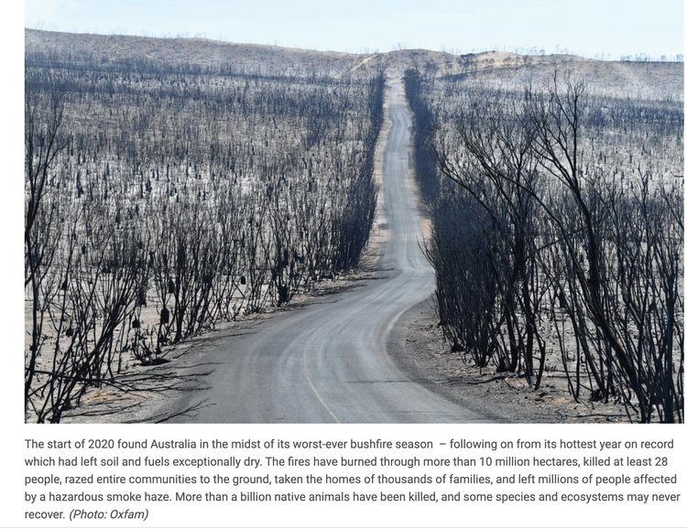
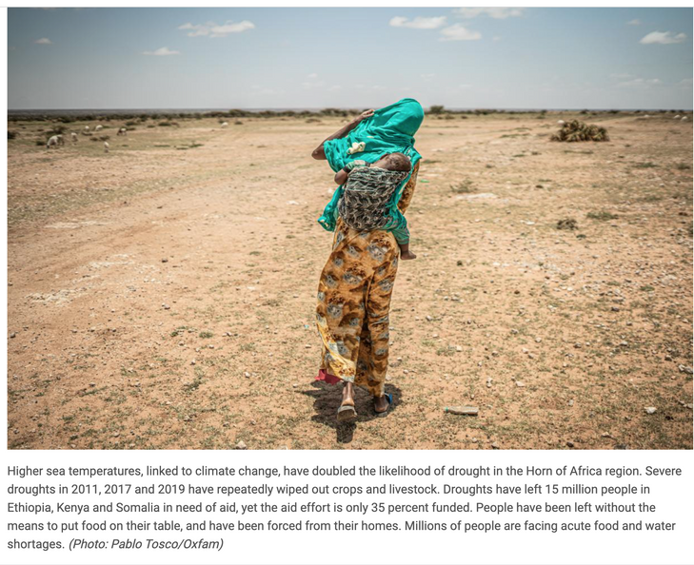

Slide 10
Let's Create a Pledge
Notes:
Put the pupils in groups.
A3 Sheets of paper - Pens.
The objective of this activity is for the teams to remember as many items on the two slides as they can.
They can look at them in any order, however, they must only look at each slide twice and for a minute at a time (adjust this accordingly for your class).
The teams must not write anything down when the slides are being shown.
Discussion points:
After one view, encourage your teams to think strategically & discuss these points:
How can we work as a team to remember all the items?
Are there any methods we can use to remember all the items?
When the activity is complete, ask them:
What type of communication was used in attempting to solve the problem?
Did we communicate well as a team? Why? Why not?

Slide 11








The Climate Pledge Commitments

Slide 12
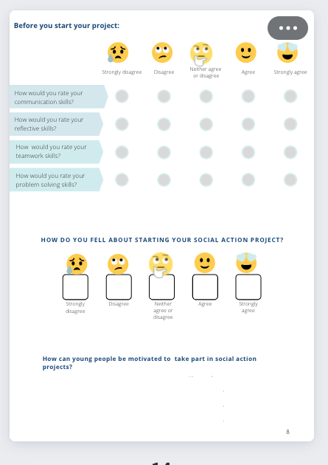
Notes:
Put the pupils in groups.
A3 Sheets of paper - Pens.
The objective of this activity is for the teams to remember as many items on the two slides as they can.
They can look at them in any order, however, they must only look at each slide twice and for a minute at a time (adjust this accordingly for your class).
The teams must not write anything down when the slides are being shown.
Discussion points:
After one view, encourage your teams to think strategically & discuss these points:
How can we work as a team to remember all the items?
Are there any methods we can use to remember all the items?
When the activity is complete, ask them:
What type of communication was used in attempting to solve the problem?
Did we communicate well as a team? Why? Why not?

