Slide 1
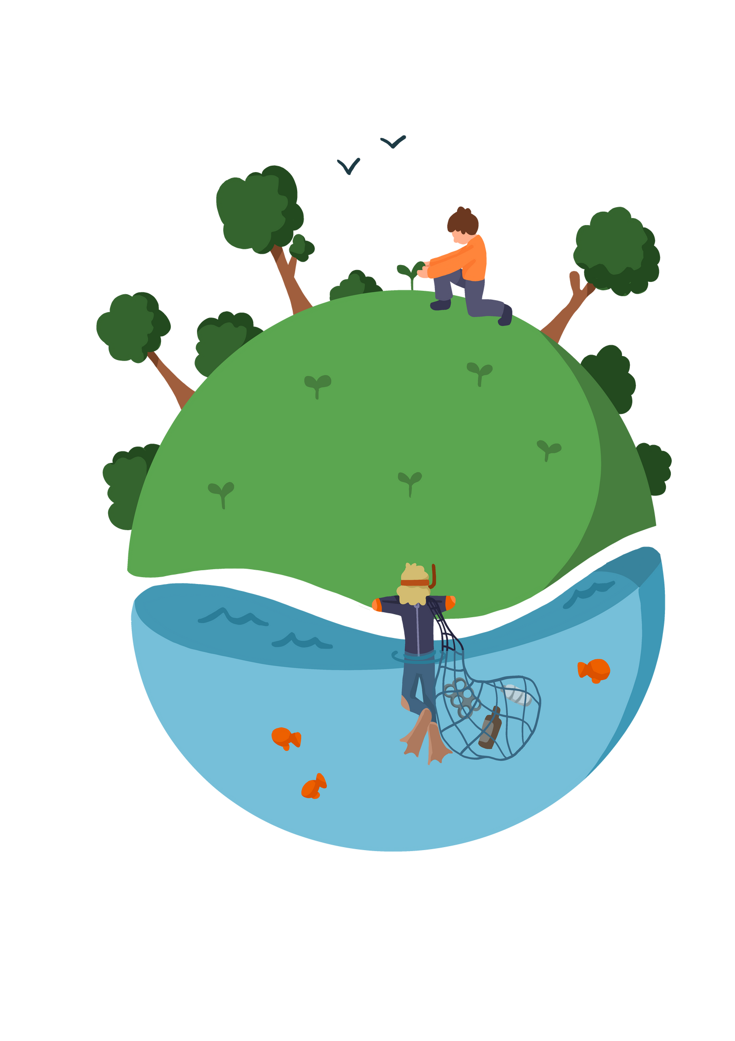
Lesson 5 - The Role of The UN In Supporting Young People to Support Change.
Create Your Own School Agreement.
Notes:
Pupils need to understand what sustainability means. before giving them the definitions ask pupils to suggest what they think sustainability means.

Slide 2



Lesson Objectives
Young people to understand the role of the United Nations in supporting young people.
 |  |  | National Curriculum: Careers
Notes:
Pupils need to understand what sustainability means. before giving them the definitions ask pupils to suggest what they think sustainability means.

Slide 3
Skills Objectives
Communication - I can produce professional presentations while keeping in mind the pitfalls of poorly prepared and presented presentations. Team Work -I have the confidence to work with others and adapt to the situation
 |  |  | National Curriculum: Careers
Notes:
Pupils need to understand what sustainability means. before giving them the definitions ask pupils to suggest what they think sustainability means.

Slide 4
What do these graphs tell us?
Notes:
Pupils need to understand what sustainability means. before giving them the definitions ask pupils to suggest what they think sustainability means.

Slide 5
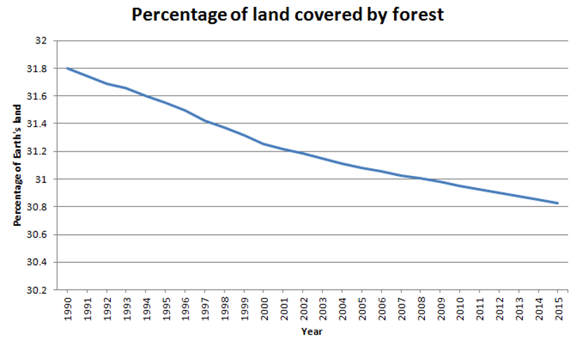
Notes:
Pupils need to understand what sustainability means. before giving them the definitions ask pupils to suggest what they think sustainability means.

Slide 6
What percentage of the Earth’s land was covered with forest in 1995?
What percentage of the Earth’s land was covered with forest in 2015?
What percentage of Earth’s land was deforested between 1990 and 2015?
Notes:
Pupils need to understand what sustainability means. before giving them the definitions ask pupils to suggest what they think sustainability means.

Slide 7
Answers
Notes:
Pupils need to understand what sustainability means. before giving them the definitions ask pupils to suggest what they think sustainability means.

Slide 8
What percentage of the Earth’s land was covered with forest in 1995? 31.8%
What percentage of the Earth’s land was covered with forest in 2015? 30.8%
What percentage of Earth’s land was deforested between 1990 and 2015? Approximately 1%
Notes:
Pupils need to understand what sustainability means. before giving them the definitions ask pupils to suggest what they think sustainability means.

Slide 9
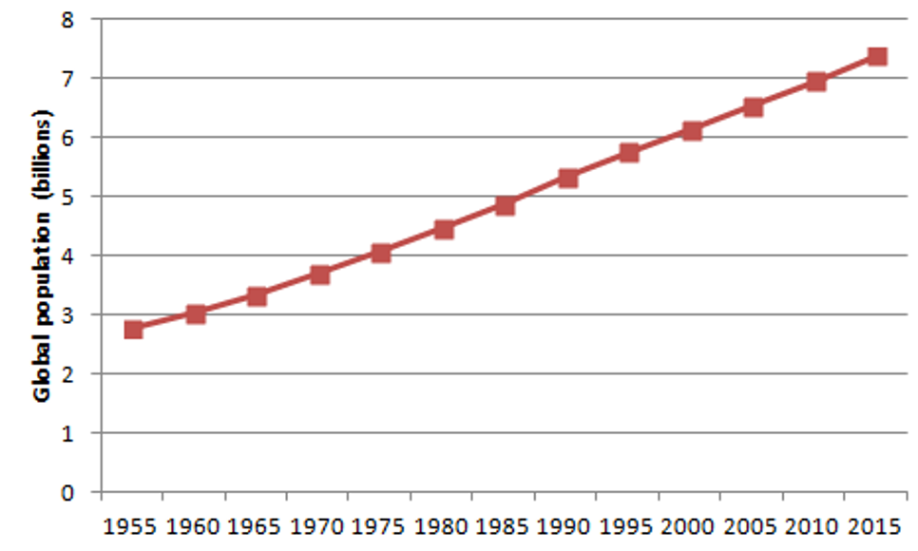
Notes:
Pupils need to understand what sustainability means. before giving them the definitions ask pupils to suggest what they think sustainability means.

Slide 10
What was the global population in 2015?
How much has the global population increased by from 1955 to 2015?
Why can having more people in the world lead to deforestation? | Why can having more people in the world lead to deforestation?
Notes:
Pupils need to understand what sustainability means. before giving them the definitions ask pupils to suggest what they think sustainability means.

Slide 11
Why can having more people in the world lead to higher CO2 emissions?
How do scientists believe that CO2 emissions contribute to climate change?
Notes:
Pupils need to understand what sustainability means. before giving them the definitions ask pupils to suggest what they think sustainability means.

Slide 12
Answers
Notes:
Pupils need to understand what sustainability means. before giving them the definitions ask pupils to suggest what they think sustainability means.

Slide 13
What was the global population in 2015? | Approximately 7.4 billion
How much has the global population increased by from 1955 to 2015? | Approximately 4.6 billion
Why can having more people in the world lead to deforestation? The land is needed for people to live on and to produce the things they need (eg to farm food) The wood is needed as fuel or as a material to build products | Why can having more people in the world lead to deforestation? The land is needed for people to live on and to produce the things they need (eg to farm food) The wood is needed as fuel or as a material to build products
Notes:
Pupils need to understand what sustainability means. before giving them the definitions ask pupils to suggest what they think sustainability means.

Slide 14
Why can having more people in the world lead to higher CO2 emissions? People use fuel that creates carbon dioxide People also take in oxygen and breathe out carbon dioxide Making food for people to eat almost always involves processes that release carbon dioxide into the atmosphere
How do scientists believe that CO2 emissions contribute to climate change? Carbon dioxide is a greenhouse gas. This means that carbon dioxide creates a barrier in the atmosphere that traps the sun’s rays close to the Earth. This heats the Earth’s overall temperature, contributing to global warming.
Notes:
Pupils need to understand what sustainability means. before giving them the definitions ask pupils to suggest what they think sustainability means.

Slide 15
What role does the UN allow young people to play in making a change?
What is the role of the UN in supporting climate change?
Goal 13 focuses on climate action. There are a number of other goals that relate.
Sustainable Development Goal 13 aims to “take urgent action to combat climate change and its impact” while acknowledging that the United Nations Framework Convention on Climate Change is the primary international, intergovernmental forum for negotiating the global response to climate change.
Target13.3
Improve education, awareness-raising and human and institutional capacity on climate change mitigation, adaptation, impact reduction and early warning.
13.3.1
The extent to which (i) global citizenship education and (ii) education for sustainable development are mainstreamed in (a) national education policies; (b) curricula; (c) teacher education, and (d) student assessment
Pupils to investigate the agreement by all UN countries and develop their own goals for the school to enforce change supporting climate change.
Notes:
Pupils need to understand what sustainability means. before giving them the definitions ask pupils to suggest what they think sustainability means.

Slide 16
Environmental laws and regulations. Students can research UK laws and regulations – such as
  the Environmental Protection Act (1990)
  the Energy Acts (2008, 2010 and 2011)
  the Wildlife and Countryside Act (1981)
Pupils can investigate the environmental issues behind their development, the effects they have had and the ways that they are implemented by the Government.
Students can find out about environmental EU Directives:
  the Habitats and Birds Directives,
  the Invasive Species Directive)
  the International agreements Kyoto Protocol,
  the Paris Climate change agreement, the CITES treaty about trade in endangered species,
  the UN Sustainable Development Goals).
Notes:
Pupils need to understand what sustainability means. before giving them the definitions ask pupils to suggest what they think sustainability means.

Slide 17
Look at NGOs (non-governmental organisations, such as charities) who lobby and advise governments and companies.
Explore the different ways in which this is done (e.g. petitions, peaceful protests, direct action) and the pros and cons of these approaches.
What would you like your school to do?
Notes:
Pupils need to understand what sustainability means. before giving them the definitions ask pupils to suggest what they think sustainability means.

Slide 18
Notes:
Pupils need to understand what sustainability means. before giving them the definitions ask pupils to suggest what they think sustainability means.

