Slide 1
Lesson 4 - What Do Young People Think about the Climate Crisis?
What are they doing about it? Let's meet some Young People.

Slide 2
Lesson Objective
To be able to understand the impact young people can have on issues that are important to them.
 |  |  | National Curriculum: Climate change, Food technology.

Slide 3
Skills Objective
Communication - I can present information and recognise that other people will have different opinions and views. Problem-solving - I can identify implicit and inferred meaning in texts.
 |  |  | National Curriculum: Climate change, Food technology.

Slide 4
Your instructions:​
The objective of this activity is to remember as many items on the two slides as you can in your team. ​
You get three attempts to view the slides. ​
You cannot write down your list until you have finished viewing the slides.​
Notes:
Put the pupils in groups.
A3 Sheets of paper - Pens.
The objective of this activity is for the teams to remember as many items on the two slides as they can.
They can look at them in any order, however, they must only look at each slide twice and for a minute at a time (adjust this accordingly for your class).
The teams must not write anything down when the slides are being shown.
Discussion points:
After one view, encourage your teams to think strategically & discuss these points:
How can we work as a team to remember all the items?
Are there any methods we can use to remember all the items?
When the activity is complete, ask them:
What type of communication was used in attempting to solve the problem?
Did we communicate well as a team? Why? Why not?

Slide 6
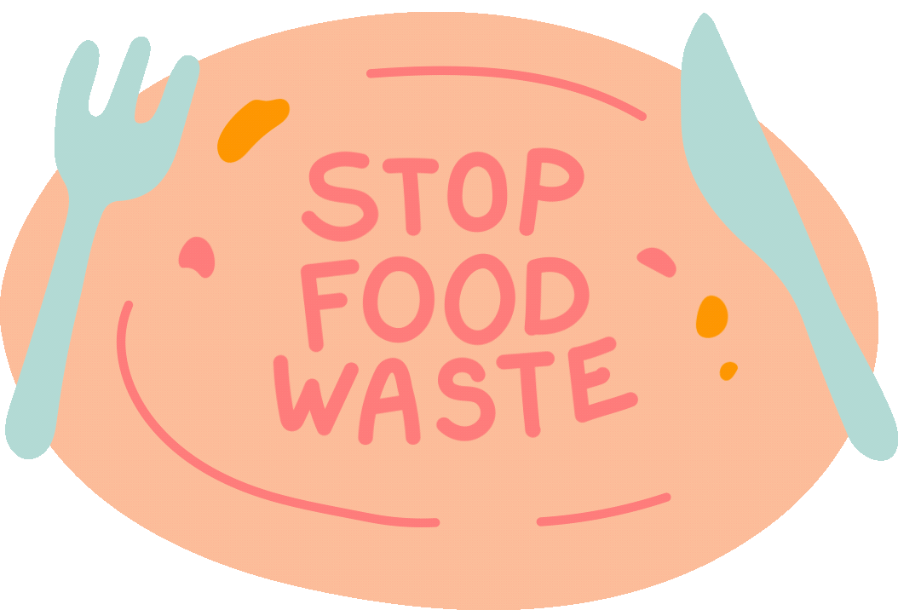

Slide 7
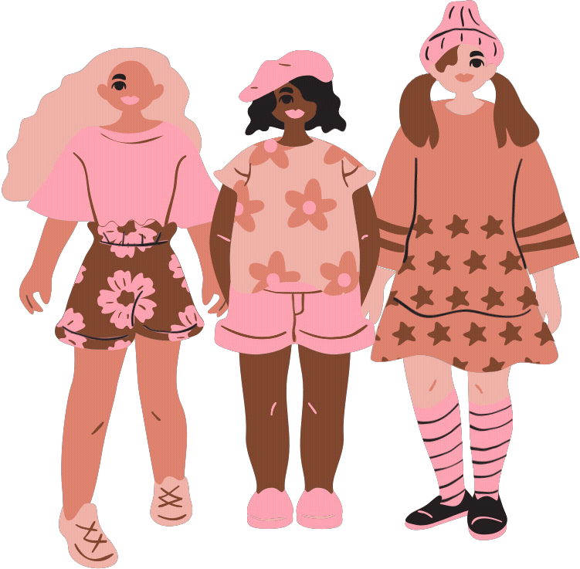
Did you know?
The clothing you wear has a significant impact on the environment?

Slide 8
Licypriya Kangujam @licypriyakangujam One of the world’s youngest climate activists, Licypriya Kangujam started advocating for local and global climate action at the age of six, when she protested outside the Indian parliament with a specific set of demands, including air pollution laws and making climate-change literacy mandatory in schools. | Xiye Bastida @xiyebeara Born to two environmentalists who met at a climate change conference in 1992, this 19-year-old is continuing her family’s legacy and is now one of the most visible young activists in Mexico.
Lesein Mutunkei @trees4goals This Kenyan teenager was driven to take action after learning the shocking impacts of pollution and deforestation while he was at school. | Luisa Neubauer @Luisamneubauer One of the main organisers of Germany’s Fridays For Future climate strike programme, and often referred to as the ‘German Greta Thunberg’, Luisa Neubauer is advocating for climate policies that surpass the goals set out in the Paris Agreement.
Ella and Amy Meek @kidsagainstplastic As the name of their non-profit suggests, Ella and Amy Meek are two kids (and sisters) fighting against plastic pollution and waste in the UK. | Qiyun Woo @theweirdandwild This Singaporean environmental activist and artist is using uniquely stylised illustrations to raise awareness of complex climate issues and sustainability-related causes
Tahsin Uddin, 22, Tahsin Uddin, 22, is a climate activist in Bangladesh – a country where many people are vulnerable to the impacts of climate change. https://www.unicef.org/stories/young-climate-activists-demand-action-inspire-hope. | Kevin J. Patel @imkevinjpatel Kevin J Patel started his climate journey nearly a decade ago, with a clear goal of reducing air pollution and the impacts of climate change in LA
Xiuhtezcatl Martinez @xiuhtezcatl Also known by the initial ‘X’, Xiuhtezcatl Martinez is a young environmental activist and advocate for indigenous and marginalised communities that have already made massive waves in the fight against climate change. | Licypriya Kangujam @licypriyakangujam One of the world’s youngest climate activists, Licypriya Kangujam, started advocating for local and global climate action at six when she protested outside the Indian parliament with a specific set of demands, including air pollution laws making climate-change literacy mandatory in schools.

Slide 9
10 Inspiring Young Climate Activists Leading the Way in Global Climate Action.
Let's discuss..............................
Notes:
Share one example with the pupils and encourage them to

Slide 10
Possible projects:
Recycling and upcycling: Provide opportunities for students to ‘repurpose’ waste materials, for example using plastic bottles to build a greenhouse, and making recycled paper using natural dyes. They can also make recycling boxes and signs for classrooms and communal areas.
Careers in the built and natural environment: Students could research jobs such as landscape architecture and sustainable building design.
Ethical and sustainable fashion: Students can design and make jewellery and clothing from waste materials. They can also research where their clothes come from and devise ethical and environmental criteria to investigate and compare clothing companies (e.g. what are working conditions and pay like for the people who make the clothes?). They could even try growing their own fabric.

