Slide 1
Lesson 3
Notes:
Put the pupils in groups.
A3 Sheets of paper - Pens.
The objective of this activity is for the teams to remember as many items on the two slides as they can.
They can look at them in any order, however, they must only look at each slide twice and for a minute at a time (adjust this accordingly for your class).
The teams must not write anything down when the slides are being shown.
Discussion points:
After one view, encourage your teams to think strategically & discuss these points:
How can we work as a team to remember all the items?
Are there any methods we can use to remember all the items?
When the activity is complete, ask them:
What type of communication was used in attempting to solve the problem?
Did we communicate well as a team? Why? Why not?

Slide 2

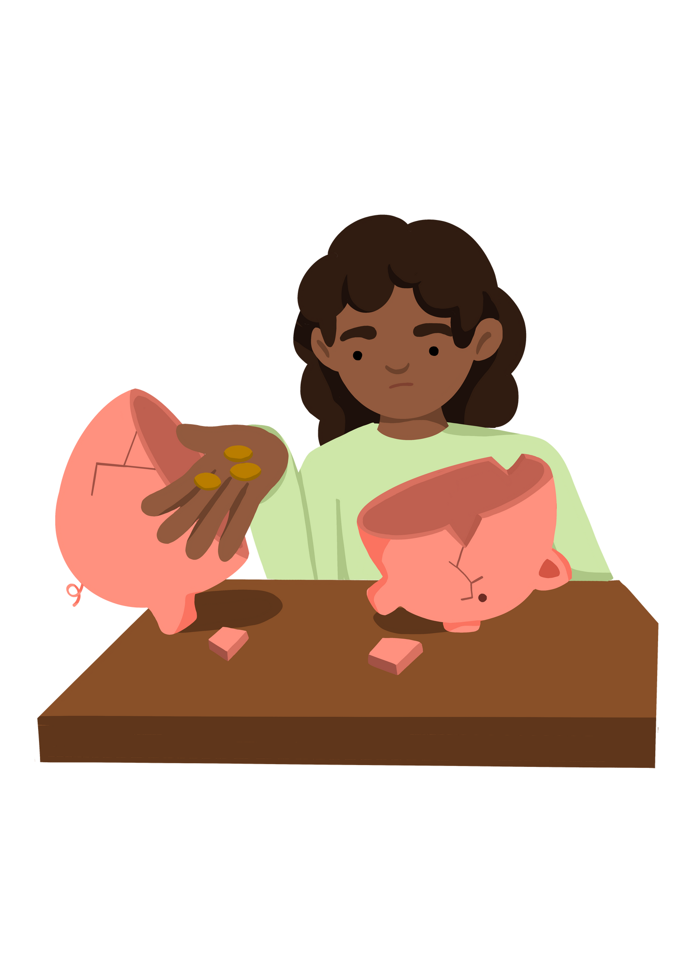
Ending poverty in all its forms everywhere by 2030.
Notes:
Put the pupils in groups.
A3 Sheets of paper - Pens.
The objective of this activity is for the teams to remember as many items on the two slides as they can.
They can look at them in any order, however, they must only look at each slide twice and for a minute at a time (adjust this accordingly for your class).
The teams must not write anything down when the slides are being shown.
Discussion points:
After one view, encourage your teams to think strategically & discuss these points:
How can we work as a team to remember all the items?
Are there any methods we can use to remember all the items?
When the activity is complete, ask them:
What type of communication was used in attempting to solve the problem?
Did we communicate well as a team? Why? Why not?

Slide 3




Lesson Objective | Skills Objective
To understand the process of debating. | I can prepare and participate in a debate. I can think creatively about solutions, identify multiple options, assess and learn from potential options, create better solutions and decide on a final answer. I can present their ideas with great impact and clarity.
 | National Curriculum: English
Notes:
Put the pupils in groups.
A3 Sheets of paper - Pens.
The objective of this activity is for the teams to remember as many items on the two slides as they can.
They can look at them in any order, however, they must only look at each slide twice and for a minute at a time (adjust this accordingly for your class).
The teams must not write anything down when the slides are being shown.
Discussion points:
After one view, encourage your teams to think strategically & discuss these points:
How can we work as a team to remember all the items?
Are there any methods we can use to remember all the items?
When the activity is complete, ask them:
What type of communication was used in attempting to solve the problem?
Did we communicate well as a team? Why? Why not?

Slide 4
Let's Play Simon Says –
Notes:
Put the pupils in groups.
A3 Sheets of paper - Pens.
The objective of this activity is for the teams to remember as many items on the two slides as they can.
They can look at them in any order, however, they must only look at each slide twice and for a minute at a time (adjust this accordingly for your class).
The teams must not write anything down when the slides are being shown.
Discussion points:
After one view, encourage your teams to think strategically & discuss these points:
How can we work as a team to remember all the items?
Are there any methods we can use to remember all the items?
When the activity is complete, ask them:
What type of communication was used in attempting to solve the problem?
Did we communicate well as a team? Why? Why not?

Slide 5
Debate: Richer countries should give more money to poorer countries to end poverty.
Debate: Should the government be helping people living in poverty by giving them money and making people with more money pay more taxes.
Debate: Why does poverty still exist?
Notes:
Put the pupils in groups.
A3 Sheets of paper - Pens.
The objective of this activity is for the teams to remember as many items on the two slides as they can.
They can look at them in any order, however, they must only look at each slide twice and for a minute at a time (adjust this accordingly for your class).
The teams must not write anything down when the slides are being shown.
Discussion points:
After one view, encourage your teams to think strategically & discuss these points:
How can we work as a team to remember all the items?
Are there any methods we can use to remember all the items?
When the activity is complete, ask them:
What type of communication was used in attempting to solve the problem?
Did we communicate well as a team? Why? Why not?

Slide 6

Let's debate: What are the possible solutions for ending poverty?
Notes:
Put the pupils in groups.
A3 Sheets of paper - Pens.
The objective of this activity is for the teams to remember as many items on the two slides as they can.
They can look at them in any order, however, they must only look at each slide twice and for a minute at a time (adjust this accordingly for your class).
The teams must not write anything down when the slides are being shown.
Discussion points:
After one view, encourage your teams to think strategically & discuss these points:
How can we work as a team to remember all the items?
Are there any methods we can use to remember all the items?
When the activity is complete, ask them:
What type of communication was used in attempting to solve the problem?
Did we communicate well as a team? Why? Why not?

Slide 7
Lesson 4
Notes:
Put the pupils in groups.
A3 Sheets of paper - Pens.
The objective of this activity is for the teams to remember as many items on the two slides as they can.
They can look at them in any order, however, they must only look at each slide twice and for a minute at a time (adjust this accordingly for your class).
The teams must not write anything down when the slides are being shown.
Discussion points:
After one view, encourage your teams to think strategically & discuss these points:
How can we work as a team to remember all the items?
Are there any methods we can use to remember all the items?
When the activity is complete, ask them:
What type of communication was used in attempting to solve the problem?
Did we communicate well as a team? Why? Why not?

Slide 8
Ending poverty in all its forms everywhere by 2030.

Slide 9
Lesson Objective | Skills Objective
I can participate in a debate | I can prepare and participate in a debate. I can present their ideas with great impact and clarity.
 | National Curriculum: English
Notes:
Put the pupils in groups.
A3 Sheets of paper - Pens.
The objective of this activity is for the teams to remember as many items on the two slides as they can.
They can look at them in any order, however, they must only look at each slide twice and for a minute at a time (adjust this accordingly for your class).
The teams must not write anything down when the slides are being shown.
Discussion points:
After one view, encourage your teams to think strategically & discuss these points:
How can we work as a team to remember all the items?
Are there any methods we can use to remember all the items?
When the activity is complete, ask them:
What type of communication was used in attempting to solve the problem?
Did we communicate well as a team? Why? Why not?

Slide 10
Participate in a Debate
Notes:
Put the pupils in groups.
A3 Sheets of paper - Pens.
The objective of this activity is for the teams to remember as many items on the two slides as they can.
They can look at them in any order, however, they must only look at each slide twice and for a minute at a time (adjust this accordingly for your class).
The teams must not write anything down when the slides are being shown.
Discussion points:
After one view, encourage your teams to think strategically & discuss these points:
How can we work as a team to remember all the items?
Are there any methods we can use to remember all the items?
When the activity is complete, ask them:
What type of communication was used in attempting to solve the problem?
Did we communicate well as a team? Why? Why not?

