Slide 1
Learning New Skills

Slide 2




Lesson Objectives
To demonstrate an understanding of what can affect well-being and resilience (e.g. life changes, relationships, achievements and employment)
 | Curriculum Link: PSHE, Citizenship

Slide 3
Skills Objectives
I can apply the PEEL method using different mediums when communicating. I can recognise the barriers to my learning and develop strategies to overcome these.
 | Curriculum Link: PSHE, Citizenship

Slide 4

Notes:
A short video to explain mental illness and stop the stigma surrounding mental illnesses early.

Slide 5
As you journey from childhood into your teen years and then into adulthood, your brain is changing in ways that might explain why the teen years can be a bit of a roller coaster. In this animation we take a look at what’s happening in teenagers’ heads and how researchers at the University of Oxford are trying to understand this important developmental period better.

Slide 6
Pupils to reflect on their current achievements. Don’t just focus on academic, sports and musical achievements but include personal achievements, too. This could include things like getting to school independently, staying away from home, managing friendship or relationship difficulties, and managing their wellbeing.
Discuss how all these things take time to develop and how they will have grown over time.
Introduce the idea of writing a letter to their younger selves.
What advice and reassurance can you give to their younger self? Can they write it in a letter starting ‘Dear [name] aged X’ and signed off from your current self.

Slide 7

What will you change?

Slide 8
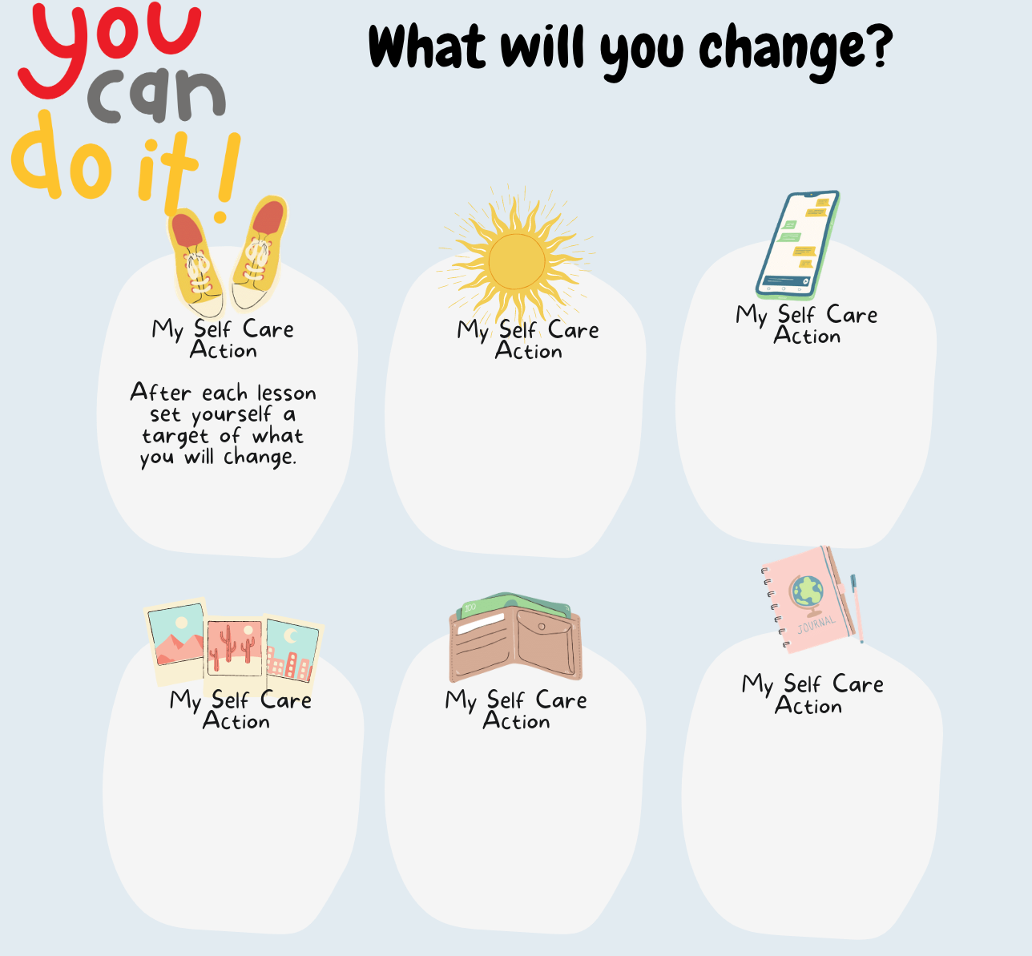

Slide 9
Know whom in school they should speak to if they are worried about their own or someone else’s mental wellbeing or ability to control their emotions (including issues arising online).
Please add details of whom to contact in school if they are concerned about themselves or others.

Slide 10

Childline.org.uk - 0800 1111 (free 24hr) confidential listening
Samaritans.org - 116 123 (free 24 hr) confidential listening
Studentsagainstdepression.org - Resources to move away from depression
Youngminds.org.uk - Mental health info and guidance
Youthaccess.org.uk - Young people’s info, advice and counselling
Themix.org.uk - Essential support for under 25s
If you have a mental health crisis and don't know whom to contact, call NHS 111. Call 111, free from any phone, 24 hours a day, seven days a week, and speak to a highly trained adviser supported by healthcare professionals.

