Slide 1
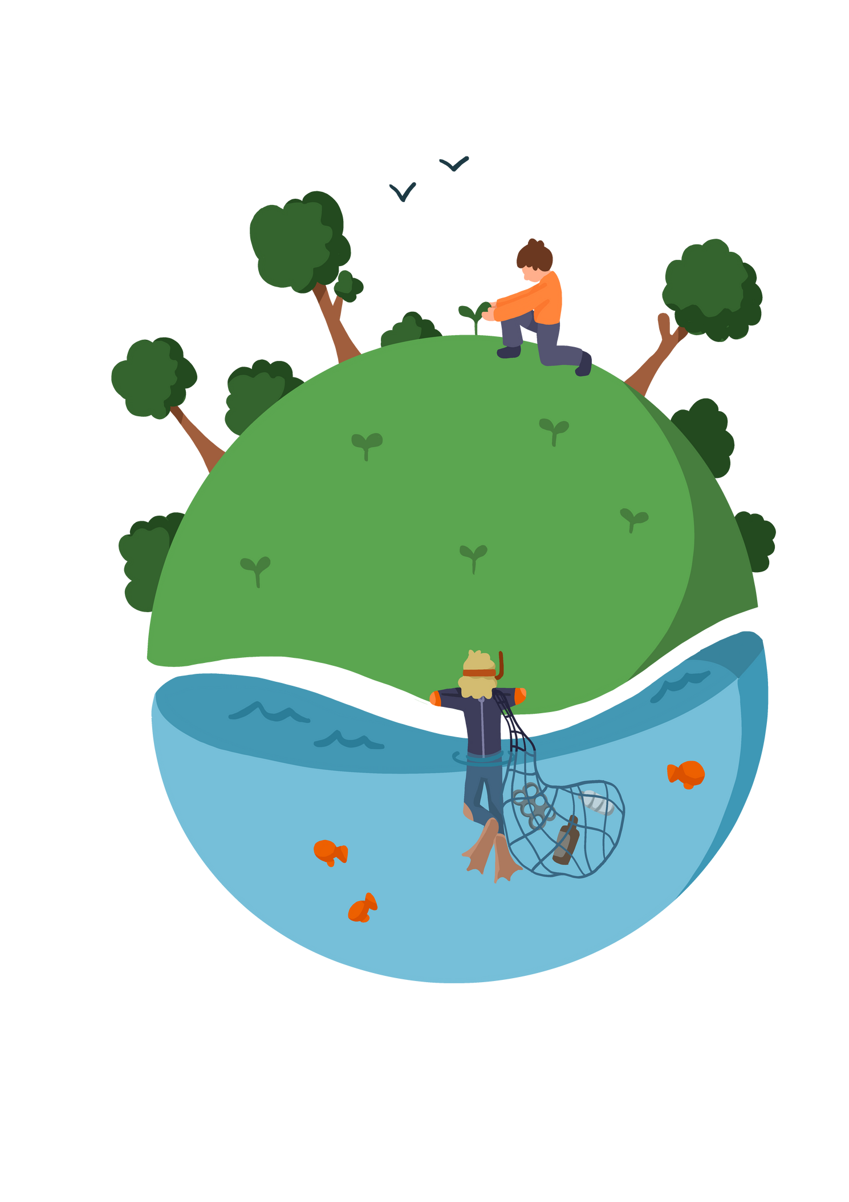
Lesson 3 - What is Bio-diversity?
Notes:
Pupils need to understand what sustainability means. before giving them the definitions ask pupils to suggest what they think sustainability means.

Slide 2
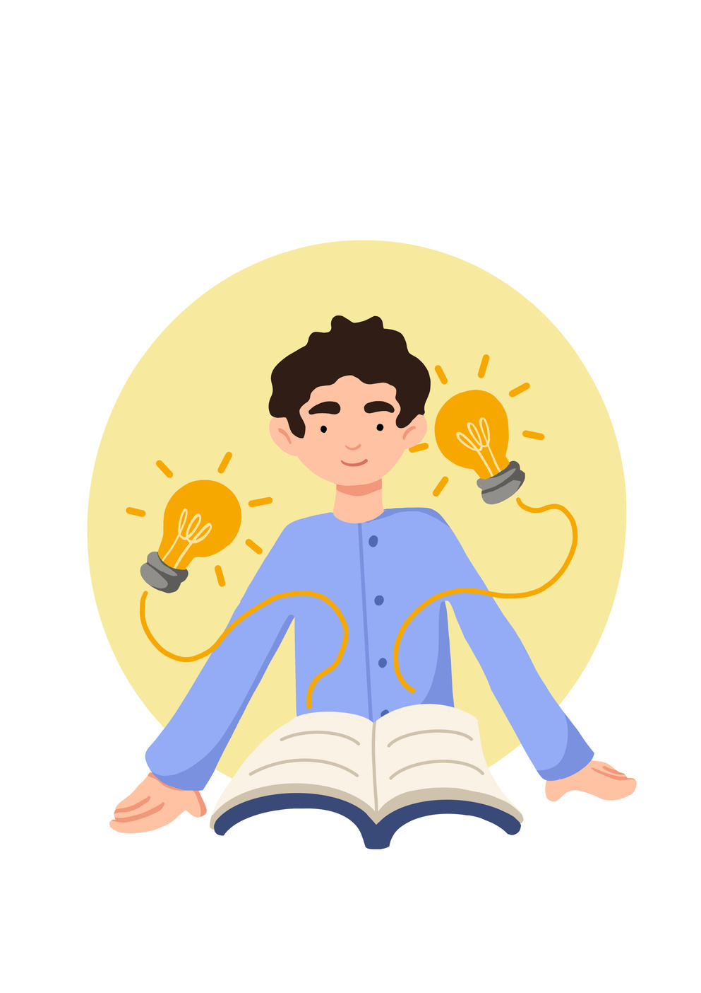


Lesson Objectives
To be able to learn about Bio-diversity and its importance.
 |  |  | National Curriculum: Climate change, Food technology, STEM
Notes:
Pupils need to understand what sustainability means. before giving them the definitions ask pupils to suggest what they think sustainability means.

Slide 3
Skills Objectives
Problem-solving - I can identify relevant information from extended explanations or presentations when solving problems. Communication - I can apply the PEEL method using different mediums.
 |  |  | National Curriculum: Climate change, Food technology, STEM
Notes:
Pupils need to understand what sustainability means. before giving them the definitions ask pupils to suggest what they think sustainability means.

Slide 4
Biodiversity is all the different kinds of life you'll find in one area—the variety of animals, plants, fungi, and even microorganisms like bacteria that make up our natural world. These species and organisms work together in ecosystems, like an intricate web, to maintain balance and support life.
Notes:
Pupils need to understand what sustainability means. before giving them the definitions ask pupils to suggest what they think sustainability means.

Slide 5
Biodiversity is life. Scientists use the word to describe the links and
the variety between all living things on the planet – including humans.
You may think of biodiversity as the environment, or as nature, wildlife, plants and animals, but the important thing to remember is it’s all interconnected. That includes every person too – we all rely on biodiversity for our survival, because of the vast number of goods and services our planet provides for us.
Notes:
Pupils need to understand what sustainability means. before giving them the definitions ask pupils to suggest what they think sustainability means.

Slide 6

Notes:
Pupils need to understand what sustainability means. before giving them the definitions ask pupils to suggest what they think sustainability means.

Slide 7
What will your one thing for the planet be?
Plan your project or create a guide for parents and the local community.
Notes:
Pupils need to understand what sustainability means. before giving them the definitions ask pupils to suggest what they think sustainability means.

Slide 8
Grow a part of your school lawn. You will need the following:
  to avoid mowing completely or letting patches at the edges and around trees grow long
  to avoid using fertilisers, pesticides and weed killers on your lawn
  to consider adding wildflowers, such as oxeye daisy or yarrow, and different native grass species to attract more wildlife
Longer grass will also provide shelter and egg-laying opportunities for insects. The invertebrates that call your garden home are an important part of birds' diets – you may spot blackbirds hopping across your lawn in search of earthworms, for example. An abundance of insects and longer grass may also attract other animals, such as hedgehogs, lizards and frogs.
Grow wildflower pots for pollinators. MAKE a Weekend project
  Growing wildflowers is an excellent way to provide food for pollinating insects. These animals play a vital role in allowing plants to reproduce. Without pollination, many of our crops and wild plants wouldn't survive. The good news is that you don't need lots of space to help pollinators. Wildflowers that benefit these insects will grow in a pot. By planting British wildflower species, you will ensure your pot is attractive to native wildlife – some non-native flowers look spectacular to us but may not be that helpful for insects.
Grow a green screen that helps block out air pollution
  Air pollution impacts everyone's health and the long-term effects can be severe. The main source of air pollution is the emissions from cars and other transport, as well as gas use and industry in some areas.
  By growing a green screen on your property, such as ivy, you can create a natural barrier that helps to filter out pollution and provides a home for wildlife.
Notes:
Pupils need to understand what sustainability means. before giving them the definitions ask pupils to suggest what they think sustainability means.

Slide 9
Notes:
Pupils need to understand what sustainability means. before giving them the definitions ask pupils to suggest what they think sustainability means.

Slide 10
Notes:
Pupils need to understand what sustainability means. before giving them the definitions ask pupils to suggest what they think sustainability means.

