Slide 1
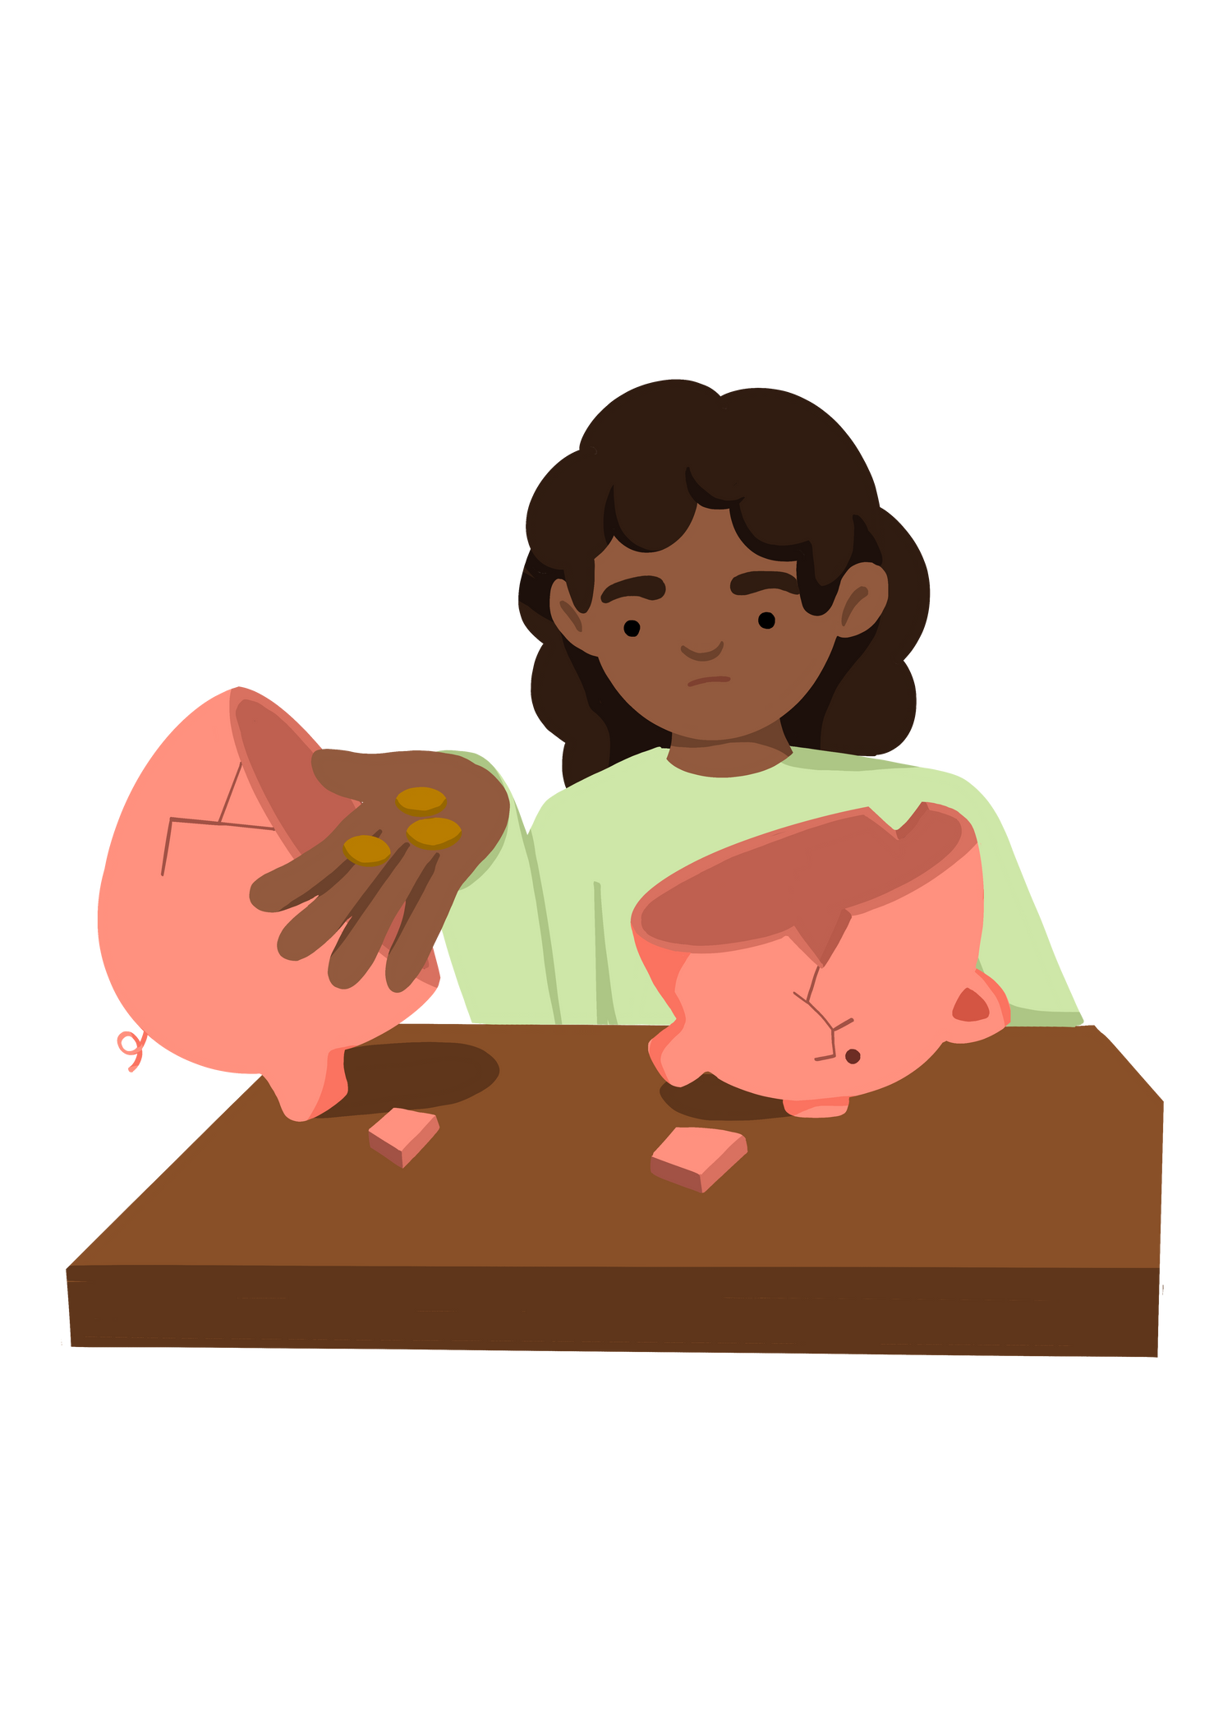
Key Stage 2
'How does poverty affect children in school?'
Lesson 3
Notes:
Put the pupils in groups.
A3 Sheets of paper - Pens.
The objective of this activity is for the teams to remember as many items on the two slides as they can.
They can look at them in any order, however, they must only look at each slide twice and for a minute at a time (adjust this accordingly for your class).
The teams must not write anything down when the slides are being shown.
Discussion points:
After one view, encourage your teams to think strategically & discuss these points:
How can we work as a team to remember all the items?
Are there any methods we can use to remember all the items?
When the activity is complete, ask them:
What type of communication was used in attempting to solve the problem?
Did we communicate well as a team? Why? Why not?

Slide 2




Activity 3 How does poverty affect children in school?
Learning Objective To discuss the effects and feelings associated with poverty | Skills Objectives
Problem-Solving - Young people can follow an argument, identify different points of view, and distinguish facts from opinions
Communication - Young people can plan what they need to share
Communication - I can apply the PEEL method using different mediums
Teamwork - Young people can work with others
 | National Curriculum PSHE
Notes:
Put the pupils in groups.
A3 Sheets of paper - Pens.
The objective of this activity is for the teams to remember as many items on the two slides as they can.
They can look at them in any order, however, they must only look at each slide twice and for a minute at a time (adjust this accordingly for your class).
The teams must not write anything down when the slides are being shown.
Discussion points:
After one view, encourage your teams to think strategically & discuss these points:
How can we work as a team to remember all the items?
Are there any methods we can use to remember all the items?
When the activity is complete, ask them:
What type of communication was used in attempting to solve the problem?
Did we communicate well as a team? Why? Why not?

Slide 3



THINK
What can you recall about the effects of poverty in relation to children's rights?
Notes:
Put the pupils in groups.
A3 Sheets of paper - Pens.
The objective of this activity is for the teams to remember as many items on the two slides as they can.
They can look at them in any order, however, they must only look at each slide twice and for a minute at a time (adjust this accordingly for your class).
The teams must not write anything down when the slides are being shown.
Discussion points:
After one view, encourage your teams to think strategically & discuss these points:
How can we work as a team to remember all the items?
Are there any methods we can use to remember all the items?
When the activity is complete, ask them:
What type of communication was used in attempting to solve the problem?
Did we communicate well as a team? Why? Why not?

Slide 4
With your groups work on the following questions and present your answers afterwards:
  How do you think poverty can affect a child's experience of school?
  How do you think poverty can affect a child's learning?
  How do you think we should treat everyone to make sure we don't discriminate others?
  What should we do if we see or think someone is being discriminated or bullied?
Notes:
Put the pupils in groups.
A3 Sheets of paper - Pens.
The objective of this activity is for the teams to remember as many items on the two slides as they can.
They can look at them in any order, however, they must only look at each slide twice and for a minute at a time (adjust this accordingly for your class).
The teams must not write anything down when the slides are being shown.
Discussion points:
After one view, encourage your teams to think strategically & discuss these points:
How can we work as a team to remember all the items?
Are there any methods we can use to remember all the items?
When the activity is complete, ask them:
What type of communication was used in attempting to solve the problem?
Did we communicate well as a team? Why? Why not?

Slide 5
The following websites can help you find out more about the effects of poverty
The Child Poverty Action Group: https://cpag.org.uk
Children’s Society UK: https://childrenssociety.org.uk
The Unicef: https://www.unicef.org
Notes:
Put the pupils in groups.
A3 Sheets of paper - Pens.
The objective of this activity is for the teams to remember as many items on the two slides as they can.
They can look at them in any order, however, they must only look at each slide twice and for a minute at a time (adjust this accordingly for your class).
The teams must not write anything down when the slides are being shown.
Discussion points:
After one view, encourage your teams to think strategically & discuss these points:
How can we work as a team to remember all the items?
Are there any methods we can use to remember all the items?
When the activity is complete, ask them:
What type of communication was used in attempting to solve the problem?
Did we communicate well as a team? Why? Why not?

