Slide 1
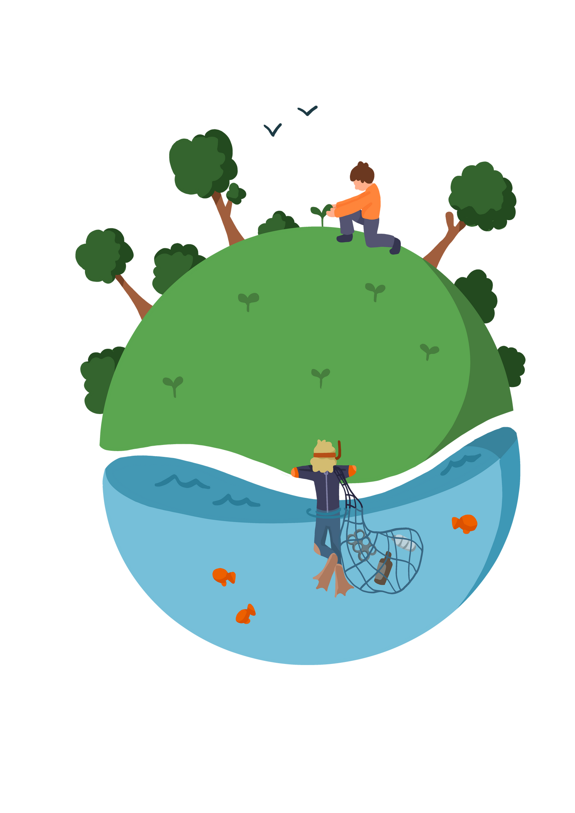
Lesson 3: What Effect is Climate Change Having on the Antarctic Food Web?

Slide 2



Learning Objective
To research the impact of climate change on the food web
Skills Objective
  Young people are able to accept responsibility as an individual and as a member of my team
  Young people can prepare for discussions, debates, and presentations.
#WeWill Stage | National Curriculum: Science Recognises that environments can change and that this can sometimes pose dangers to living things. Construct and interpret a variety of food chains, identifying producers, predators and prey.

Slide 3
A food web is a tool that illustrates the feeding relationship among species within a specific habitat. It is a connection of multiple food chains to show the interaction between different organisms in an ecosystem.
You end up with a food web when you draw multiple food chains together. These represent relationships in ecosystems more accurately and give you a much clearer visualization of how each animal affects others.

Slide 4
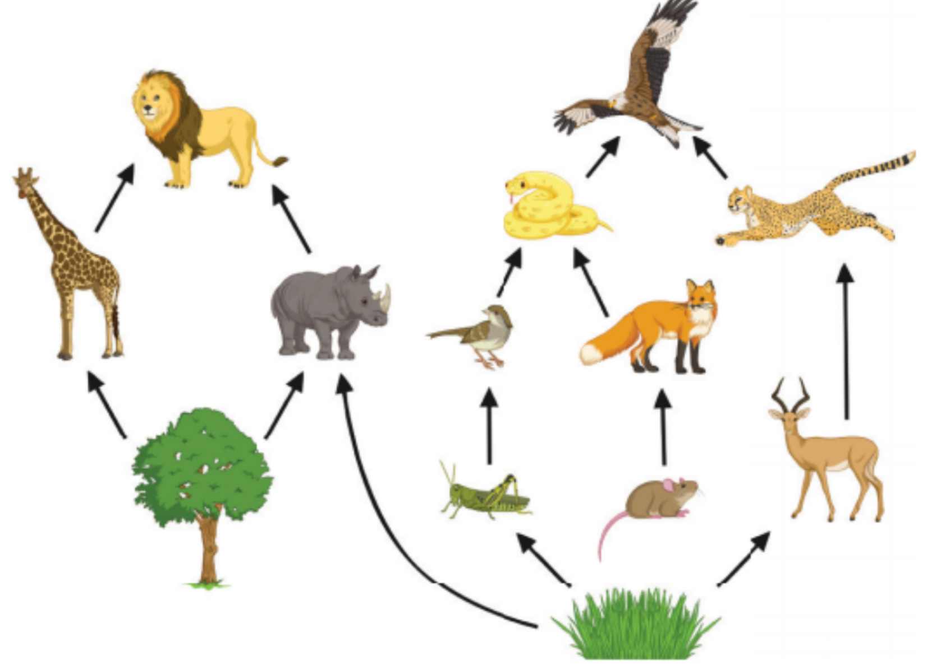
Notes:
Grass → Rat → Fox → Snake → Hawk
Grass → Antelope → Cheetah → Hawk
Tree → Rhino → Lion
Tree → Giraffe → Lion

Slide 5

Notes:
Explain that for a number of years, the Earth has been warming up because of the way humans are releasing harmful gases in the sky that block the sunlight radiation. A very simple way to illustrate this introduction is through the use of a diagram, please refer to the presentation slides to see an example.

Slide 6
Research in groups.
Create your own food webs.

