Slide 1
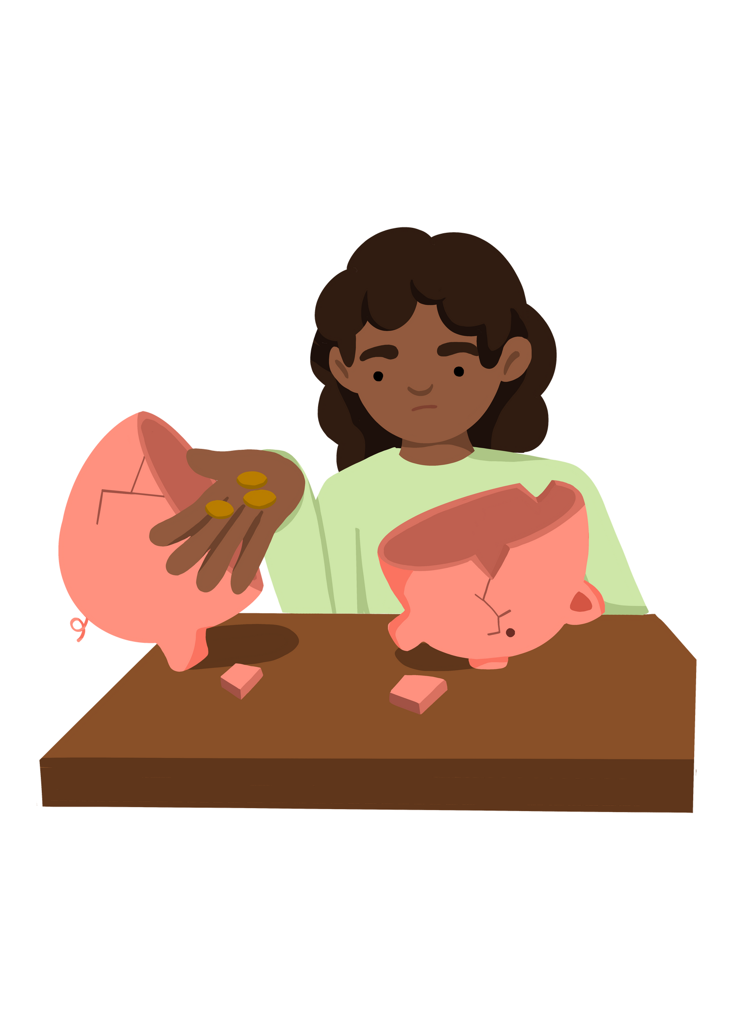


Key Stage 1
How can we make children in need feel welcome in our school?
Lesson 3

Slide 2




Learning Objective To think and name ways to help children in need. | Skills Objectives
Teamwork - Young people can work with others
Communication - Young people can plan what they need to share.
 |  | National Curriculum: PSHE Know friendship's characteristics, including mutual respect, generosity, trust, etc. (my community)

Slide 3
Activity 3
Enquiry question: How can we make children in need feel welcomed in our school?

Slide 4


Some children may be experiencing poverty at home. They are sometimes not aware that their family may be facing a struggle. These children come to school everyday and they might feel unwell and not sure why they are feeling this way.
In the UK they are about 3.9 million children experiencing the effects of poverty today. These children may not know how it feels to live without to worry about their family situations.

Slide 5
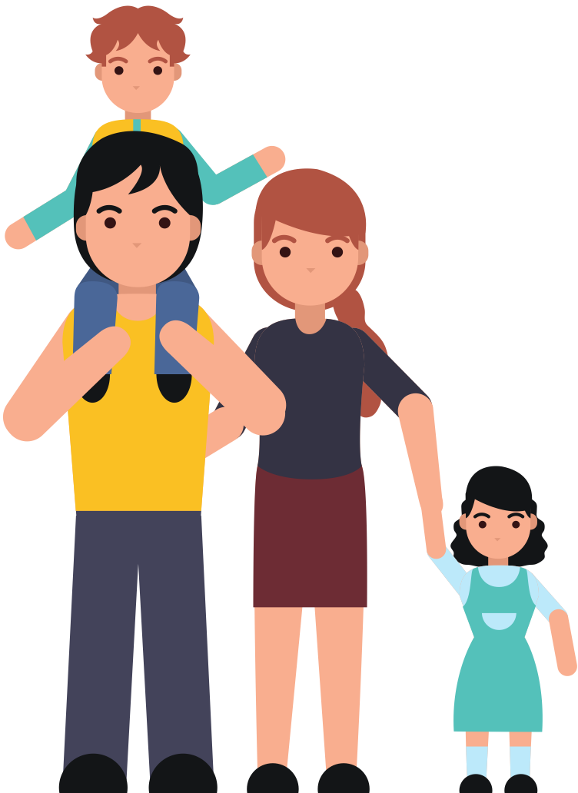

Families are all different and one family who may be experiencing poverty may have different difficulties than another family who is also experiencing poverty.
Children who come to school may be affected by this in different ways.

Slide 6


A pupil may come to school and not feel well because he is regularly changing homes.
Another pupil may feel hungry and/or not having simple things to come to school such as a water bottle and a bagpack.

Slide 7



With your partners, discuss what your school could do to help those children.

Slide 8


Social action
In a school in South Tyneside pupils campaigned to ensure that every pupil at their school received their own water bottle so children could keep hydrated throughout the day, helping them to focus on their learning.
Think about how has this action helped poor children?

Slide 9

How can you get involved to help children in your school today?

