Slide 1
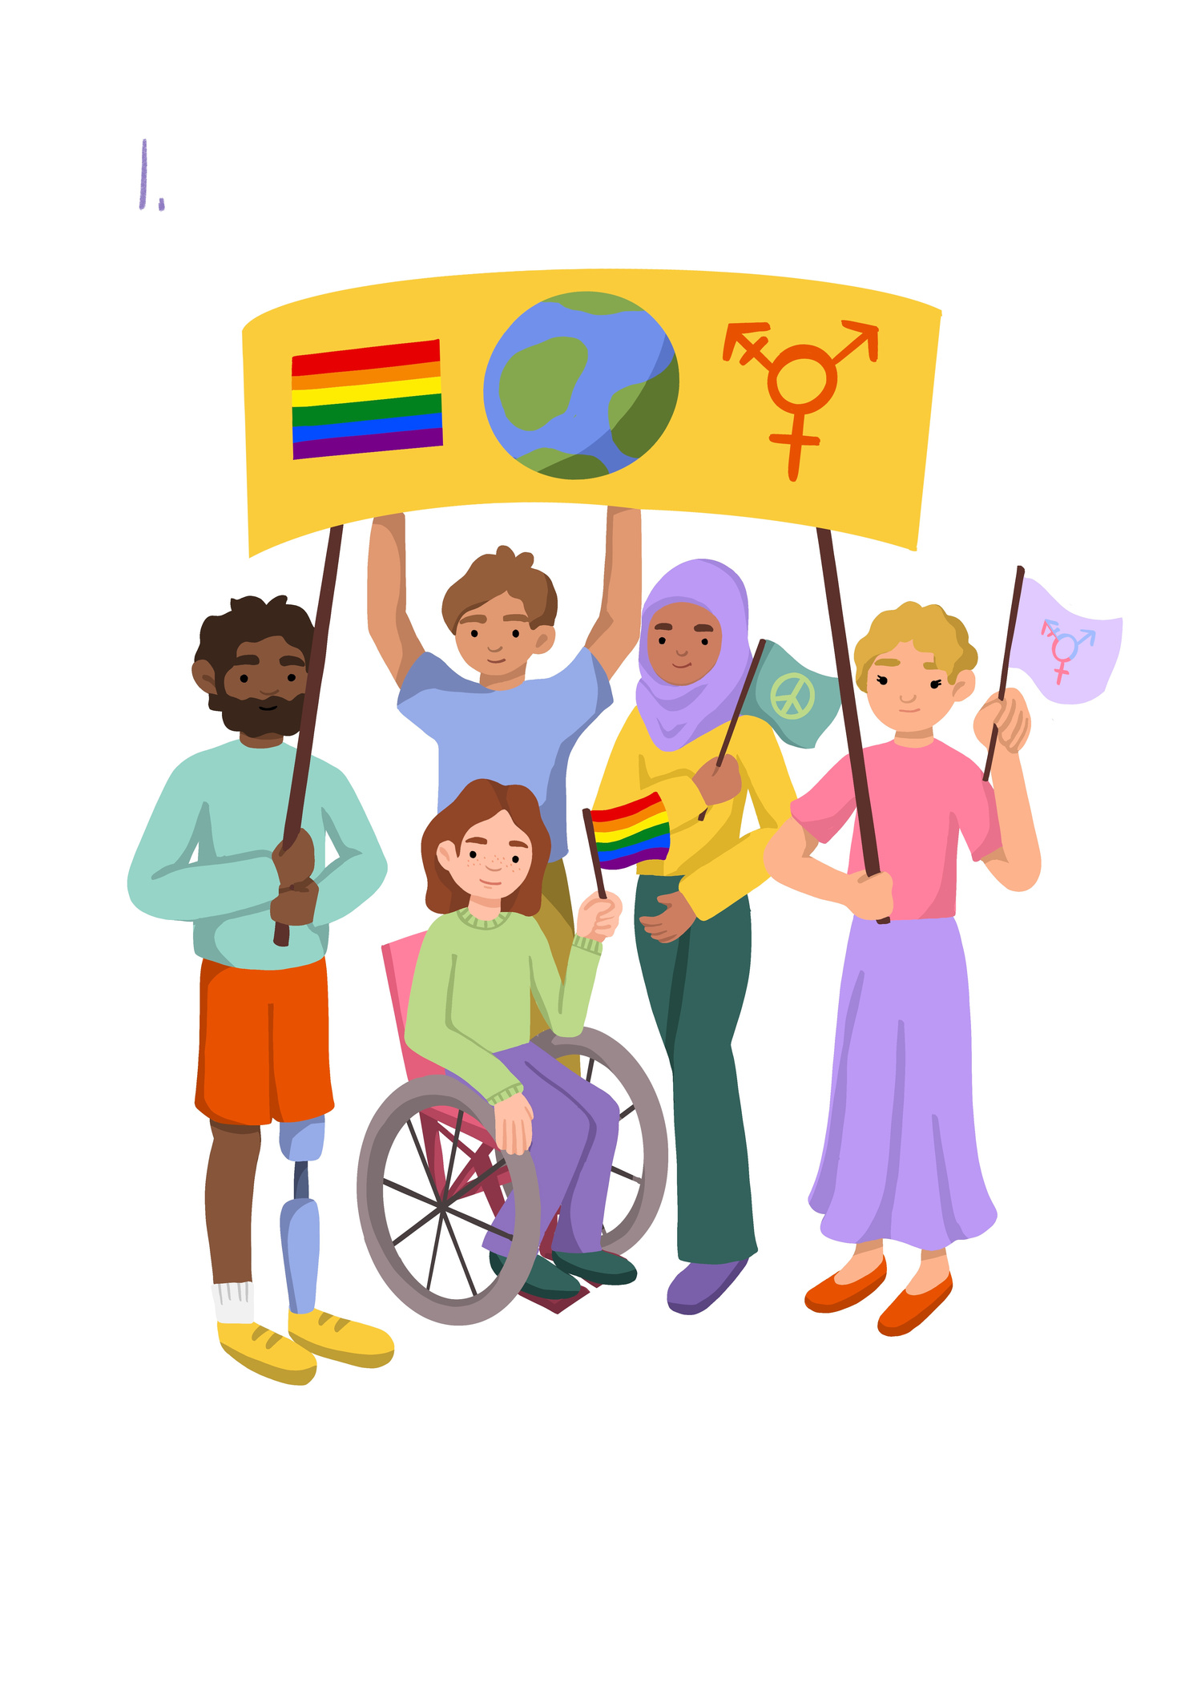
Inclusion and Diversity
Lesson 3

Slide 2

Learning objective To plan creative work celebrating diversity. | Skills Objectives
Communication - I can take part in discussions, debates and presentations.
Communication - I can present my ideas with great impact and clarity on the diversity of animals and habitats can also be the starting point for a play.
Outcome: Young people can explain what diversity is and identify how this is expressed through different contexts/mediums. This may include: Imitating an artistic style to create a self-portrait. Creating a display of wonky vegetables to celebrate diversity in the vegetable world. Making a presentation on the diversity of animals and habitats can also be the starting point for a play. | Outcome: Young people can explain what diversity is and identify how this is expressed through different contexts/mediums. This may include: Imitating an artistic style to create a self-portrait. Creating a display of wonky vegetables to celebrate diversity in the vegetable world. Making a presentation on the diversity of animals and habitats can also be the starting point for a play.

Slide 3
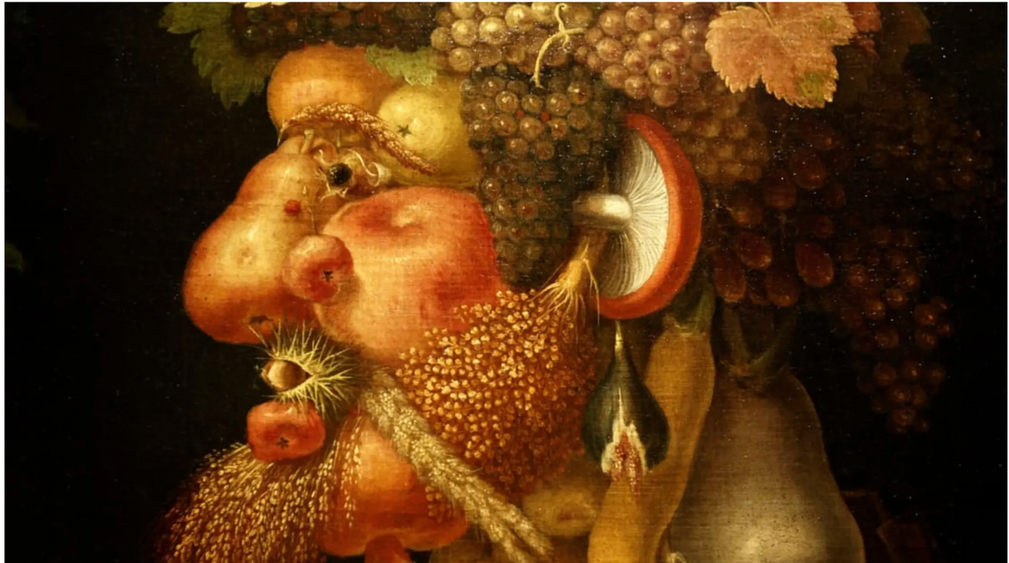
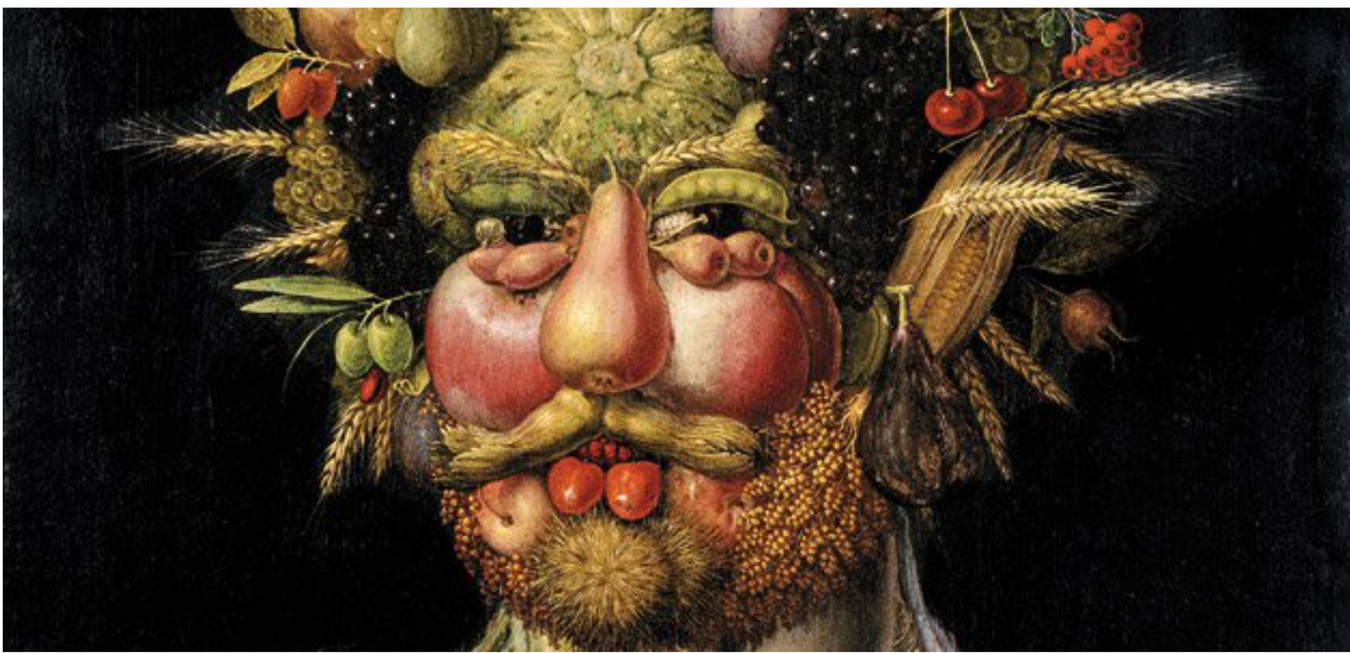
Giuseppe Arcimboldo

Slide 4
Using actual vegetables or images create your own self-Portrait using Giuseppe Arcimboldo approach.
Notes:
If you are using real vegetables - draw your self-portrait on a large piece of paper and place vegetables on your portrait and take a picture.
Approach no2: use images and stick these on.
Approach no3: Draw fruit and vegetables.

