Slide 1

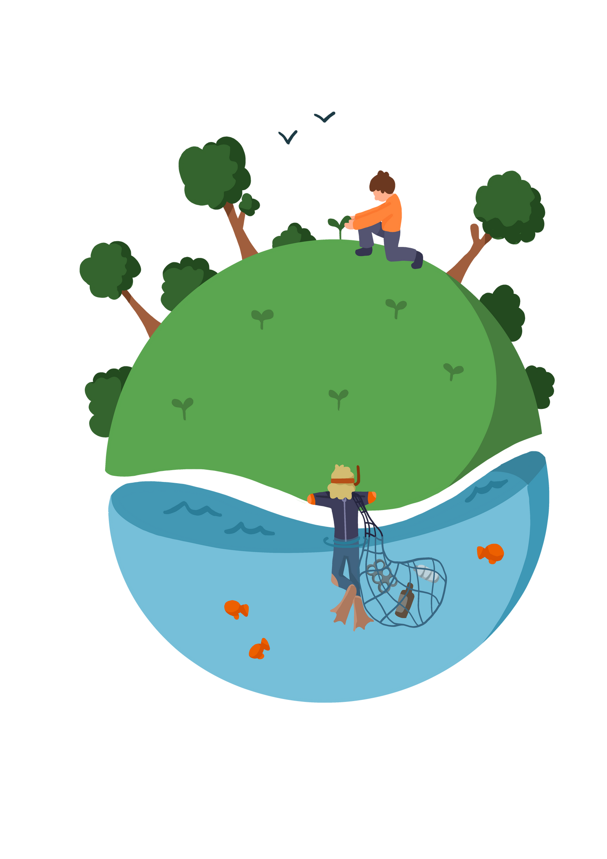



'HOW CAN I PLANT A GARDEN?'
Key Stage 1
Activity 3

Slide 2







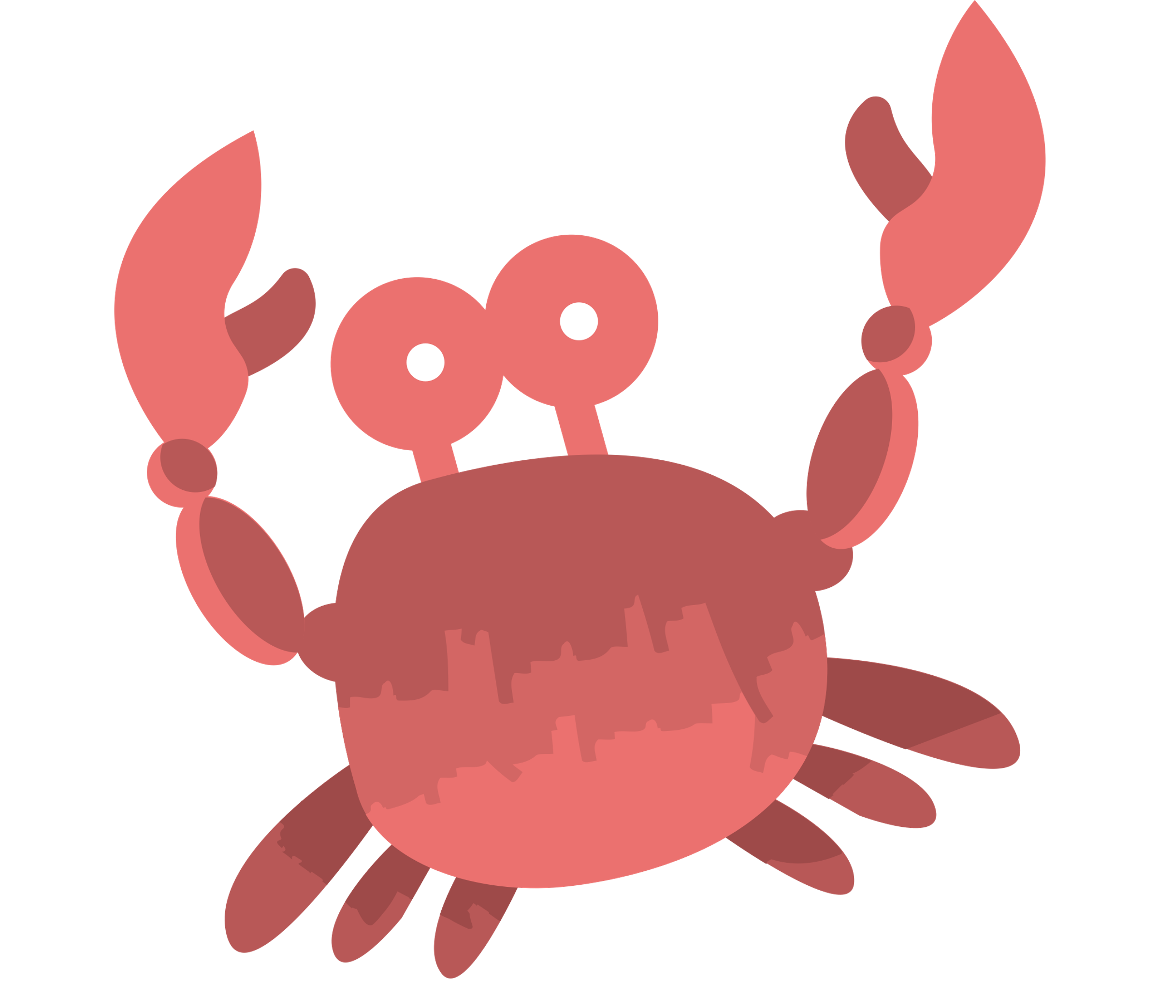




LEARNING OBJECTIVE:
To learn how to plant a garden.
Outcomes
By the end of the session, children will be able to explain how to plant seeds, and why it is important to look after nature in their school. They will also be able to explain why wildflowers are important for bees and other pollinators.
 | National Curriculum: Science - Young people should use the local environment throughout the year to explore and answer questions about plants growing in their habitat. Where possible, they should observe the growth of flowers and vegetables that they have planted.

Slide 3
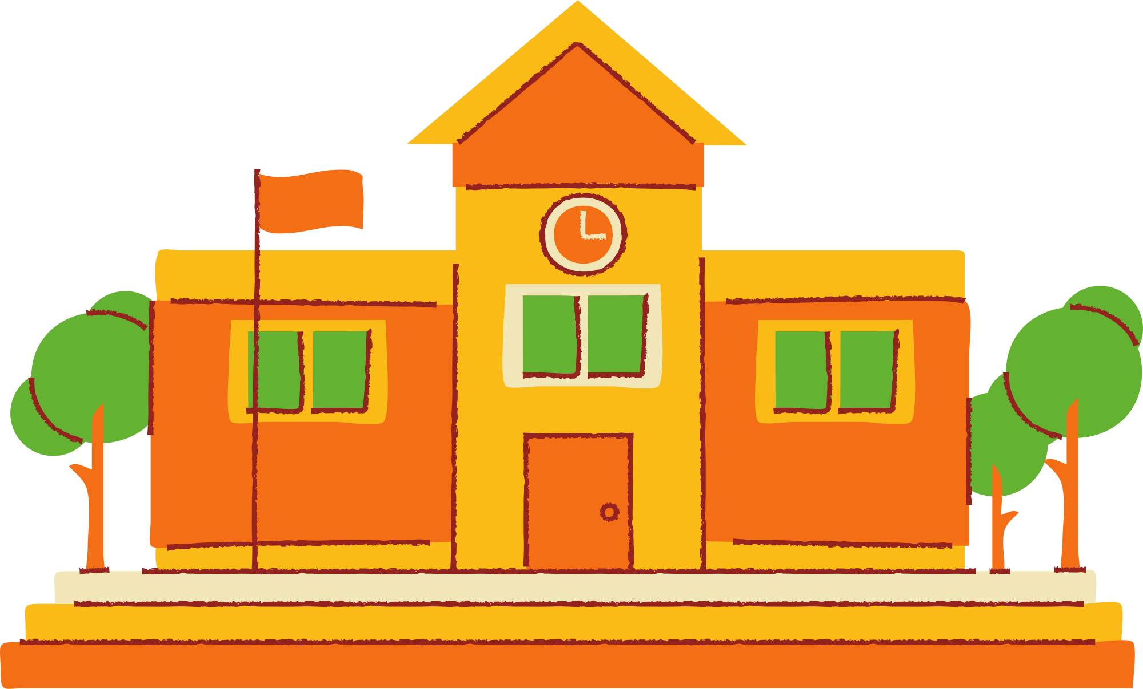
WHAT NATURE CAN I FIND IN MY SCHOOL?
Have you got...
- a green area?
- trees?
- a growing area with pots?
- flowers?
Think about the things you could be growing in your school?

Slide 4
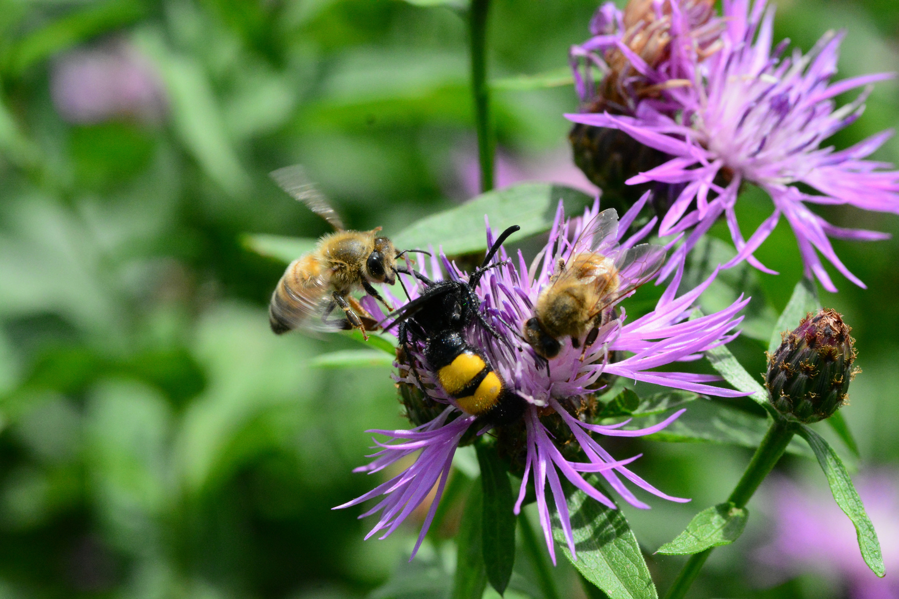
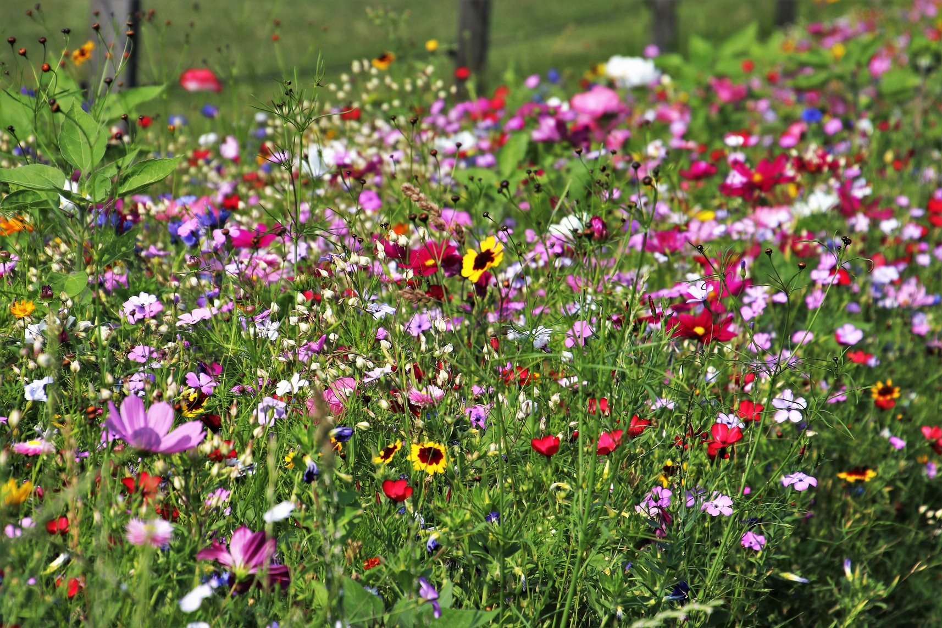

DID YOU KNOW?
WILDFLOWERS are great for pollinators such as bees, butterflies or even wasps! They help those communities of insects to survive and thrive.

Slide 5
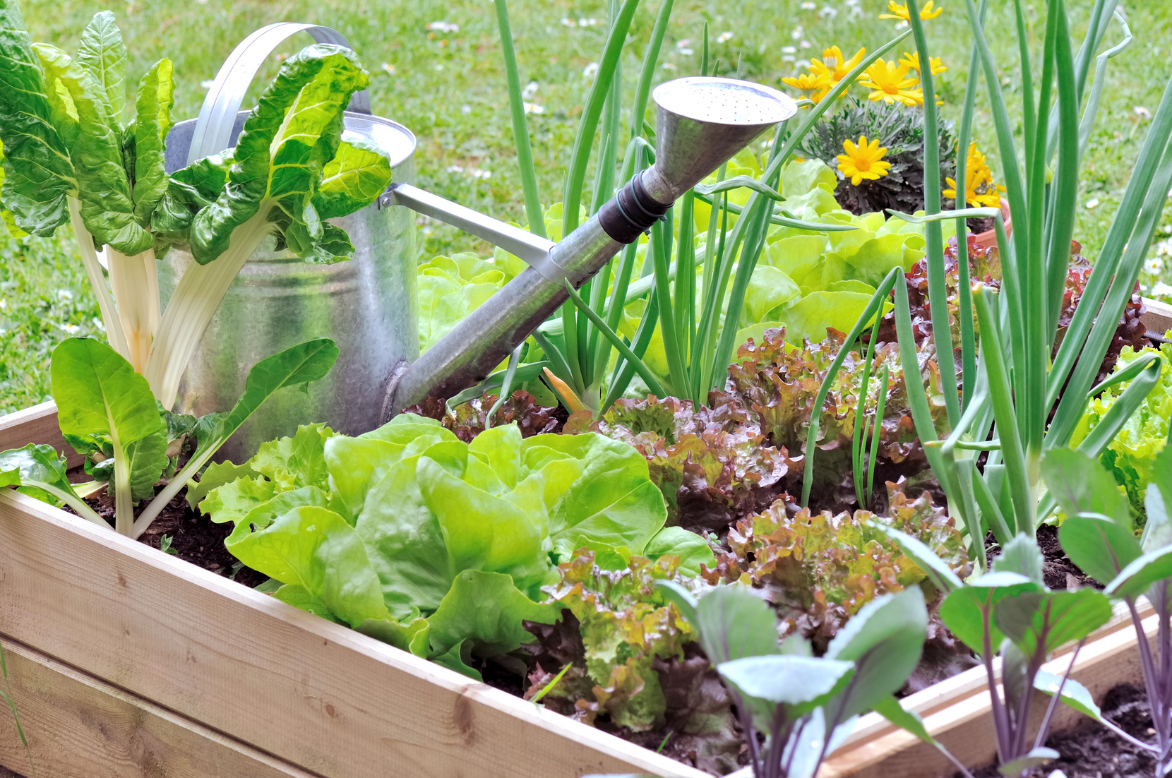
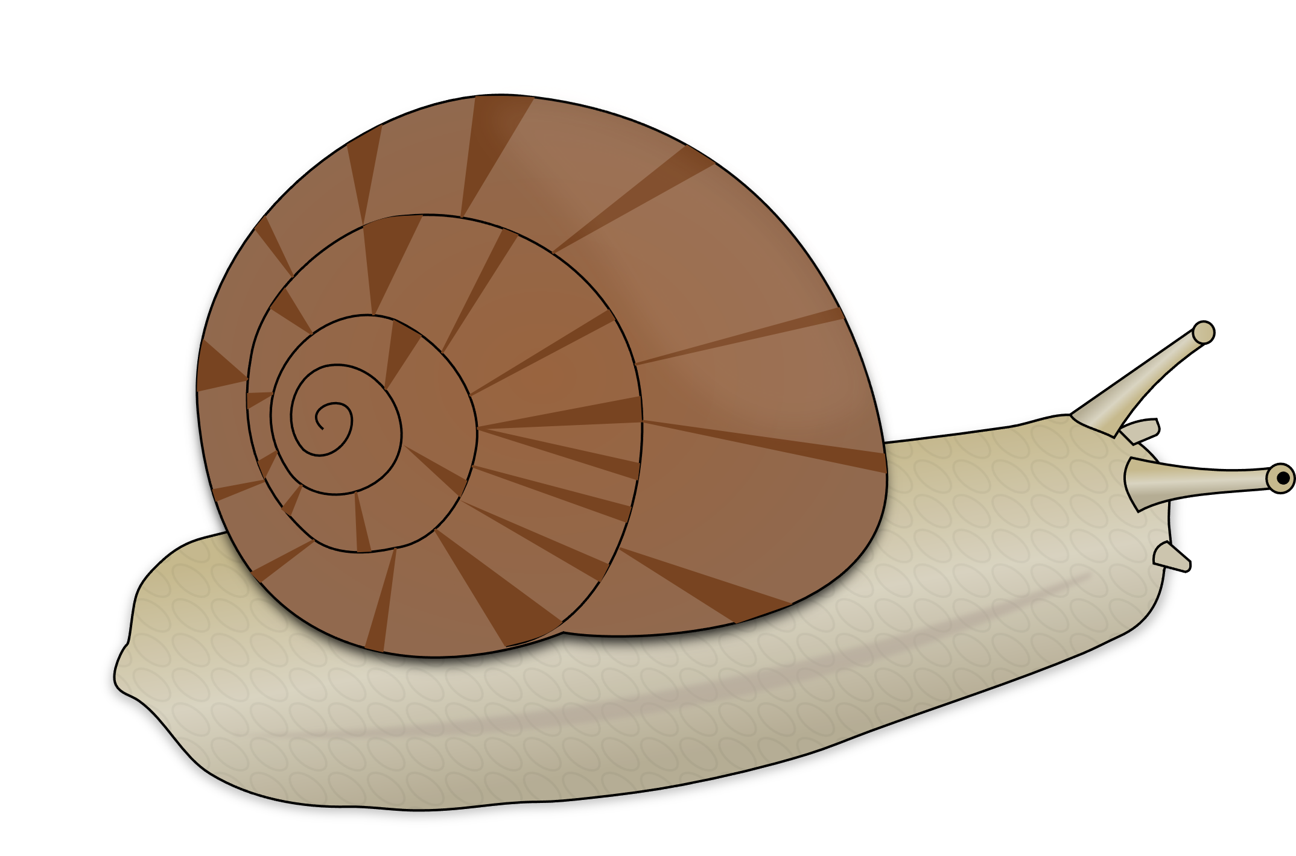
Growing a vegetable patch
Growing your school's vegetable patch can be a great way to help you and other pupils try new vegetables you have not tried before.
You can grow vegetables directly in the soil or in pots or larger planting container.
You'll need to check that they have enough water and sunlight exposure, and that the snails do not eat them all!

Slide 6
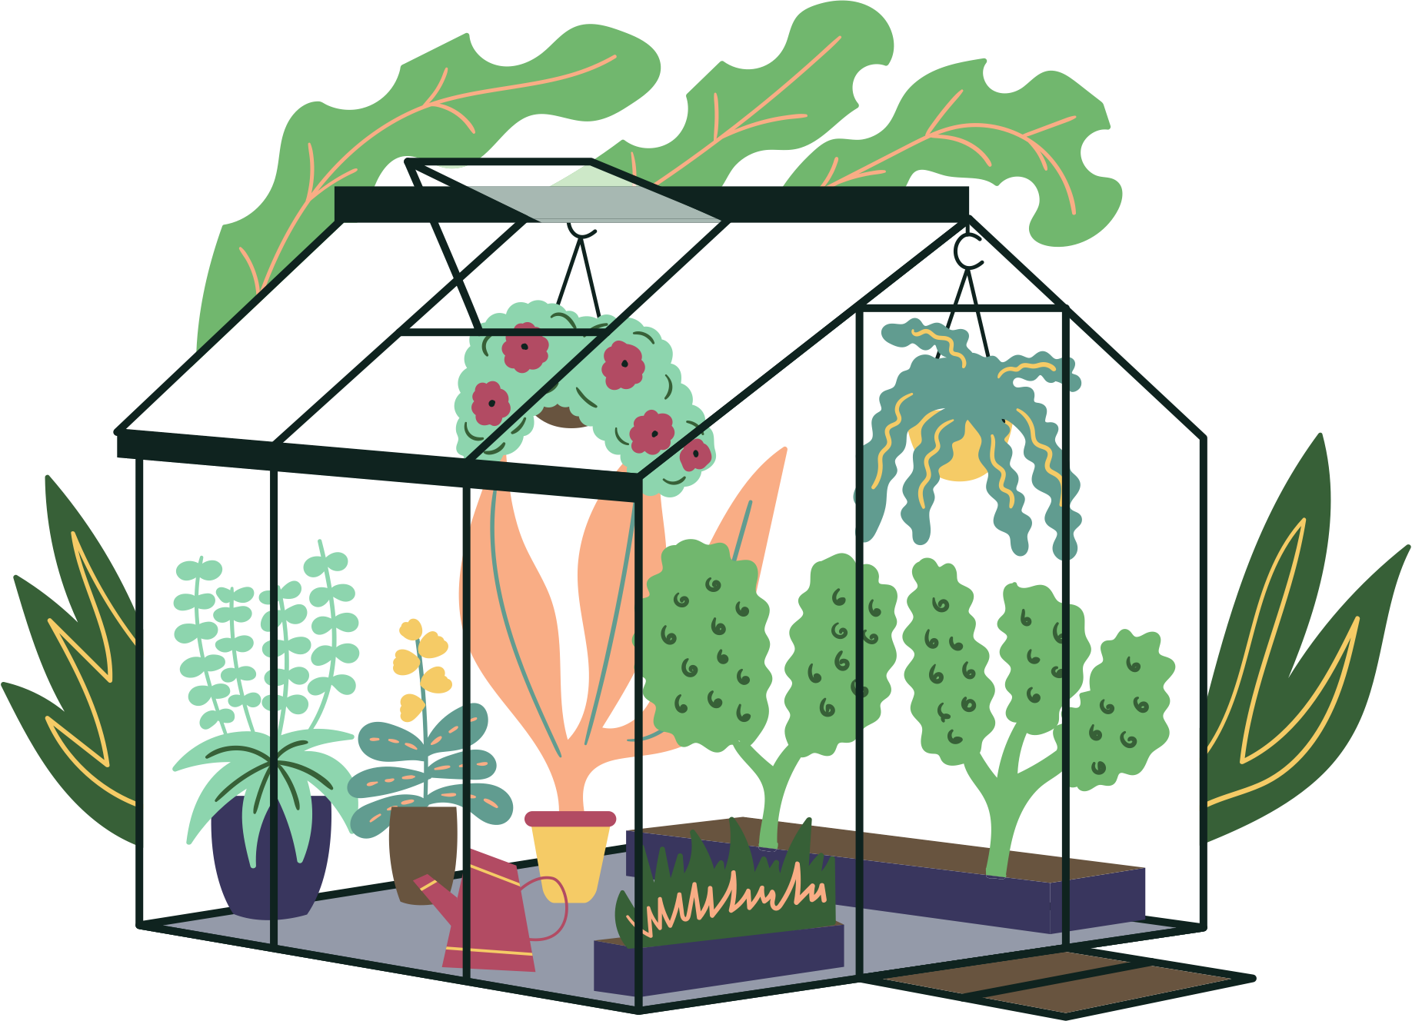
A greenhouse
Some schools have built a greenhouse to keep special plants all year long. Inside the greenhouse, the temperature stays warm as the sunlight is reflected through the windows.
Miniature greenhouses can also be installed in the classroom to help you look after your small plants.

Slide 7
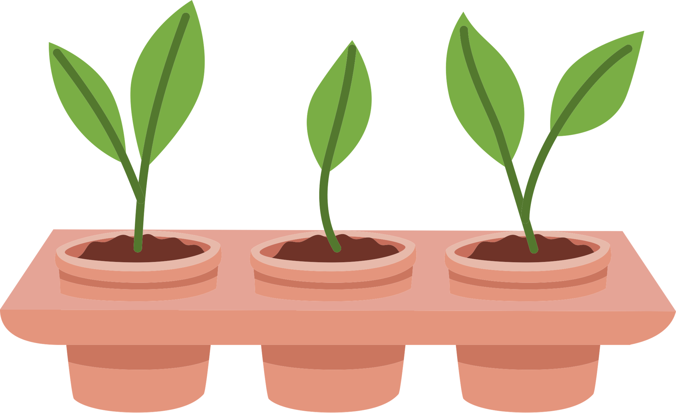
Planting in pots
Planting in pots is the easiest way to start planting if you have not got a piece of land to use.
The pots have to be large enough to contain the plants that will grow. You'll also need a saucer to collect the water when you are watering it. Your teacher will help you with this.

Slide 8
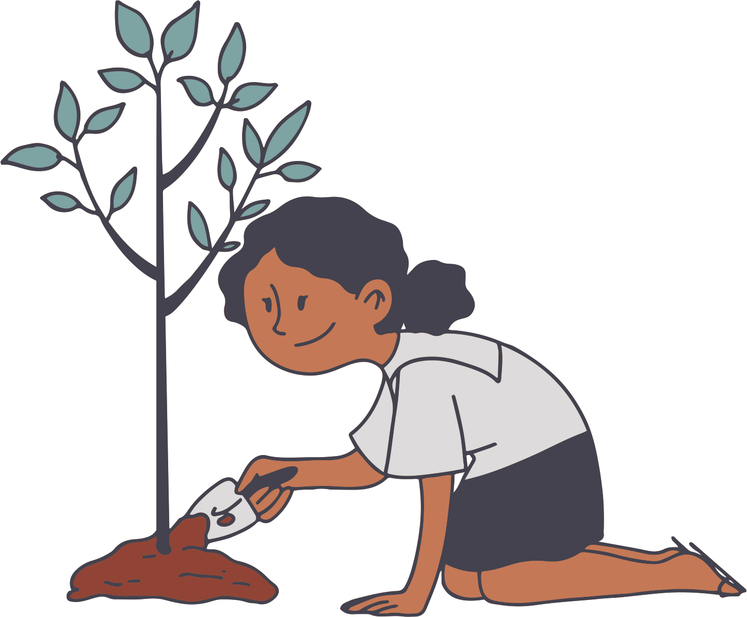
Planting a tree
Planting a tree is an amazing thing to do. If you plant a tree you will:
Help to creat oxygen in the area.
Give a new home to birds.
Help other plants to grow and connect to the tree underground.
Create some shade on hot days.

Slide 9
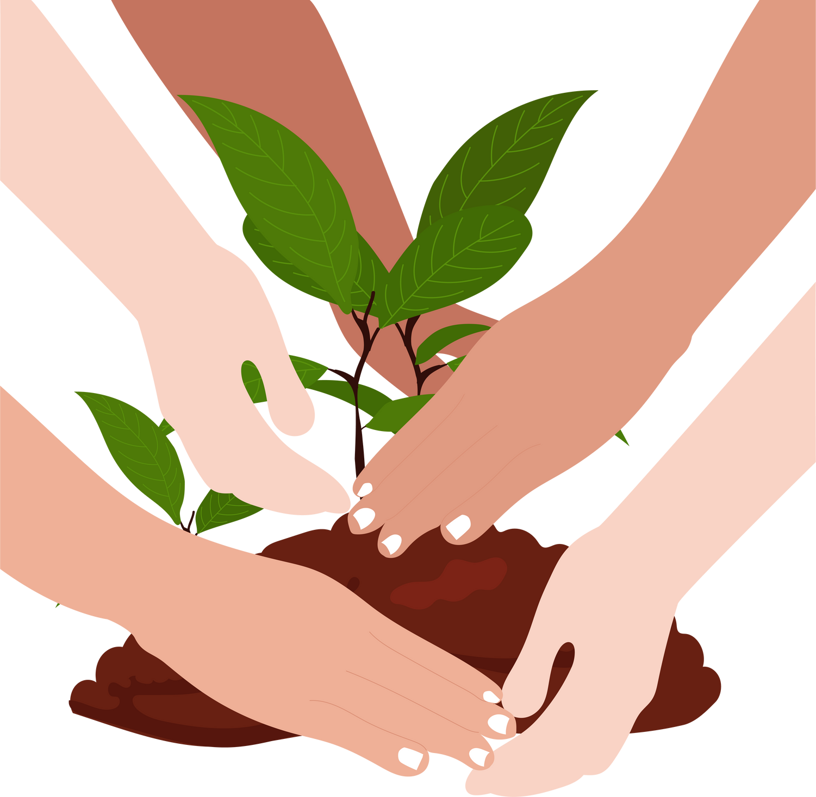

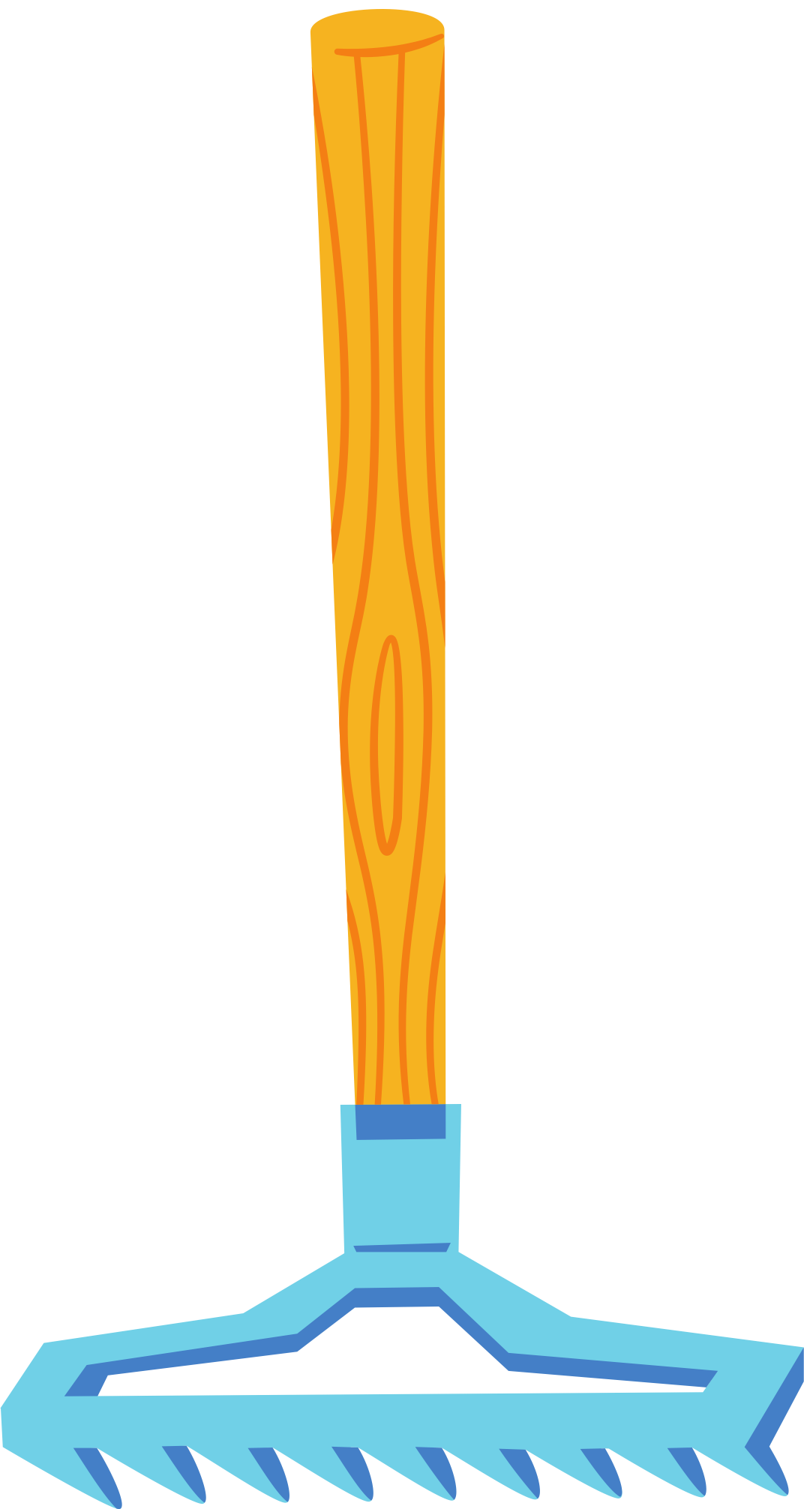
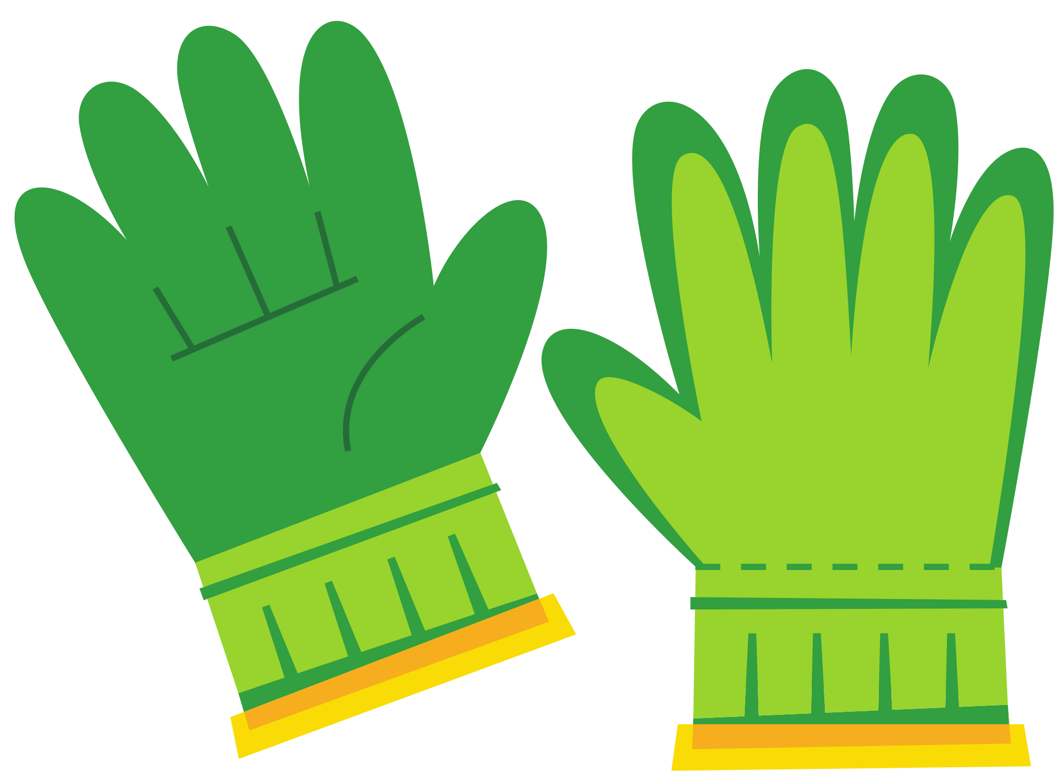
PLAN your planting project
Your teacher will tell you what your planting project can be done.
To plant you will also need to have some gardening tools such as a spade, a rake and some gardening gloves.

