Slide 1

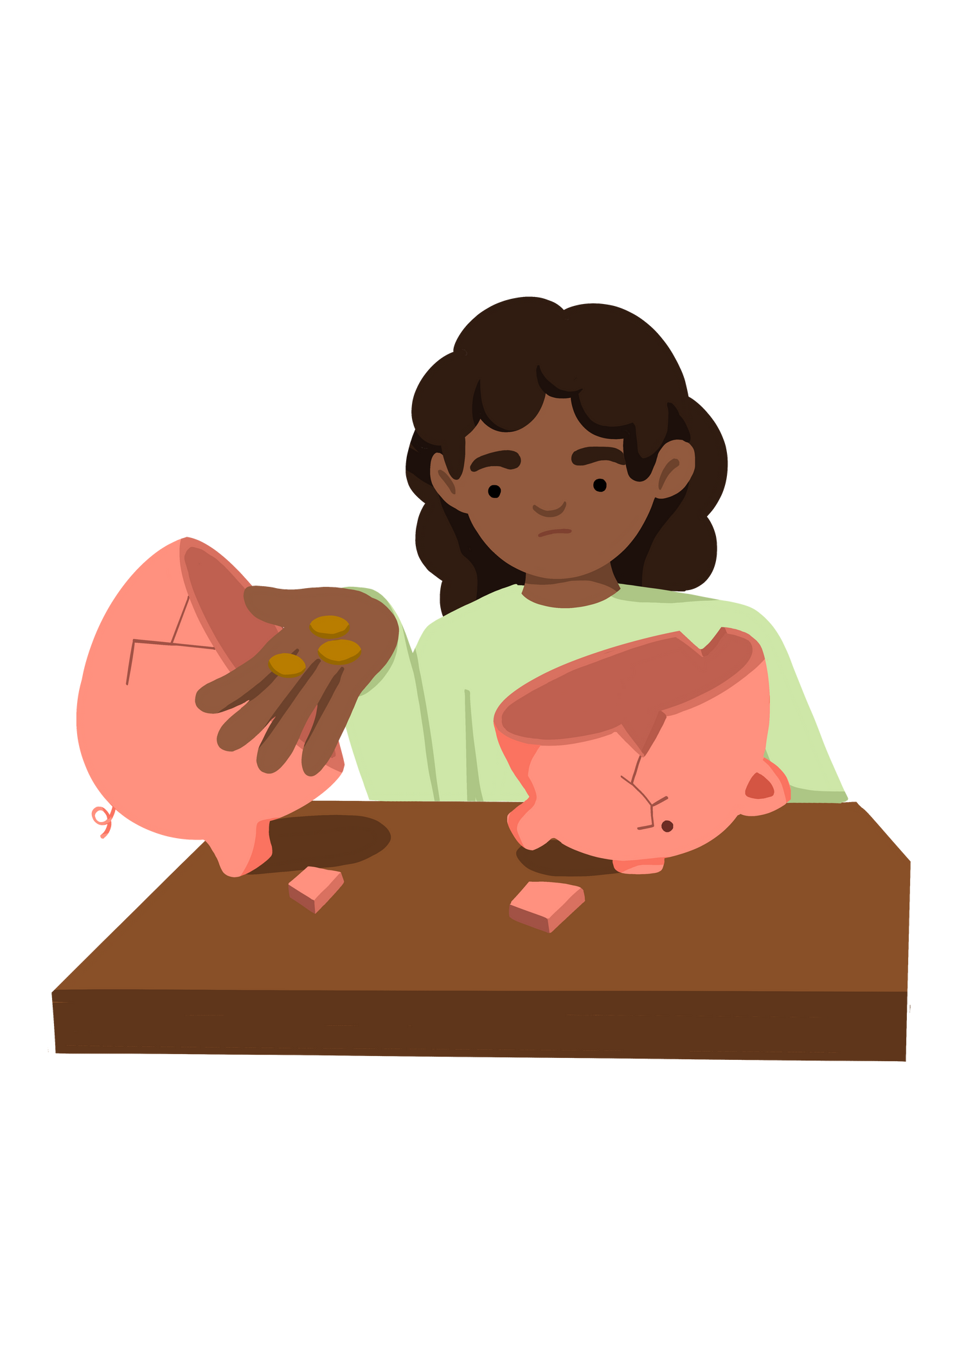
Understand the Meaning of Poverty
Notes:
Put the pupils in groups.
A3 Sheets of paper - Pens.
The objective of this activity is for the teams to remember as many items on the two slides as they can.
They can look at them in any order, however, they must only look at each slide twice and for a minute at a time (adjust this accordingly for your class).
The teams must not write anything down when the slides are being shown.
Discussion points:
After one view, encourage your teams to think strategically & discuss these points:
How can we work as a team to remember all the items?
Are there any methods we can use to remember all the items?
When the activity is complete, ask them:
What type of communication was used in attempting to solve the problem?
Did we communicate well as a team? Why? Why not?

Slide 2



Lesson Objectives | Lesson Objectives | Skills Objectives
Young people to understand the impact of poverty | Young people to understand the impact of poverty | I can think of possible solutions and justify your responses.
 | National Curriculum: Science, PE, Food Technology, Maths
Notes:
Put the pupils in groups.
A3 Sheets of paper - Pens.
The objective of this activity is for the teams to remember as many items on the two slides as they can.
They can look at them in any order, however, they must only look at each slide twice and for a minute at a time (adjust this accordingly for your class).
The teams must not write anything down when the slides are being shown.
Discussion points:
After one view, encourage your teams to think strategically & discuss these points:
How can we work as a team to remember all the items?
Are there any methods we can use to remember all the items?
When the activity is complete, ask them:
What type of communication was used in attempting to solve the problem?
Did we communicate well as a team? Why? Why not?

Slide 3
Your instructions:​
The objective of this activity is to remember as many items on the two slides as you can. ​
You get three attempts to view the slides. ​
You cannot write down your list until you have finished viewing the slides.​
Notes:
Put the pupils in groups.
A3 Sheets of paper - Pens.
The objective of this activity is for the teams to remember as many items on the two slides as they can.
They can look at them in any order, however, they must only look at each slide twice and for a minute at a time (adjust this accordingly for your class).
The teams must not write anything down when the slides are being shown.
Discussion points:
After one view, encourage your teams to think strategically & discuss these points:
How can we work as a team to remember all the items?
Are there any methods we can use to remember all the items?
When the activity is complete, ask them:
What type of communication was used in attempting to solve the problem?
Did we communicate well as a team? Why? Why not?

Slide 4

Notes:
Put the pupils in groups.
A3 Sheets of paper - Pens.
The objective of this activity is for the teams to remember as many items on the two slides as they can.
They can look at them in any order, however, they must only look at each slide twice and for a minute at a time (adjust this accordingly for your class).
The teams must not write anything down when the slides are being shown.
Discussion points:
After one view, encourage your teams to think strategically & discuss these points:
How can we work as a team to remember all the items?
Are there any methods we can use to remember all the items?
When the activity is complete, ask them:
What type of communication was used in attempting to solve the problem?
Did we communicate well as a team? Why? Why not?

Slide 5




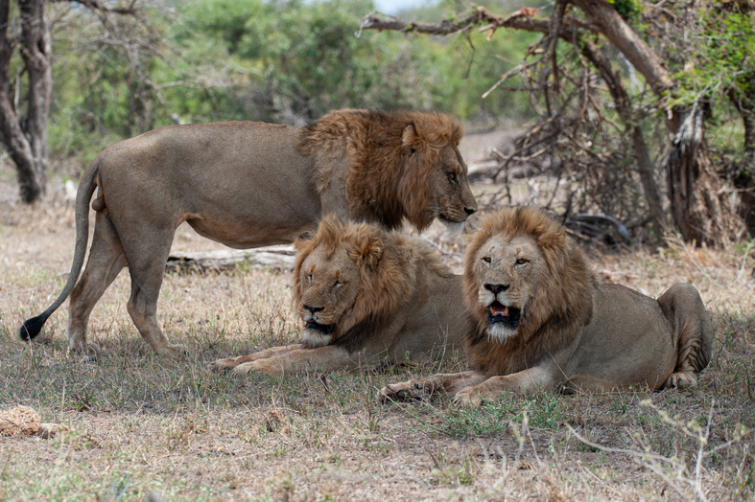



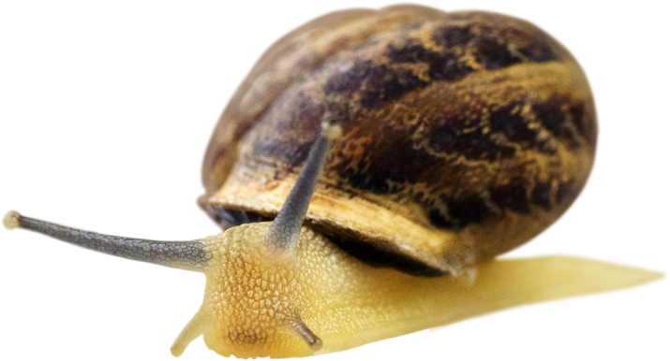


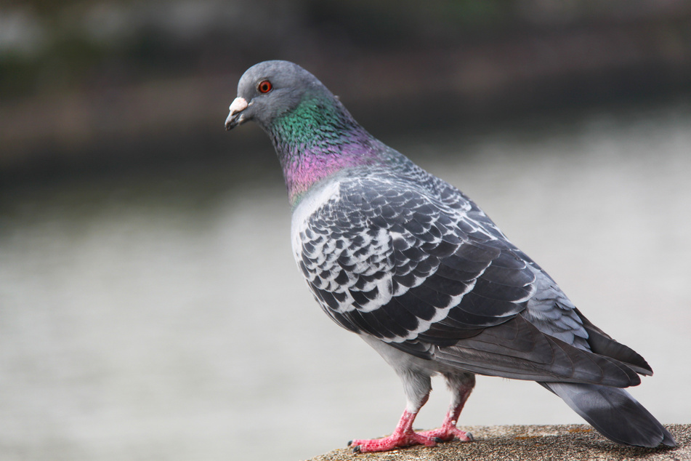











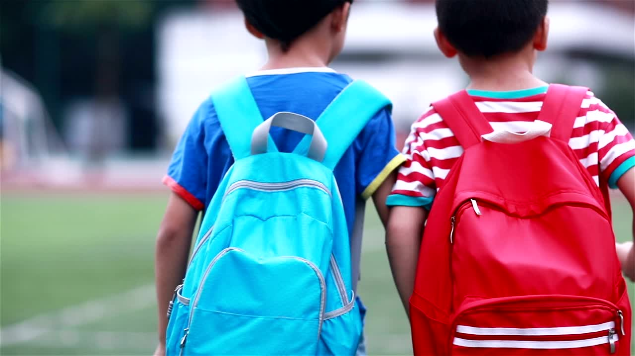

Slide 6
According to estimates by the UN, in 2015, 10 per cent of the world’s population or 734 million people, lived on less than $1.90 a day.
This is known as Absolute poverty which is defined as:
"a condition characterised by severe deprivation of basic human needs, including food, safe drinking water, sanitation facilities, health, shelter, education and information. It depends not only on income but also on access to services."
Notes:
Put the pupils in groups.
A3 Sheets of paper - Pens.
The objective of this activity is for the teams to remember as many items on the two slides as they can.
They can look at them in any order, however, they must only look at each slide twice and for a minute at a time (adjust this accordingly for your class).
The teams must not write anything down when the slides are being shown.
Discussion points:
After one view, encourage your teams to think strategically & discuss these points:
How can we work as a team to remember all the items?
Are there any methods we can use to remember all the items?
When the activity is complete, ask them:
What type of communication was used in attempting to solve the problem?
Did we communicate well as a team? Why? Why not?

Slide 7
What would you buy for $1.90, the same as £1.41?
Notes:
Put the pupils in groups.
A3 Sheets of paper - Pens.
The objective of this activity is for the teams to remember as many items on the two slides as they can.
They can look at them in any order, however, they must only look at each slide twice and for a minute at a time (adjust this accordingly for your class).
The teams must not write anything down when the slides are being shown.
Discussion points:
After one view, encourage your teams to think strategically & discuss these points:
How can we work as a team to remember all the items?
Are there any methods we can use to remember all the items?
When the activity is complete, ask them:
What type of communication was used in attempting to solve the problem?
Did we communicate well as a team? Why? Why not?

Slide 8
Notes:
Put the pupils in groups.
A3 Sheets of paper - Pens.
The objective of this activity is for the teams to remember as many items on the two slides as they can.
They can look at them in any order, however, they must only look at each slide twice and for a minute at a time (adjust this accordingly for your class).
The teams must not write anything down when the slides are being shown.
Discussion points:
After one view, encourage your teams to think strategically & discuss these points:
How can we work as a team to remember all the items?
Are there any methods we can use to remember all the items?
When the activity is complete, ask them:
What type of communication was used in attempting to solve the problem?
Did we communicate well as a team? Why? Why not?

Slide 9


Date:
Daily Meal Plan
BREAKFAST
LUNCH
Using the template and the Eatwell guide, create a
healthy menu for one day.
DINNER
SNACKS
SHOPPING LIST
Create a shopping list and
work out the cost of each item.

Slide 10

Understand how poverty can have an impact on an individual and the community.
Respond to solutions by justifying your responses.
#WeWill: Inspire and Assess #WeWill Skill: Teamwork | National Curriculum: Science, PE, Food technology, maths
Notes:
Put the pupils in groups.
A3 Sheets of paper - Pens.
The objective of this activity is for the teams to remember as many items on the two slides as they can.
They can look at them in any order, however, they must only look at each slide twice and for a minute at a time (adjust this accordingly for your class).
The teams must not write anything down when the slides are being shown.
Discussion points:
After one view, encourage your teams to think strategically & discuss these points:
How can we work as a team to remember all the items?
Are there any methods we can use to remember all the items?
When the activity is complete, ask them:
What type of communication was used in attempting to solve the problem?
Did we communicate well as a team? Why? Why not?

