Slide 1
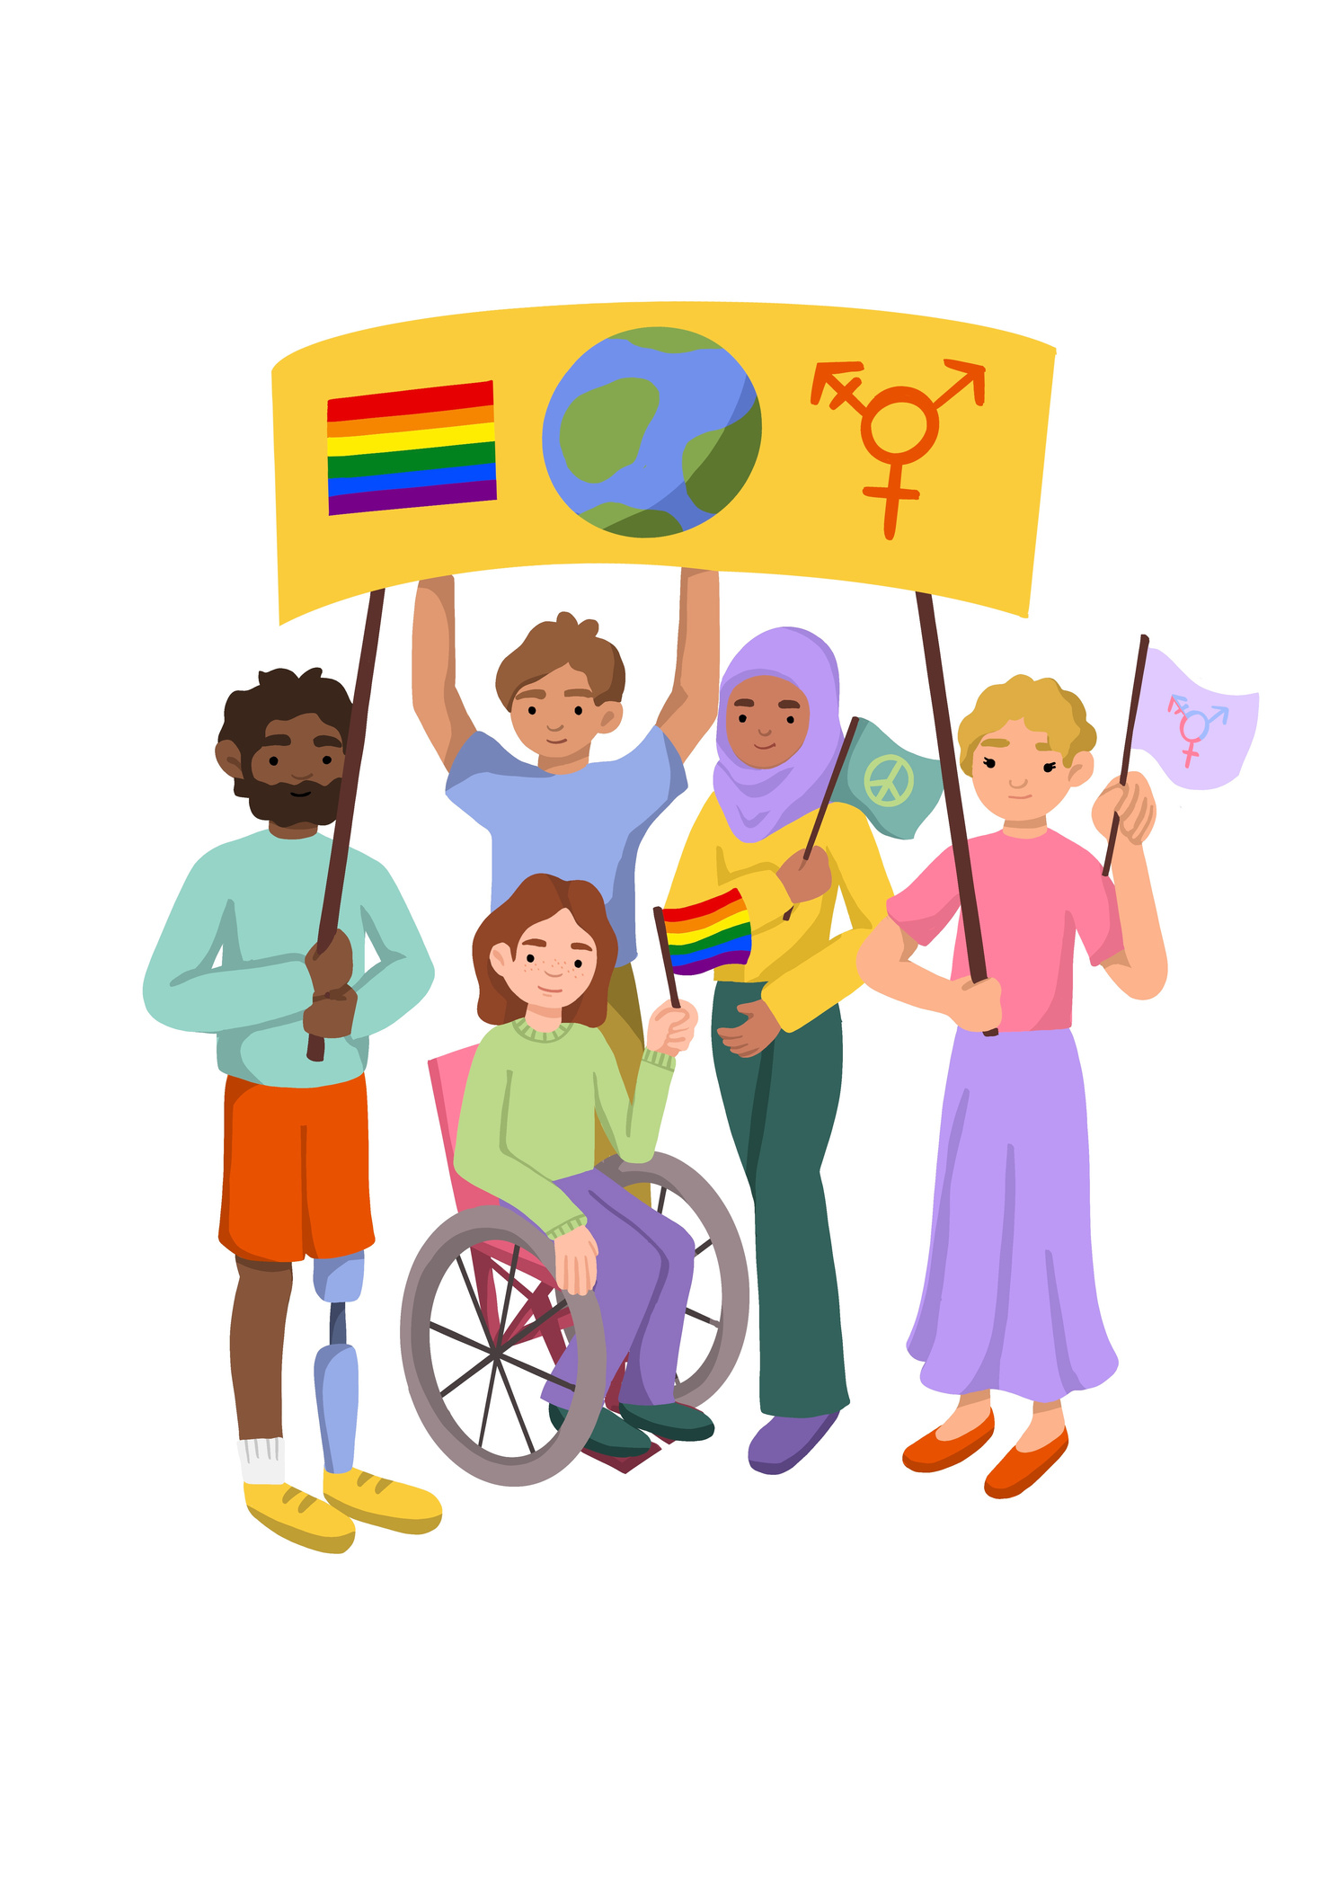
Lesson 2: Focusing on Discrimination and Prejudice and how we are all Treated Differently

Slide 2




Lesson Objectives | Skills Objectives
With examples, young people can demonstrate an understanding of discrimination and prejudice. Young people can analyse the benefits and drawbacks of diversity. | Problem-Solving - I can follow an argument, identify different points of view, and distinguish facts from opinions. Communication - I can apply the PEEL method using different mediums.
 | National Curriculum: Citizenship, PSHE, English

Slide 3
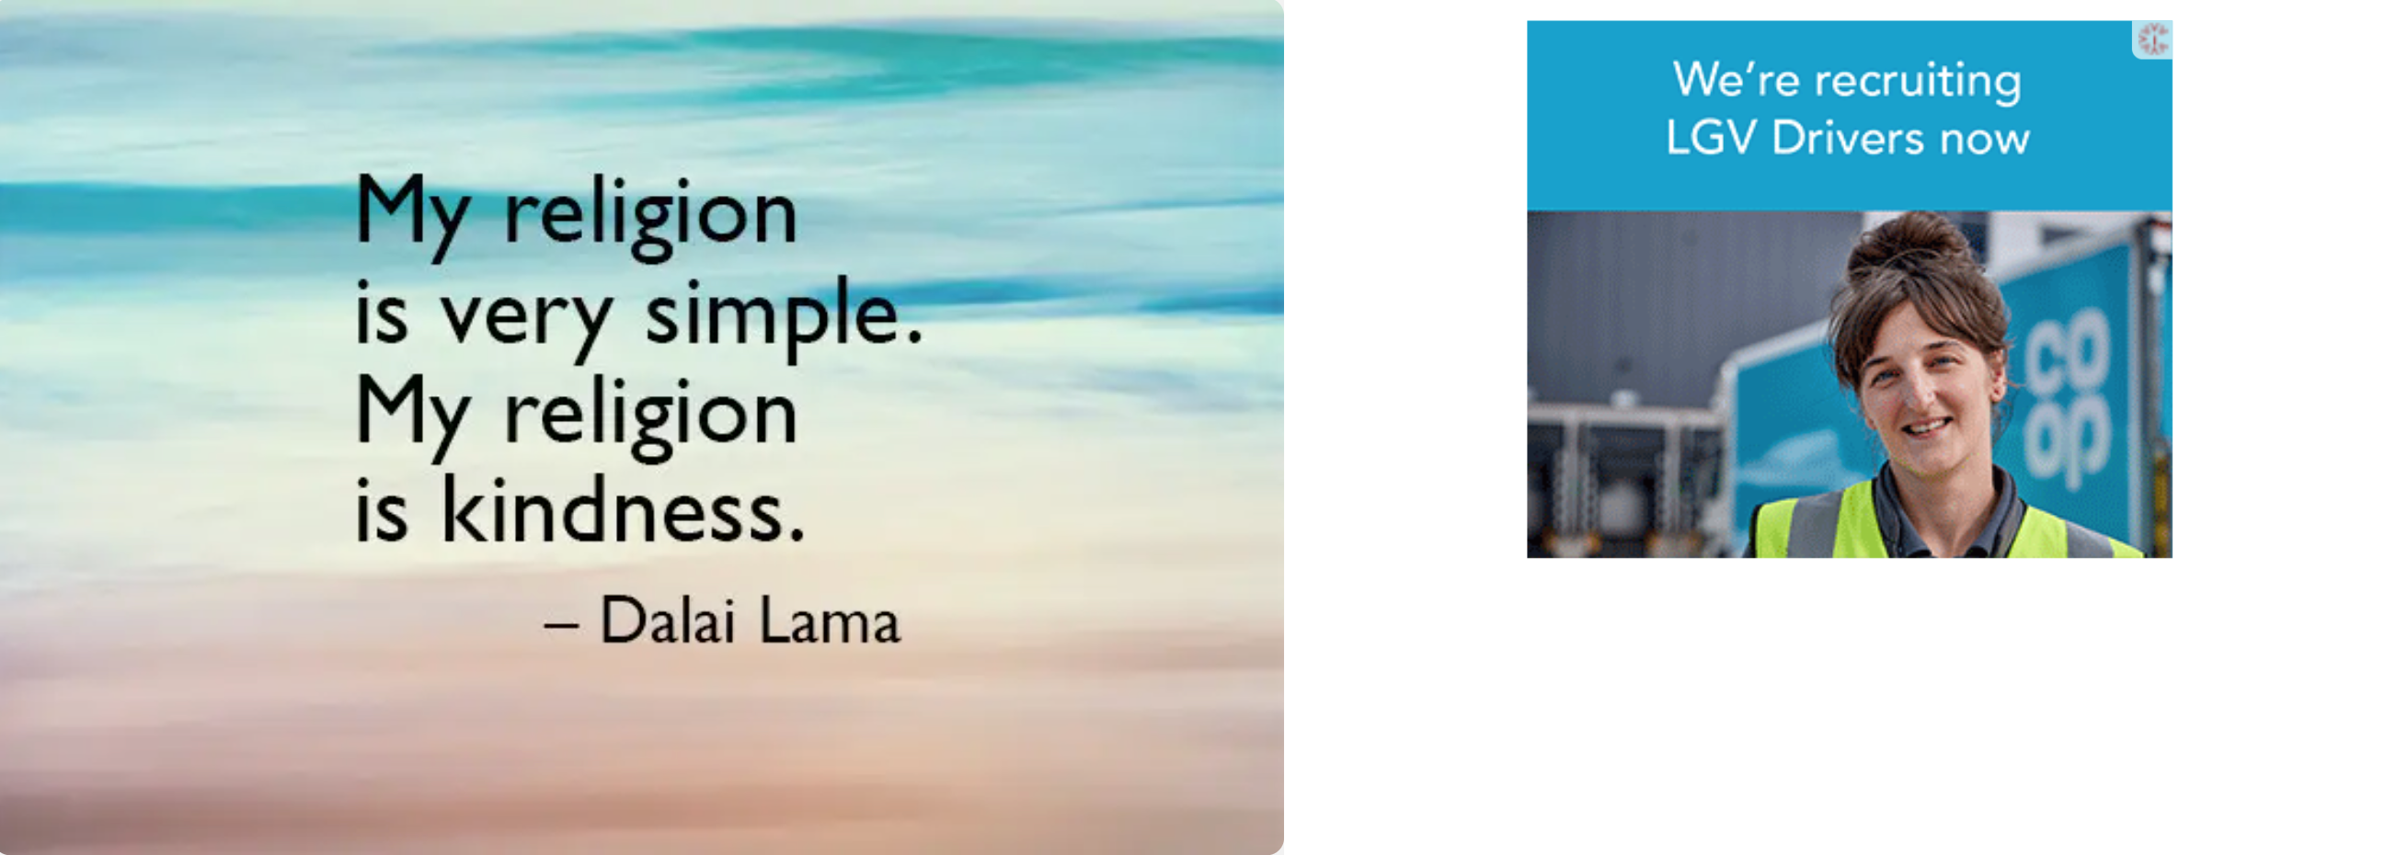
Notes:
Identify the essential aspects of effective communication

Slide 4

Notes:
Analyse Emma Watson's speech:
Watch Emma Watson's speech on gender equality and list all aspects in her speech that make it persuasive and what could be improved. Think about how many times the key message was repeated, her intention, tone, expression, language, the audience’s reaction, the risks that she took etc.

Slide 5
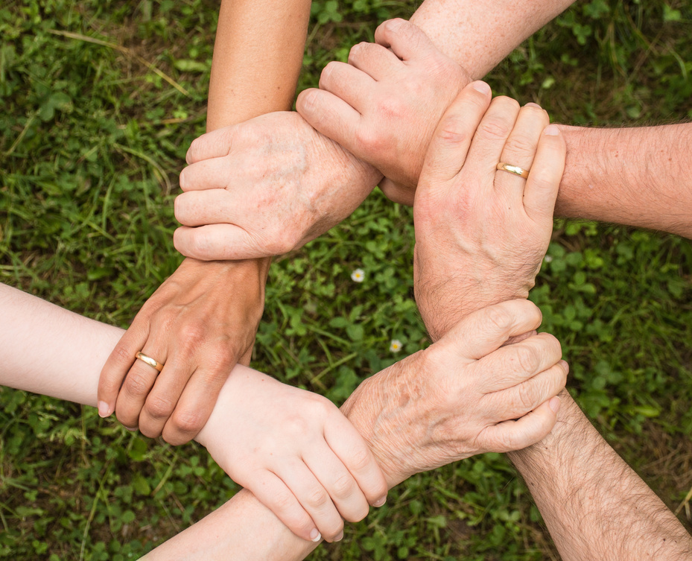
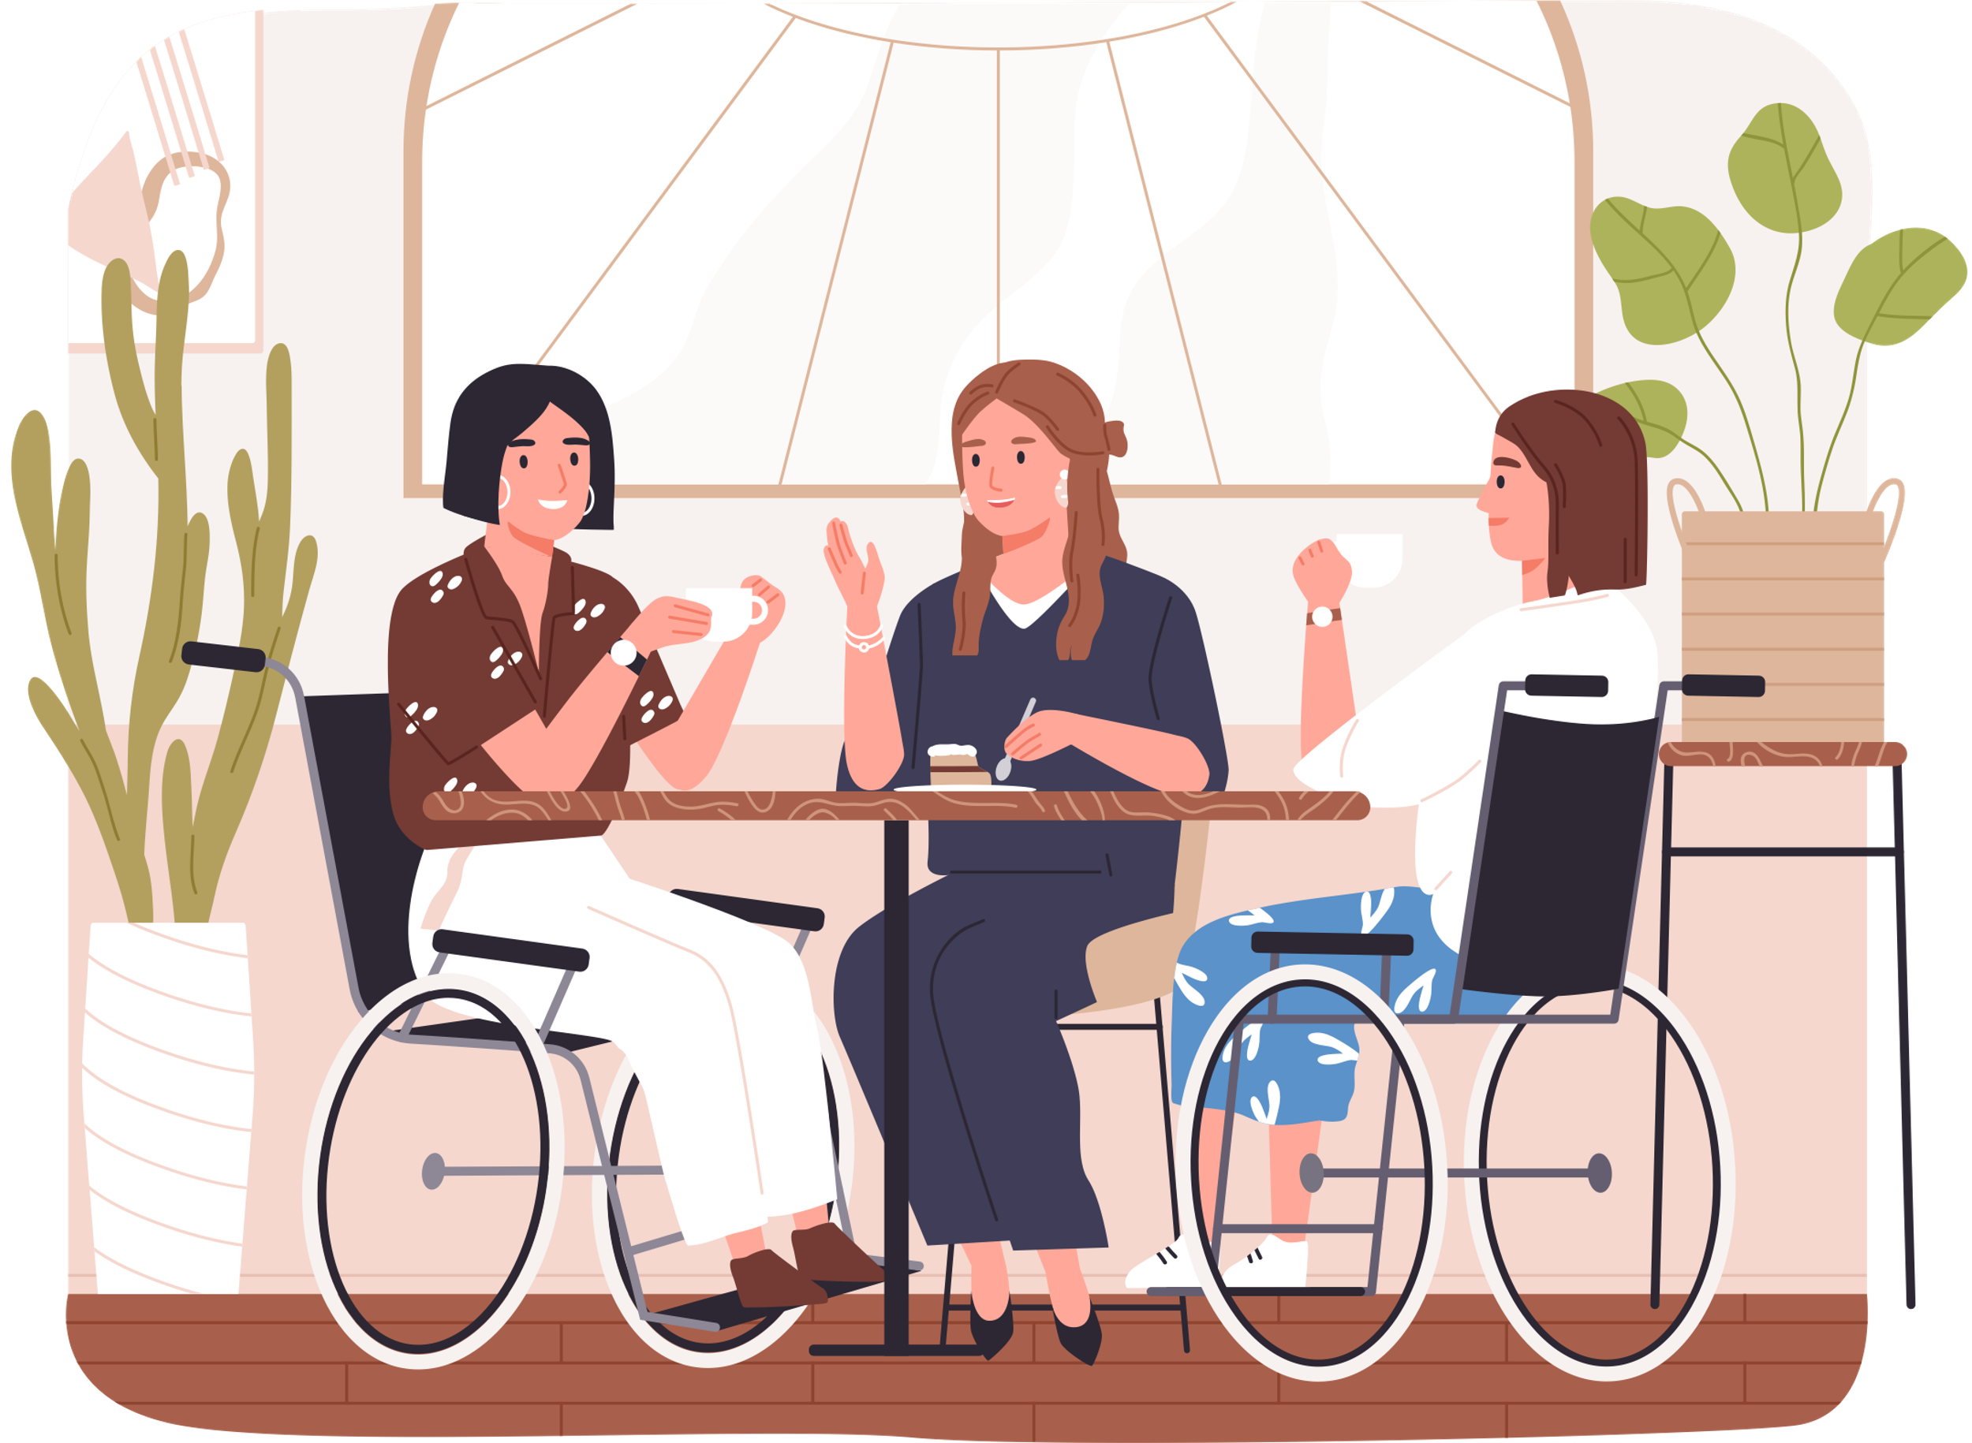
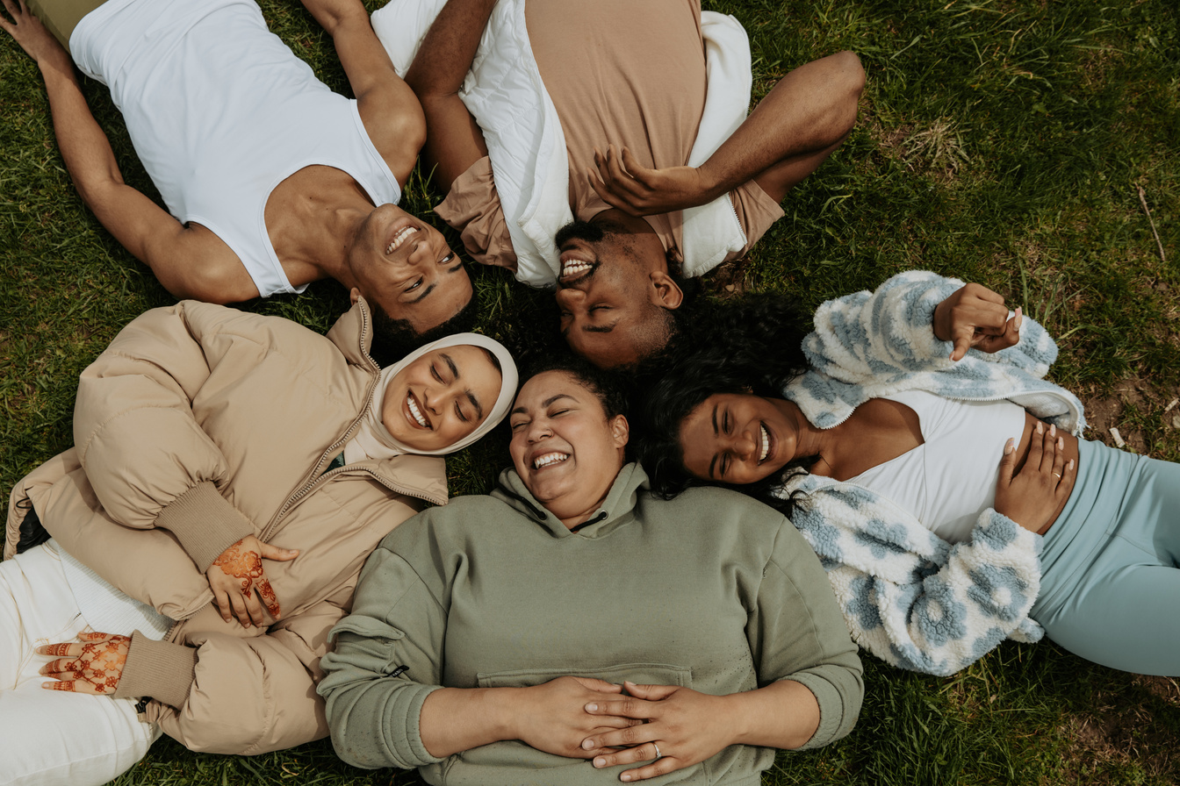
What is inclusivity?
Notes:
The practise or policy of providing equal access to opportunities and resources for people who might otherwise be excluded or marginalized, such as those having physical or mental disabilities or belonging to other minority groups.

Slide 6
Why is inclusion important?
Notes:
Pupils need to understand what sustainability means. before giving them the definitions ask pupils to suggest what they think sustainability means.

Slide 7
What are Human rights, and why were they first introduced?
The traumatic events of the Second World War brought home that human rights are not always universally respected. The extermination of almost 17 million people during the Holocaust, including 6 million Jews, was horrifying. After the war, governments worldwide made a concerted effort to foster international peace and prevent conflict. This resulted in the establishment of the United Nations in June 1945.
In 1948, representatives from the 50 member states of the United Nations came together under the guidance of Eleanor Roosevelt (First Lady of the United States 1933-1945) to devise a list of all the human rights that everybody across the world should enjoy.
On 10 December 1948, the General Assembly of the United Nations announced the Universal Declaration of Human Rights (UDHR) - 30 rights and freedoms that belong to all of us. Seven decades on and the rights they included continue to form the basis for all international human rights law.
Notes:
Pupils need to understand what sustainability means. before giving them the definitions ask pupils to suggest what they think sustainability means.

Slide 8
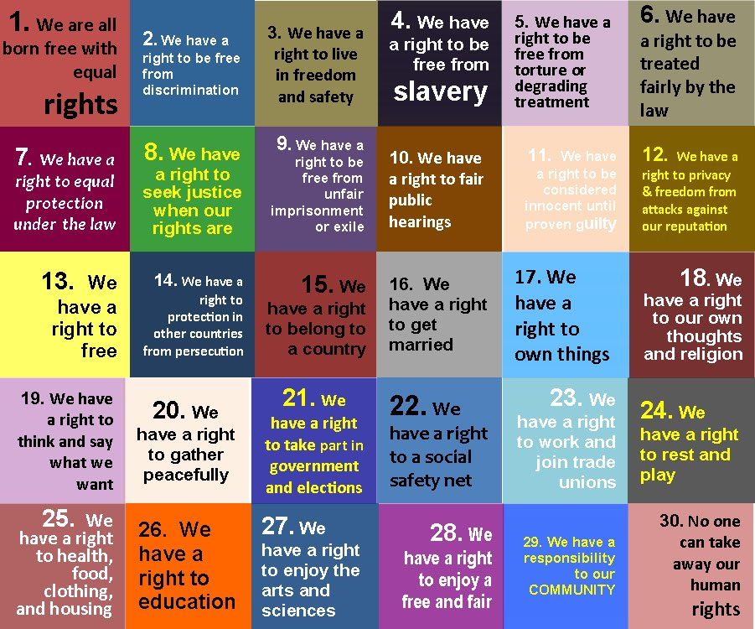
A summary of the 30 articles
of the Universal Declaration
of Human Rights
Notes:
Pupils need to understand what sustainability means. before giving them the definitions ask pupils to suggest what they think sustainability means.

Slide 9
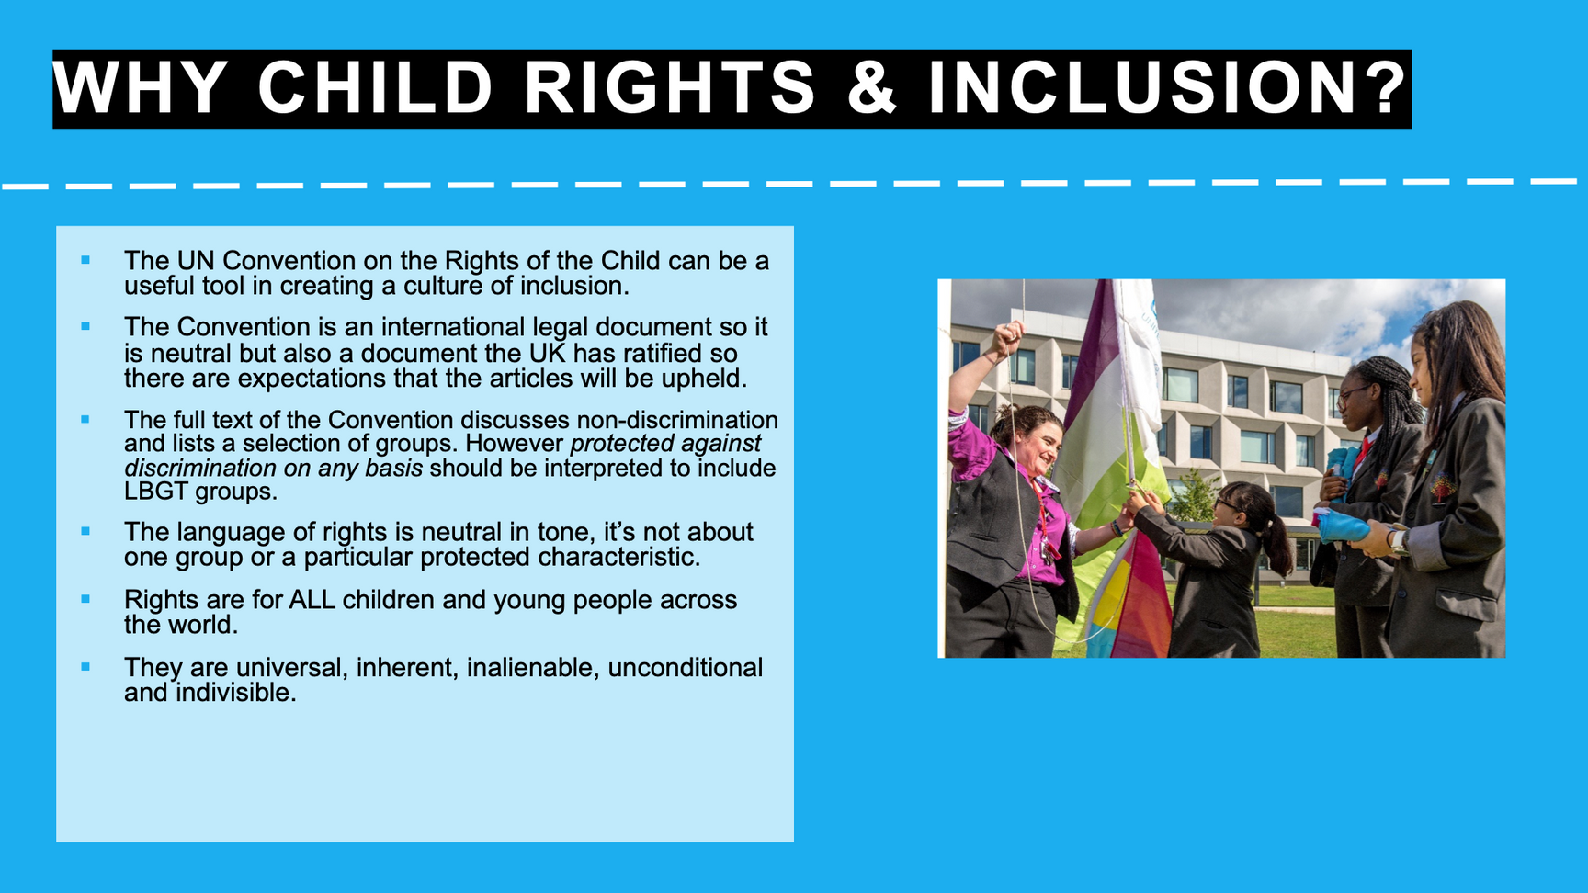
Notes:
Pupils need to understand what sustainability means. before giving them the definitions ask pupils to suggest what they think sustainability means.

Slide 10
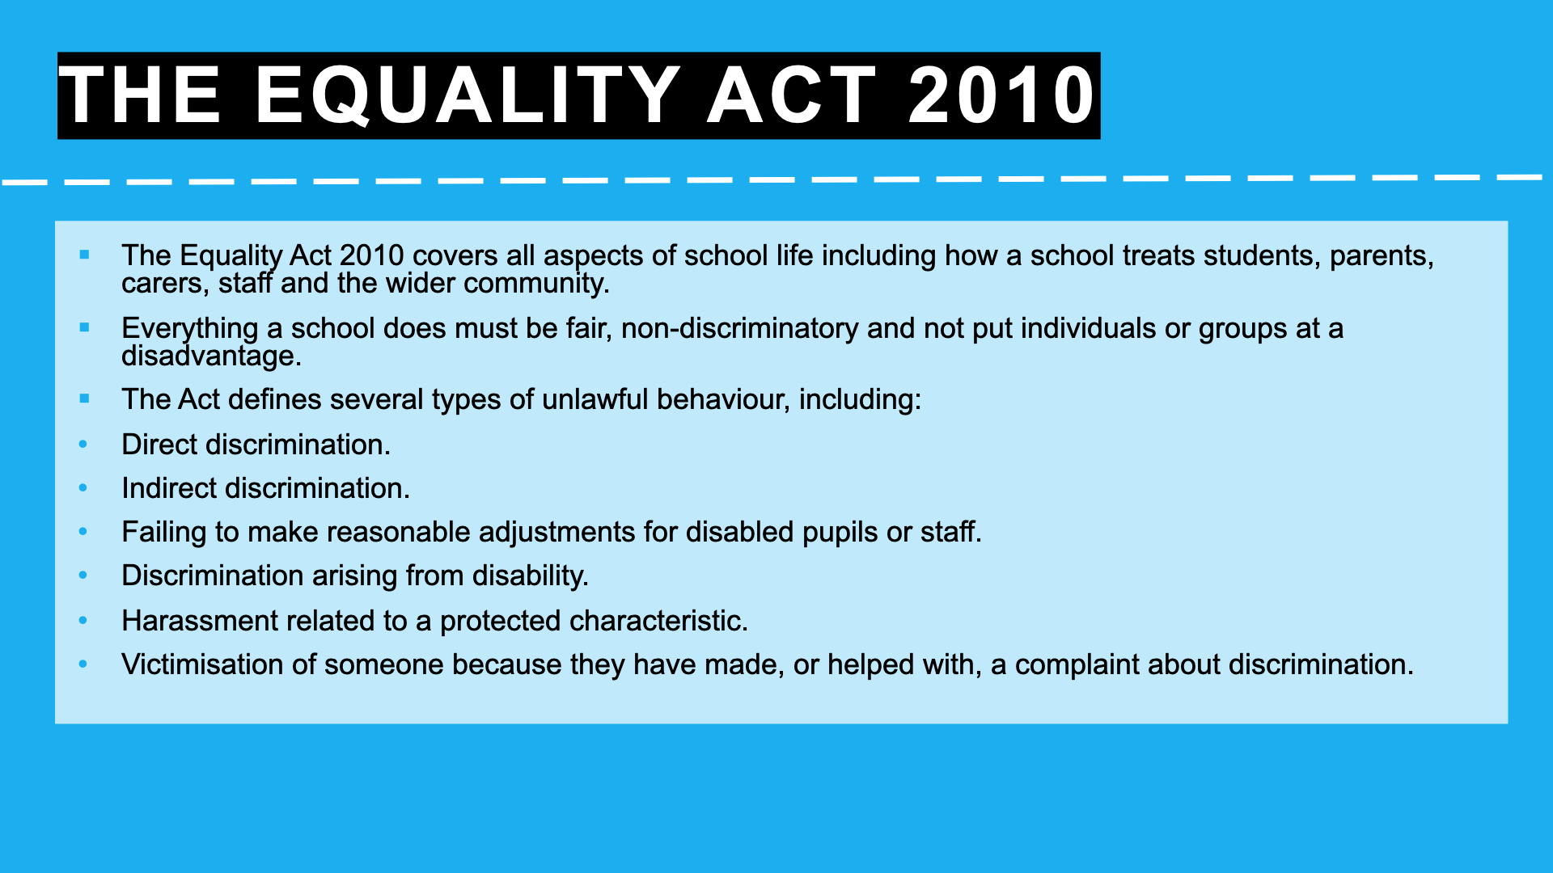
Notes:
Pupils need to understand what sustainability means. before giving them the definitions ask pupils to suggest what they think sustainability means.

Slide 11
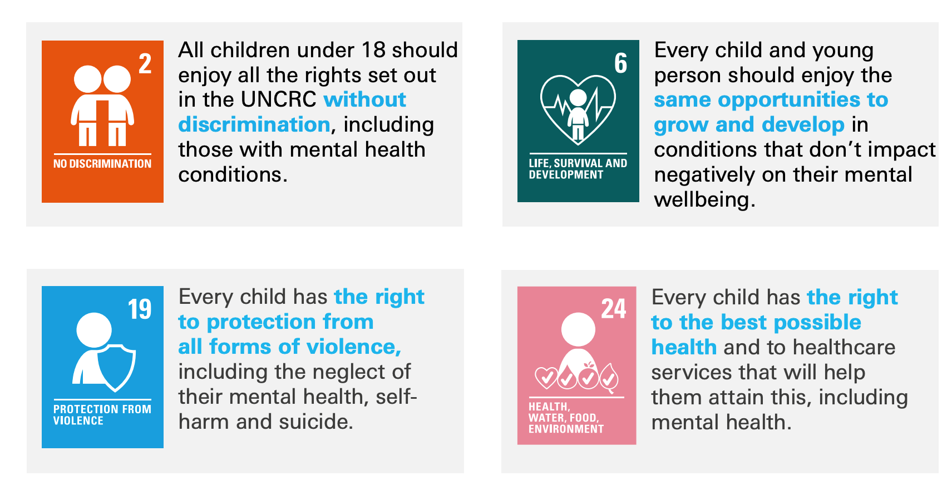
Notes:
Pupils need to understand what sustainability means. before giving them the definitions ask pupils to suggest what they think sustainability means.

Slide 12
United Nations Sustainable Goal 4 - Quality Education
By 2030, ensure that all girls and boys complete free, equitable and quality primary and secondary education leading to relevant and effective learning outcomes.
By 2030, eliminate gender disparities in education and ensure equal access to all levels of education and vocational training for the vulnerable, including persons with disabilities, indigenous peoples and children in vulnerable situations.
By 2030, ensure that all learners acquire the knowledge and skills needed to promote sustainable development, including, among others, through education for sustainable development and sustainable lifestyles, human rights, gender equality, promotion of a culture of peace and non-violence, global citizenship and appreciation of cultural diversity and of culture’s contribution to sustainable development
Notes:
Pupils need to understand what sustainability means. before giving them the definitions ask pupils to suggest what they think sustainability means.

Slide 13
We may have...
different religions, traditions or cultures......
diverse languages, ethnicity or coloured skin,
or even varied abilities,
personalities and perspectives,
but we all belong to one human race.
By Kofi Annan...
Notes:
Pupils need to understand what sustainability means. before giving them the definitions ask pupils to suggest what they think sustainability means.

Slide 14
Rise a poem about Diversity. Watch video—pupils write their poems about diversity and present them in the format of their choice.
Rise - A Poem about Diversity
Notes:
Pupils need to understand what sustainability means. before giving them the definitions ask pupils to suggest what they think sustainability means.

