Slide 1
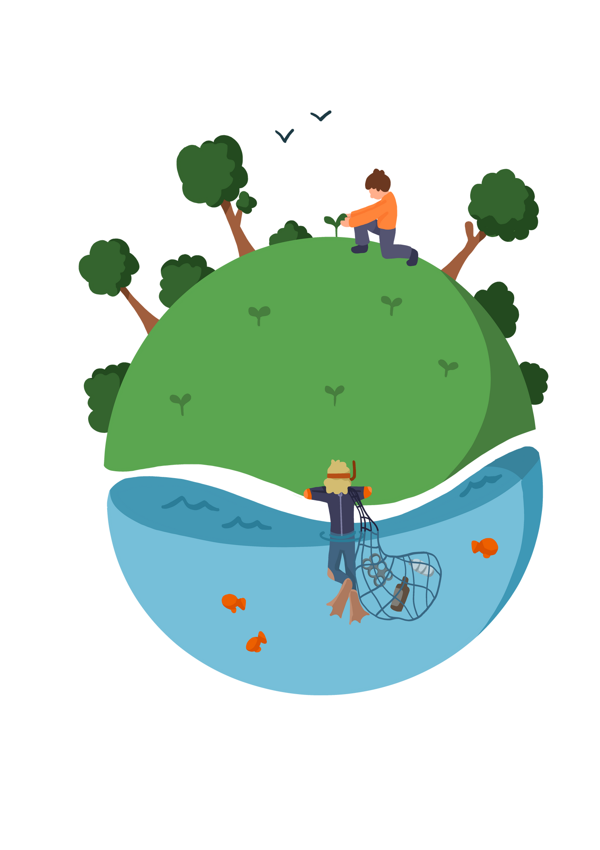
Lesson 2 - How does what we Eat Impact the Environment?
Notes:
Pupils need to understand what sustainability means. before giving them the definitions ask pupils to suggest what they think sustainability means.

Slide 2
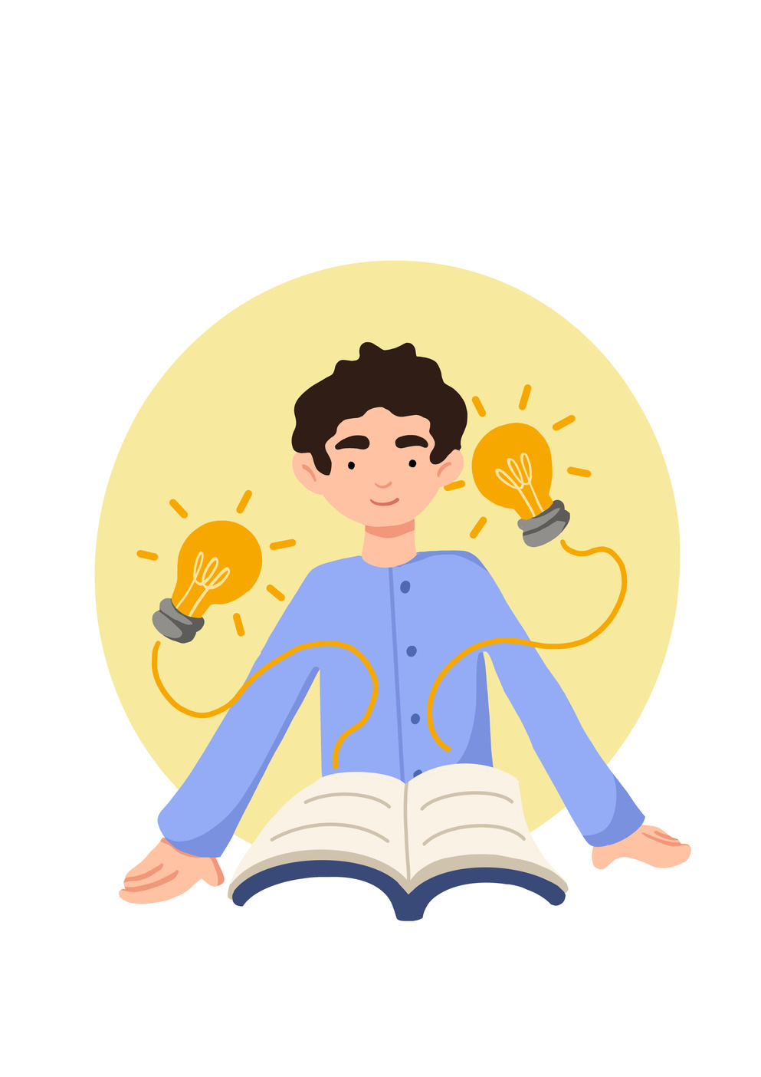



Lesson Objectives | Skills Objectives
Young people to understand the impact our eating habits can have on the environment | Problem-Solving - I can identify relevant information from extended explanations or presentations when solving problems. Communication -I can present information and recognise that other people will have different opinions and views
 |  |  |  | National Curriculum: Climate change, Food technology.
Notes:
Pupils need to understand what sustainability means. before giving them the definitions ask pupils to suggest what they think sustainability means.

Slide 3



Factors which can have an impact on Climate Crisis
Shopping
Energy Control
Money and Jobs
Lifestyle Choices
Teaching Sustainability
Leisure and Entertainment
Changing Climates
Connecting with others
Travel and Transport
Notes:
Pupils need to understand what sustainability means. before giving them the definitions ask pupils to suggest what they think sustainability means.

Slide 4
Did you know?
  Developed Countries Are Responsible for 79 Percent of Historical Carbon Emissions
  Impact on Ecosystems - Humans impact the physical environment in many ways: overpopulation, pollution, burning fossil fuels, and deforestation. Changes like these have triggered climate change, soil erosion, poor air quality, and undrinkable water.
  Understanding Why Climate Change Impacts Women More Than Men. Climate change deepens existing inequalities. Heat waves, droughts, rising sea levels, and extreme storms disproportionately affect women. That’s because women are more likely to live in poverty than men, have less access to basic human rights like the ability to freely move and acquire land, and face systematic violence that escalates during periods of instability. Global Citizenship
  Climate change is increasing the risk of severe 'food shocks' where crops fail and prices of staples rise rapidly around the world.
  Scientists believe at least 550 species could be lost this century if action is not taken.
  Frozen ground melting in places like Siberia, and greenhouse gases trapped for centuries will be released into the atmosphere, worsening climate change.
Notes:
These are some examples of the impact of our actions on the environment. The guide offers more information and links to additional sources if needed.

Slide 5
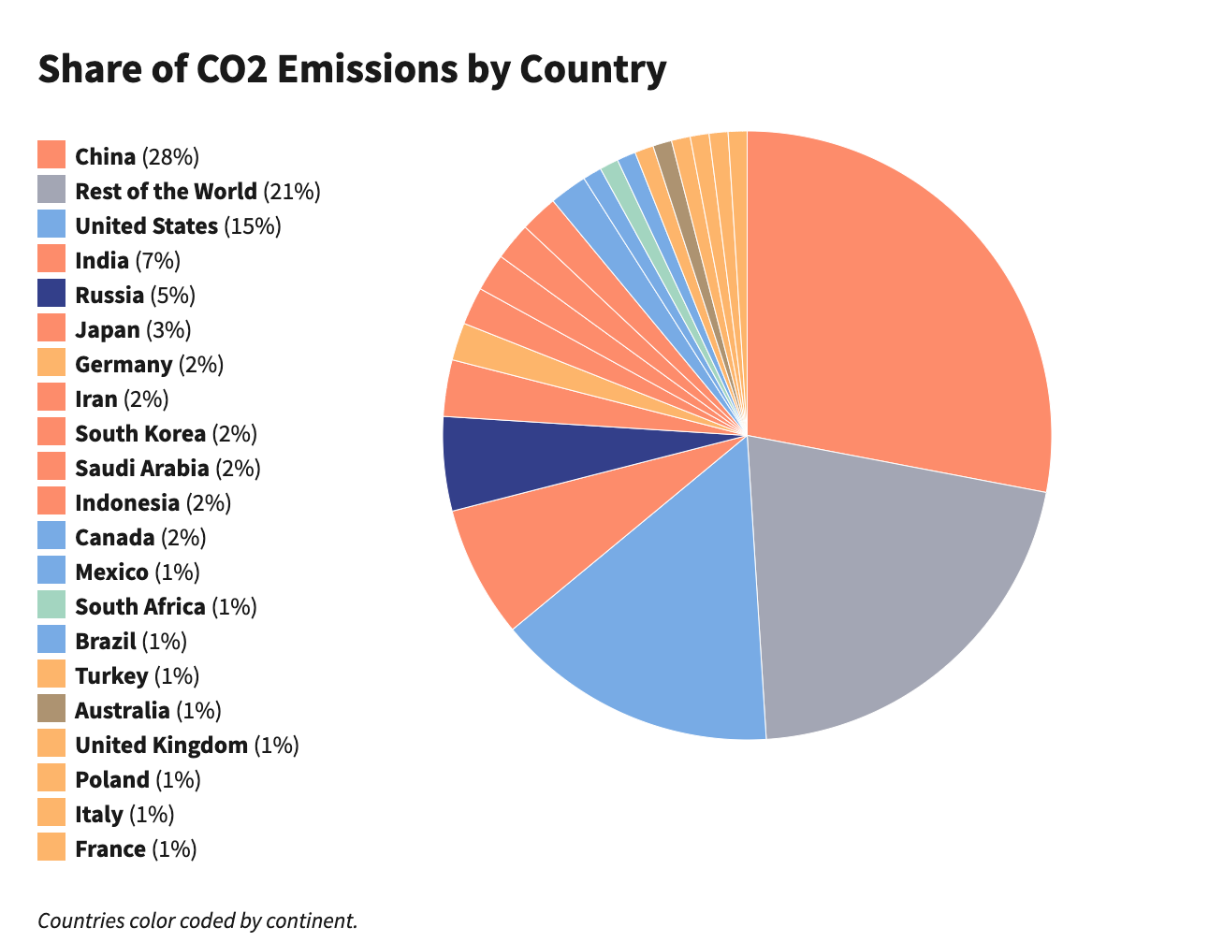
China is the largest emitter of carbon dioxide gas in the world, with 9.9 billion metric tons in 2019.
The U.S. is the second-largest emitter of CO2, with approximately 4.7 billion metric tons of carbon dioxide emissions in 2019.
India is the third-largest emitter of CO2 in the world; it produced about 2.3 billion metric tons of CO2 in 2019
Notes:
Pupils need to understand what sustainability means. before giving them the definitions ask pupils to suggest what they think sustainability means.

Slide 6
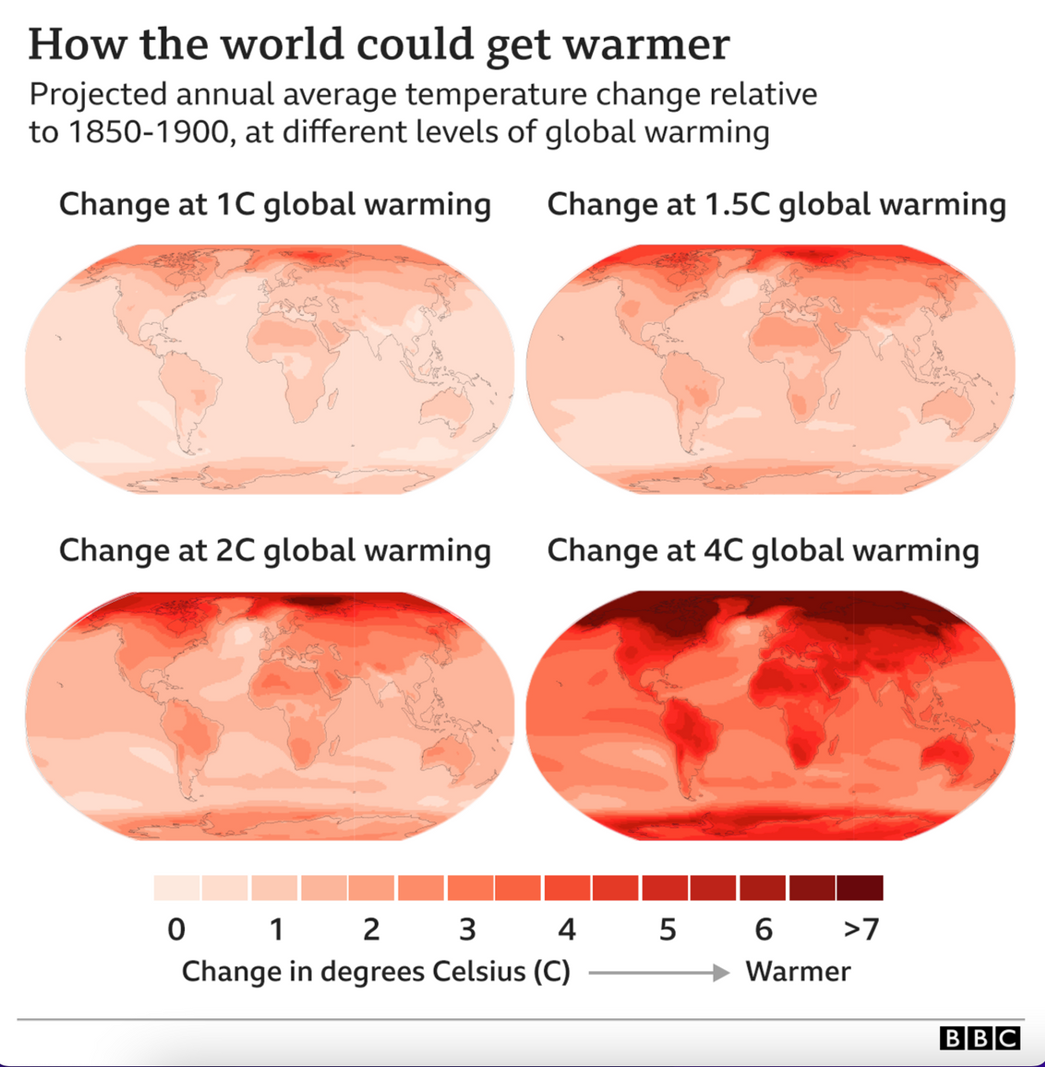

Impact of Climate Crisis
Frozen ground melting in places like Siberia, and greenhouse gases trapped for centuries will be released into the atmosphere, worsening climate change.
Notes:
Pupils need to understand what sustainability means. before giving them the definitions ask pupils to suggest what they think sustainability means.

Slide 7

5min video - to investigate the link to destruction of some of our most precious places
Notes:
Our food is the number one cause of deforestation, but it's often impossible to know that you're avoiding products that could be leading to this devastation of our planet.
The food we’re consuming right here in the UK directly links to the destruction of some of our most precious places. Watch our video (5mins) to learn the facts and reasons behind this and how our food system is driving this. (WWF)

Slide 8
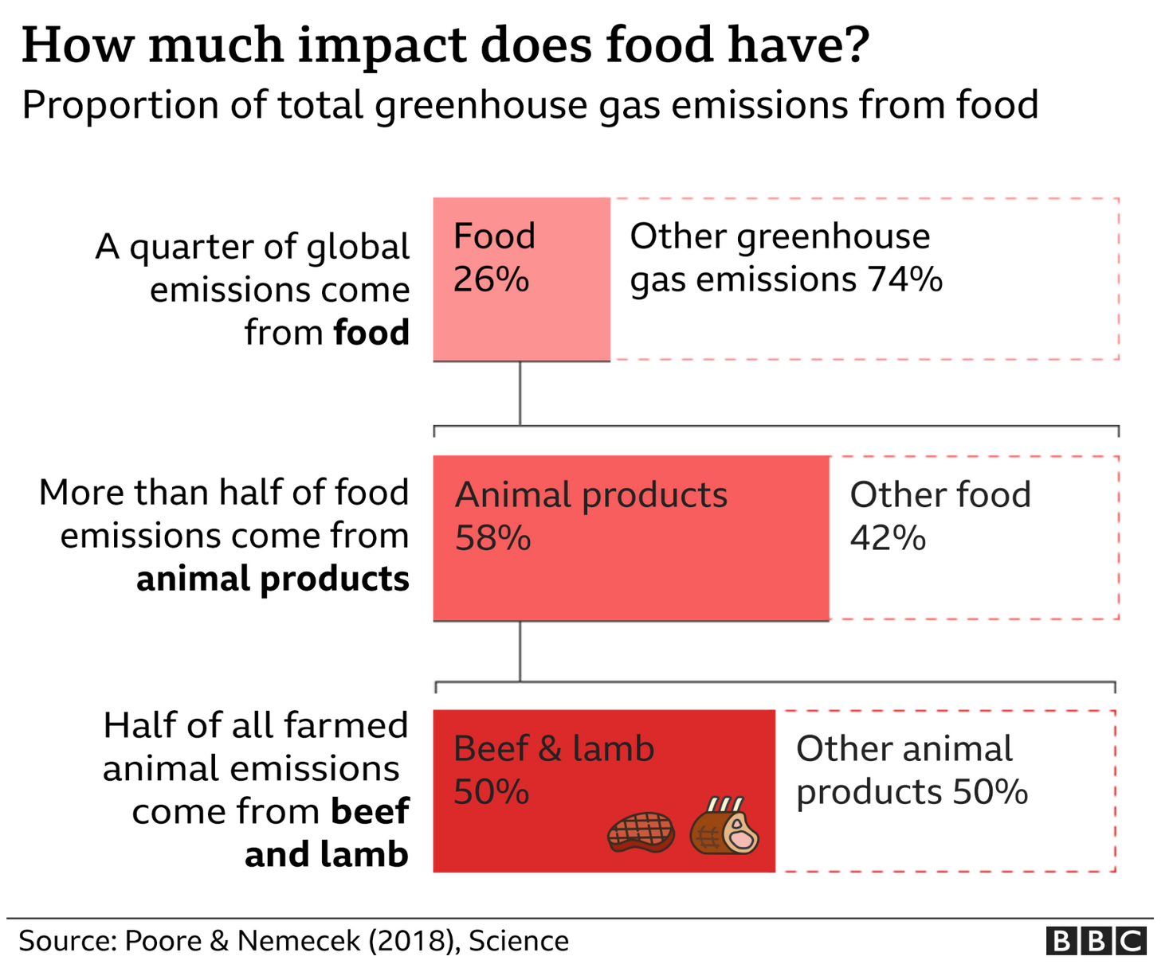
Notes:
Pupils need to understand what sustainability means. before giving them the definitions ask pupils to suggest what they think sustainability means.

Slide 9
Now watch Janne Utriainen, his wife and four daughters are tackling climate change in their way: they’ve moved to a remote location in northern Lapland, where they live off the land: they fish, hunt, pick berries, keep sheep and chickens and grow some vegetables.
People Vs Climate Change: Sustainable living on the Isle of Erraid | 5 News (3mins)
Notes:
Pupils need to understand what sustainability means. before giving them the definitions ask pupils to suggest what they think sustainability means.

Slide 10
'Survivor' Foods: 10 Foods to Take to a Desert Island
What would you choose and why?
Notes:
Pupils need to understand what sustainability means. before giving them the definitions ask pupils to suggest what they think sustainability means.

