Slide 1
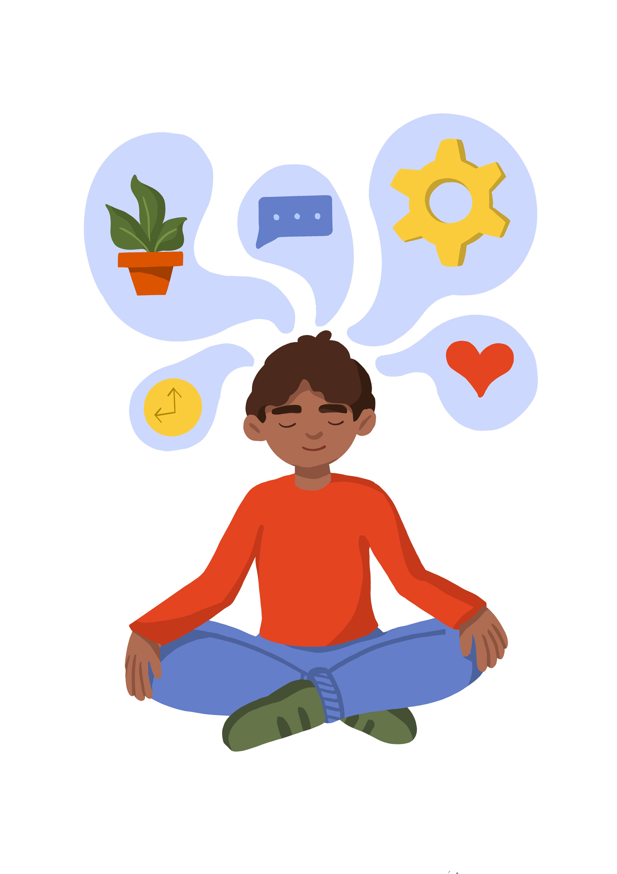
Mindfulness

Slide 2
Mindfulness: Paying more attention to the present moment can improve your mental wellbeing. This includes
your thoughts and feelings, your body and the world around you. Some people call this awareness "mindfulness".
Mindfulness can help you enjoy life more and understand yourself better. It can positively change the way you feel about life and how you approach challenges.
Notes:
Pupils need to understand what sustainability means. before giving them the definitions ask pupils to suggest what they think sustainability means.

Slide 3
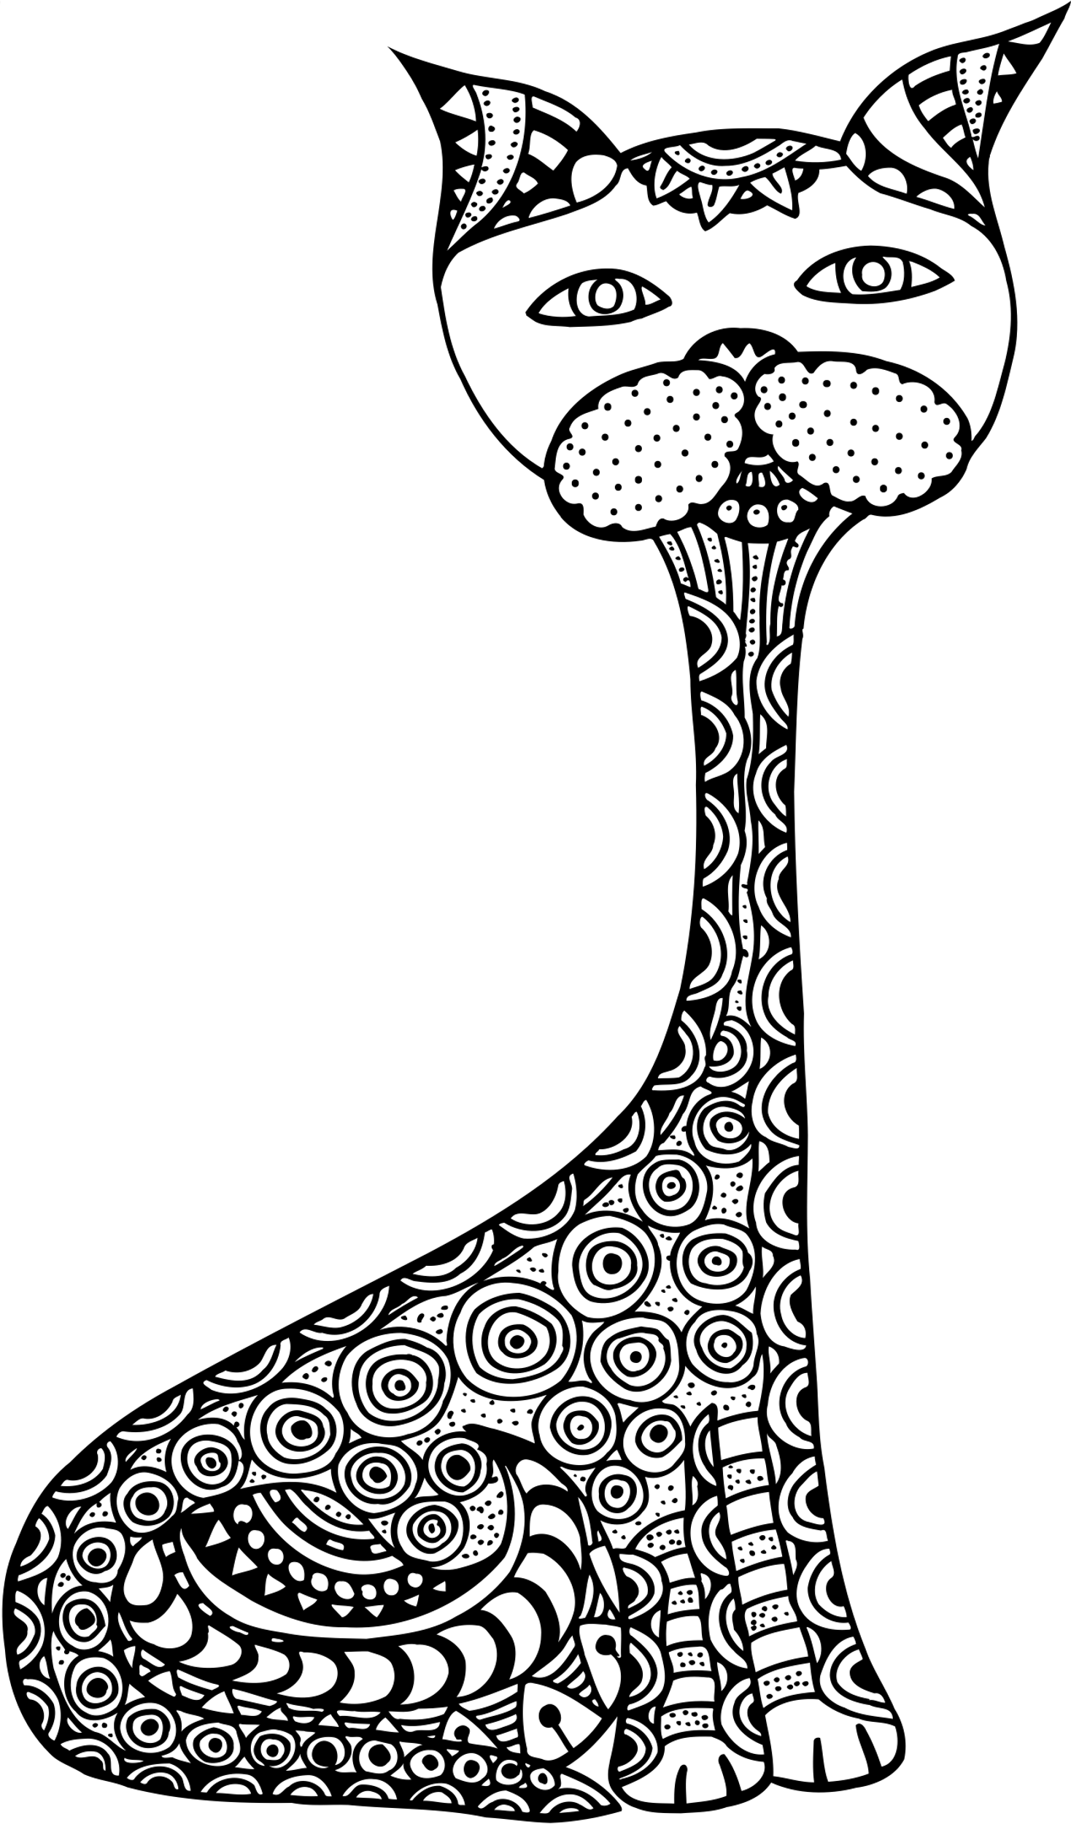



Slide 4
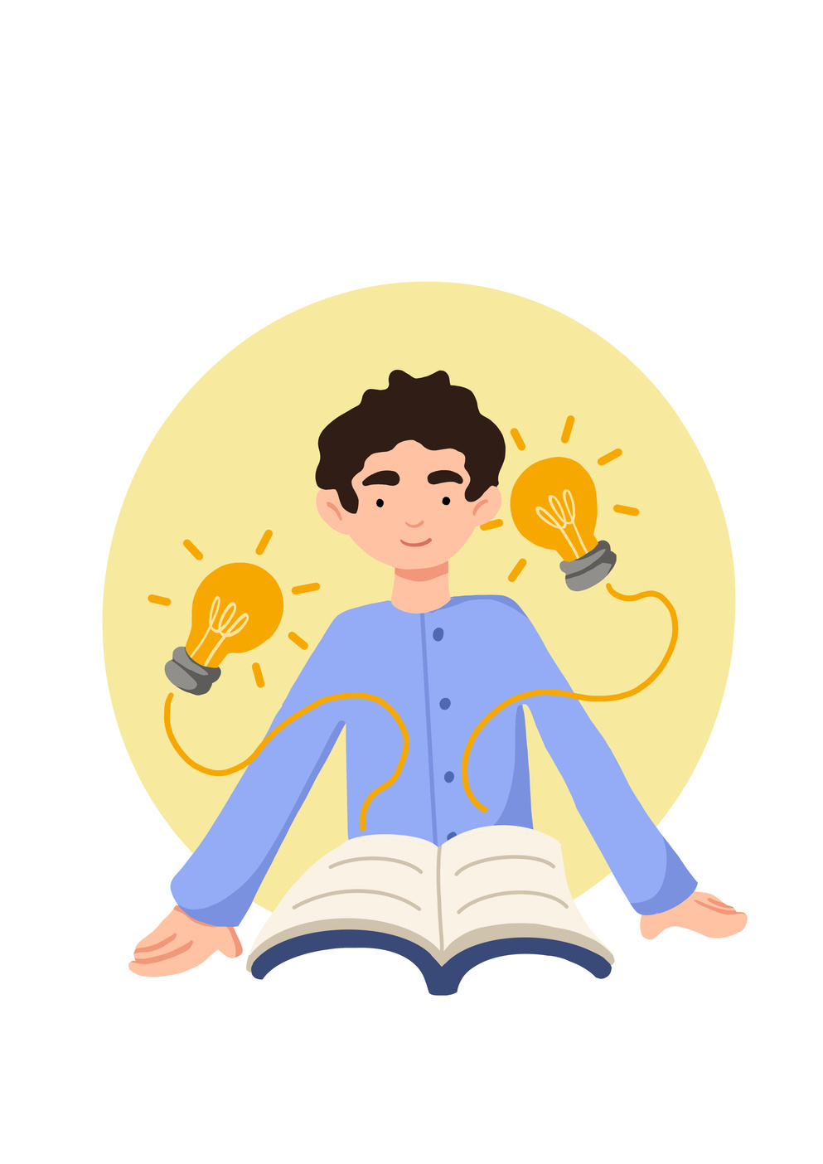
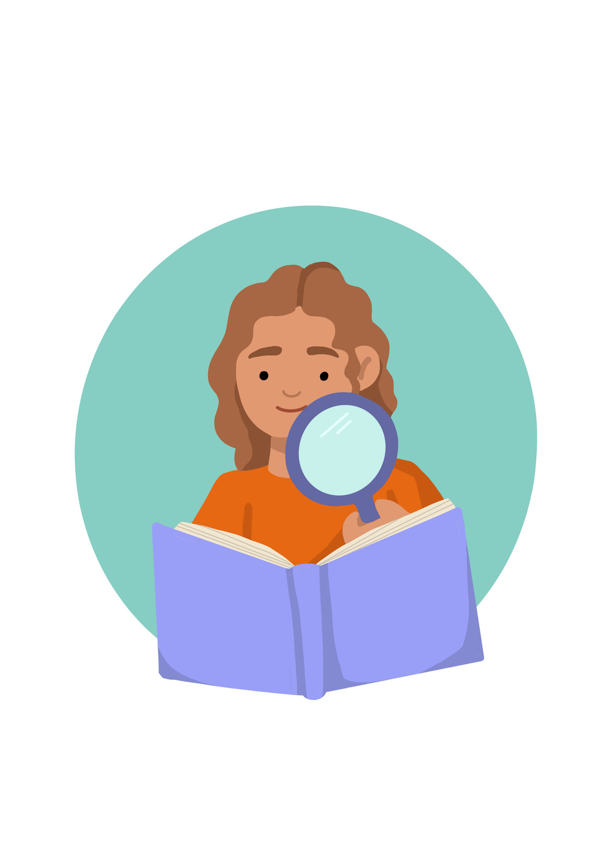


Lesson Objectives
Make use of simple self-care techniques, such as resting and spending time with family and taking up hobbies and interests. Explain factors which could contribute towards the mental health of an individual.
 | Curriculum Link: PSHE, Citizenship

Slide 5
Skills Objectives
Problem-solving - I can back my ideas with evidence.
 | Curriculum Link: PSHE, Citizenship

Slide 6
A reminder...........
Mental Health: Mental health is a set of malleable skills and beliefs which impact our thoughts, feelings and behaviour in relation to our social and emotional functioning.

Slide 7

Notes:
Talking Mental Health is an animation designed to help begin conversations about mental health in the classroom and beyond.
Introduced by Kate Middleton

Slide 8
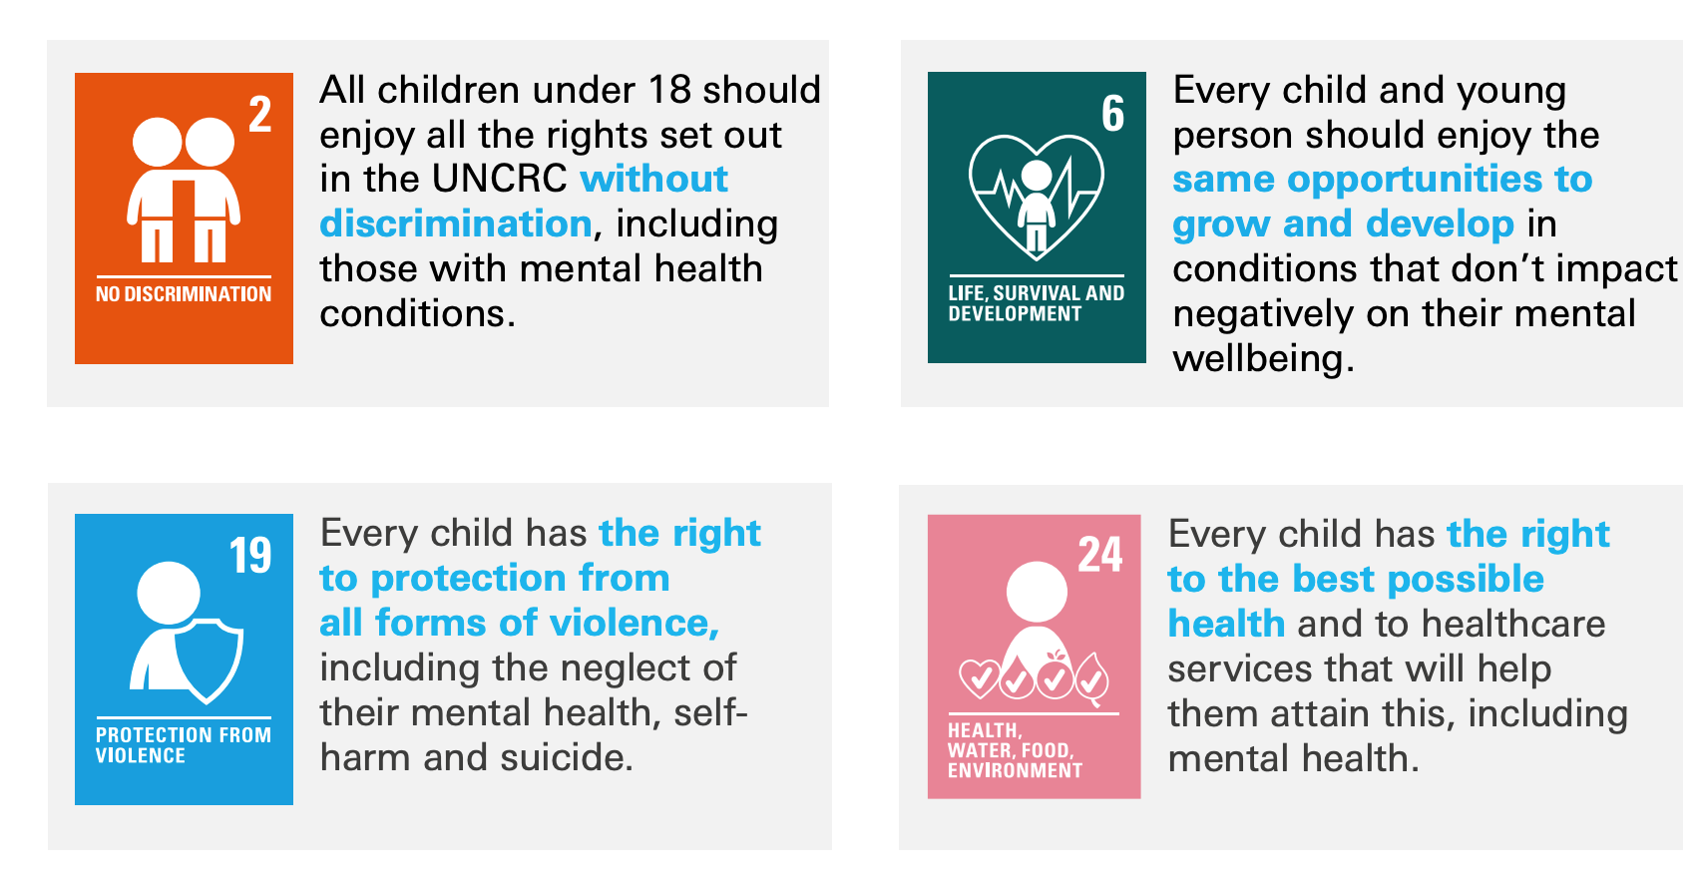
"Health - The Government must make sure you are able to be as healthy as you can be, and that you are able to get healthcare when you need it. You must also be able to get clean water, and healthy food and live in a healthy environment. The Government must also make sure you can get information about staying healthy (article 24).
Notes:
Start the lesson with some music in the background and ask the pupils to colour for about 5-10mins in silence.
After the initial - Why are we doing this?
It's important for pupils to understand how important for us to switch off. And how hard it is.

Slide 9
Social media and mobile devices may lead to psychological and physical issues, such as eyestrain and difficulty focusing on important tasks. They may also contribute to more serious health conditions, such as depression. The overuse of technology may have a more significant impact on developing children and teenagers.
Discuss factors that can contribute to the mental health of young people.
Create a guide for parents and pupils.
Notes:
Some experts think that connecting with peers online is less emotionally fulfilling than connecting in person. Research shows that teenagers who spend more time on social media also feel more isolated. It could be that kids who already feel isolated use social media more. But it could be that using social media actually makes kids feel isolated.
Another theory is that social media is bad for teenagers’ self-esteem. Seeing lots of perfect pictures online might make kids (especially girls) view themselves negatively. Feeling bad about themselves can lead to depression.
Social media can also cut into the time that kids spend on activities that make them feel good, like exercise and hobbies. Additionally, it can distract from important tasks like homework. Having to juggle those responsibilities can increase kids’ stress. Studies also suggest that using social media at night interferes with restful sleep for many teenagers.

Slide 10
Five kick-the-habit apps
Mute justmuteit.com The newest app in this genre, Mute tracks screen-time and pickups, and logs your “detox streaks” with an emphasis on celebrating the latter.
Moment inthemoment.io Moment sets daily limits on your usage, and will even try to force you off the device with a barrage of notifications if you choose that option.
Space space-app.com Space starts with a quiz to assign you a phone-user “type” (from Rabbit Hole Wanderer to Sticky Social Mitt) and then helps you set goals to change your habits.
Hold holdstudent.com Aimed at students, Hold tracks how much time they spend not using their phone, and converts that into points to be redeemed for real-world rewards.
Forest forestapp. cc Forest takes a different approach: starting the app plants a virtual tree, which grows for as long as you don’t quit the app (and thus use other ones), but dies if you exit.

Slide 11
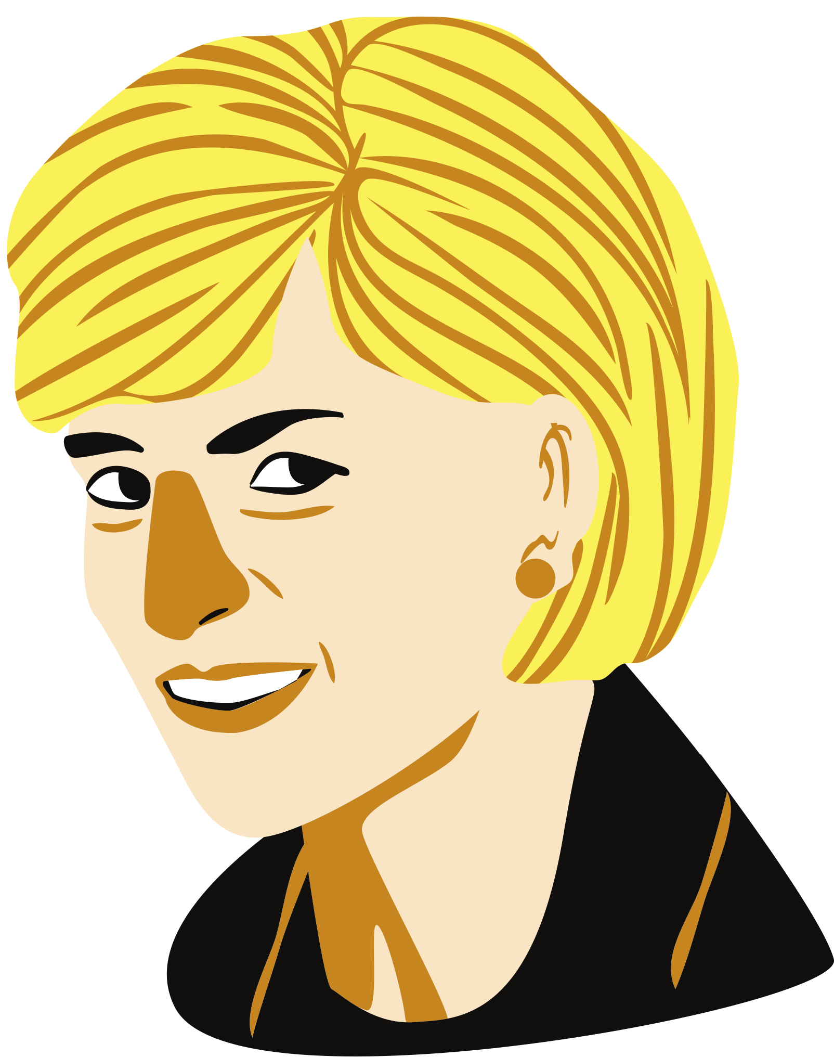
“Every one of us needs to show how much we care for each other and, in the process, care for ourselves.”
Princess Diana

Slide 12
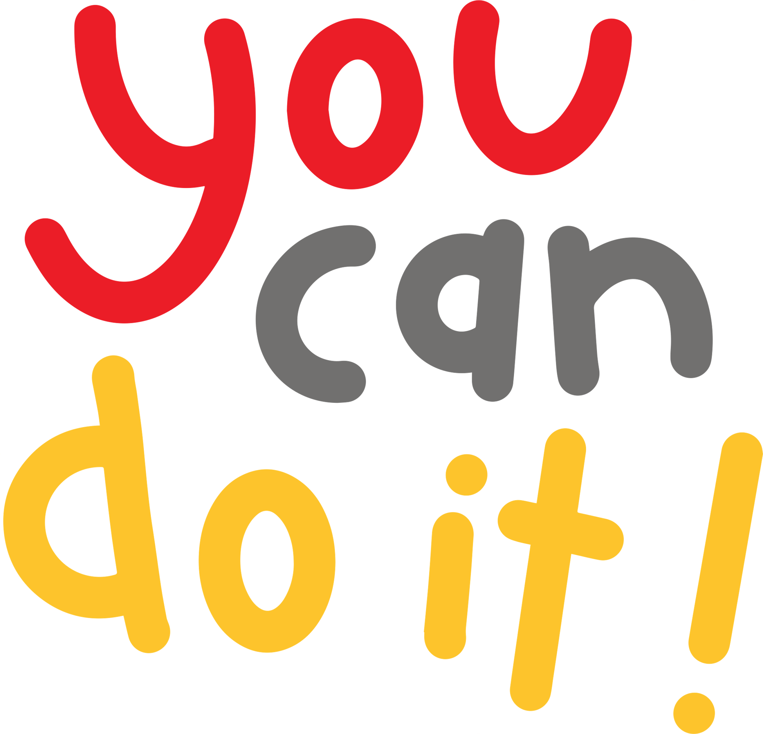
What will you change?
Notes:
Pupils need to understand what sustainability means. before giving them the definitions ask pupils to suggest what they think sustainability means.

Slide 13
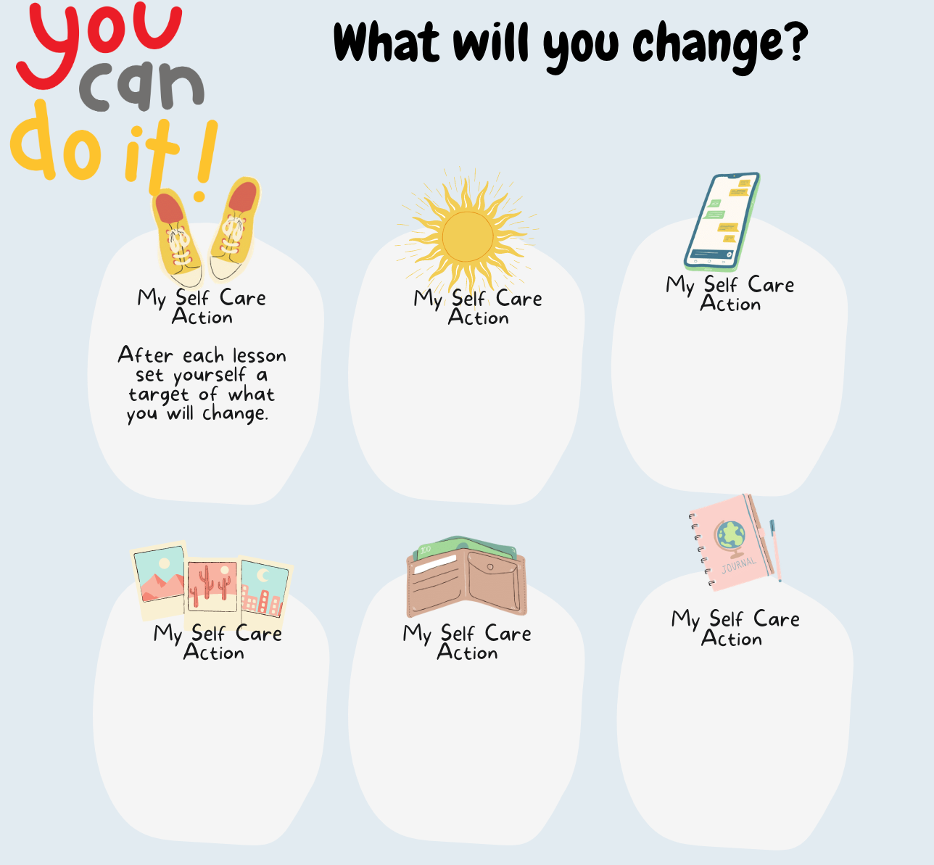

Slide 14
Know whom in school they should speak to if they are worried about their own or someone else’s mental wellbeing or ability to control their emotions (including issues arising online).
Please add details of whom to contact in school if they are concerned about themselves or others.
Notes:
Pupils need to understand what sustainability means. before giving them the definitions ask pupils to suggest what they think sustainability means.

Slide 15
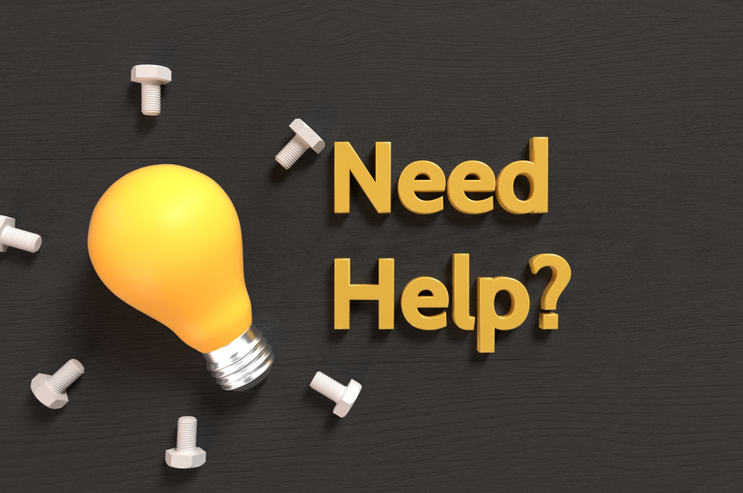
childline.org.uk - 0800 1111 (free 24hr) confidential listening
samaritans.org - 116 123 (free 24 hr) confidential listening
studentsagainstdepression.org - resources to move away from depression
youngminds.org.uk - mental health info and guidance
youthaccess.org.uk - young people’s info, advice and counselling
themix.org.uk - essential support for under 25s
If you have a mental health crisis and don't know whom to contact, call NHS 111. Call 111, free from any phone, 24 hours a day, seven days a week, and speak to a highly trained adviser supported by healthcare professionals.
Notes:
Pupils need to understand what sustainability means. before giving them the definitions ask pupils to suggest what they think sustainability means.

