Slide 1
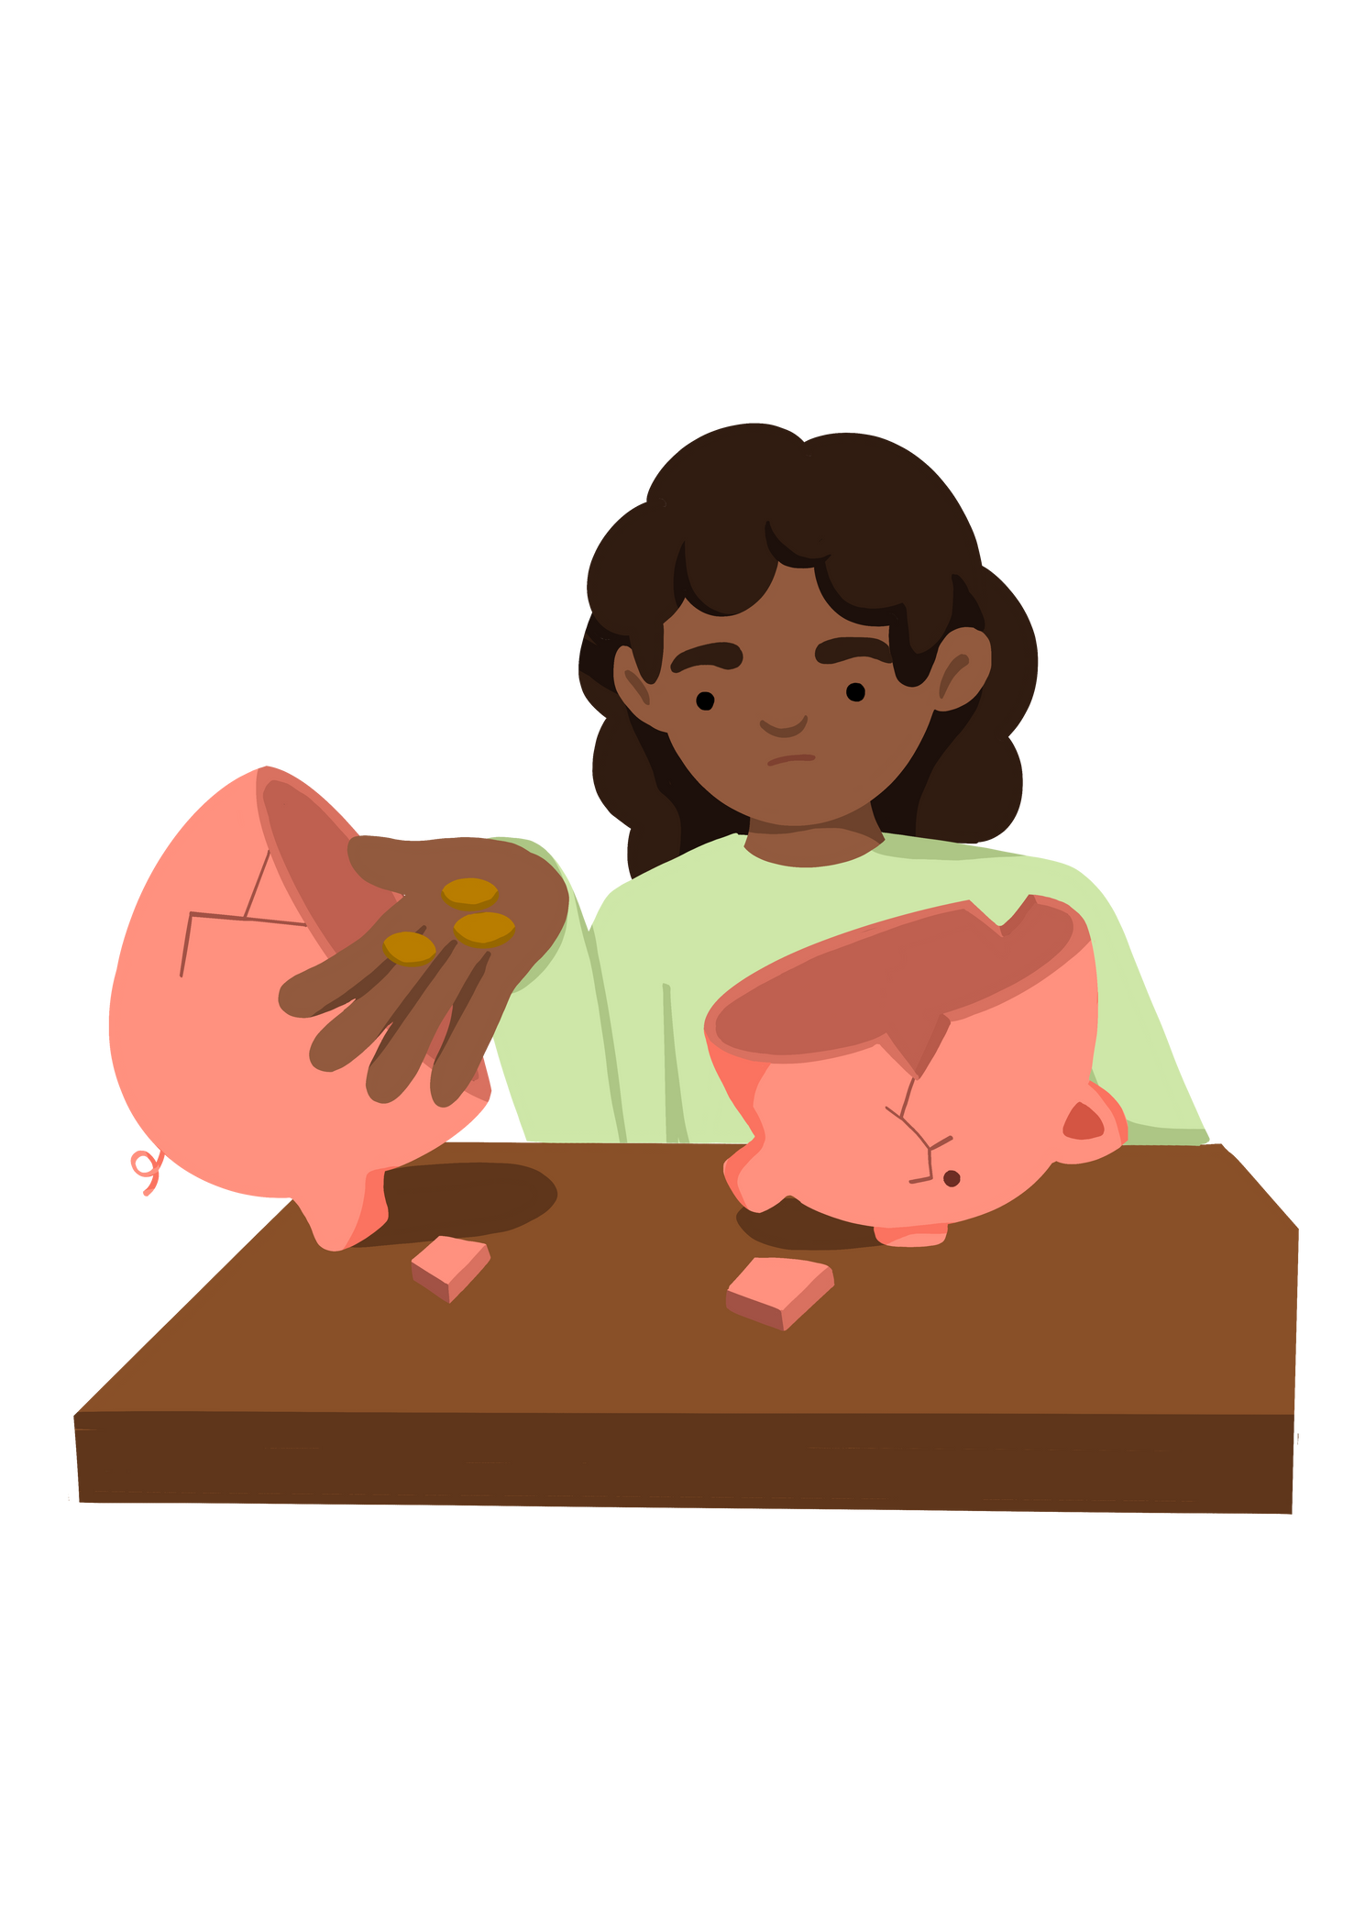
Key Stage 2
'What are different forms of poverty?'
Lesson 2
Notes:
Put the pupils in groups.
A3 Sheets of paper - Pens.
The objective of this activity is for the teams to remember as many items on the two slides as they can.
They can look at them in any order, however, they must only look at each slide twice and for a minute at a time (adjust this accordingly for your class).
The teams must not write anything down when the slides are being shown.
Discussion points:
After one view, encourage your teams to think strategically & discuss these points:
How can we work as a team to remember all the items?
Are there any methods we can use to remember all the items?
When the activity is complete, ask them:
What type of communication was used in attempting to solve the problem?
Did we communicate well as a team? Why? Why not?

Slide 2


Activity 2 What are the different forms of poverty?
Lesson Objective To be able to quote some other forms of poverty | Skills Objectives
Communication - Young people can present information to others
Communication - Young people can use their voices to improve the presentation
 | National Curriculum: PSHE
Notes:
Put the pupils in groups.
A3 Sheets of paper - Pens.
The objective of this activity is for the teams to remember as many items on the two slides as they can.
They can look at them in any order, however, they must only look at each slide twice and for a minute at a time (adjust this accordingly for your class).
The teams must not write anything down when the slides are being shown.
Discussion points:
After one view, encourage your teams to think strategically & discuss these points:
How can we work as a team to remember all the items?
Are there any methods we can use to remember all the items?
When the activity is complete, ask them:
What type of communication was used in attempting to solve the problem?
Did we communicate well as a team? Why? Why not?

Slide 3
Poverty or not?
Ali's story:
Ali is nine, wearing a big grin and a jumper two sizes too big. He lives in a small flat on a busy main road with his mum and his younger brother, who he shares a single bed with. When the motorbikes and sirens keep him and his brother awake, he opens the window and tells them to be quiet.
His mum works part time in Lidl whilst studying at university and Ali is at primary school. Ali's dream is to be a professional cricket player.
This flat is Ali’s fifth home. And he is due to move again. He doesn’t know why or where. Neither does his mum. They don't want to move but they have no choice. Ali worries about being too far from school, being made homeless, having a landlord that doesn't like them.
Notes:
Put the pupils in groups.
A3 Sheets of paper - Pens.
The objective of this activity is for the teams to remember as many items on the two slides as they can.
They can look at them in any order, however, they must only look at each slide twice and for a minute at a time (adjust this accordingly for your class).
The teams must not write anything down when the slides are being shown.
Discussion points:
After one view, encourage your teams to think strategically & discuss these points:
How can we work as a team to remember all the items?
Are there any methods we can use to remember all the items?
When the activity is complete, ask them:
What type of communication was used in attempting to solve the problem?
Did we communicate well as a team? Why? Why not?

Slide 4
Poverty or not?
Andrew's story:
Andrew is living in a house with his brother and sister. His mum works and dad stopped working three years ago before Andrew started secondary school. Recently, Andrew has been given homework online but he has not got access to a computer at home because his parents cannot afford one. He does not want to tell his teacher as he feels everyone has a computer these days, and thinks his teacher won't understand.
Notes:
Put the pupils in groups.
A3 Sheets of paper - Pens.
The objective of this activity is for the teams to remember as many items on the two slides as they can.
They can look at them in any order, however, they must only look at each slide twice and for a minute at a time (adjust this accordingly for your class).
The teams must not write anything down when the slides are being shown.
Discussion points:
After one view, encourage your teams to think strategically & discuss these points:
How can we work as a team to remember all the items?
Are there any methods we can use to remember all the items?
When the activity is complete, ask them:
What type of communication was used in attempting to solve the problem?
Did we communicate well as a team? Why? Why not?

Slide 5
Poverty or not?
Sarah's story:
Sarah's family come from another country, and they do not speak English fluently, but both of them work. Sarah is living in an appartment and she has her own bedroom. She is doing well in school, but often struggles with reading, something her parents cannot help her with, although they listen to her reading. She gets help from her teachers to practise reading quickly. When she grows up, Sarah would like to become a veterinarian.
Notes:
Put the pupils in groups.
A3 Sheets of paper - Pens.
The objective of this activity is for the teams to remember as many items on the two slides as they can.
They can look at them in any order, however, they must only look at each slide twice and for a minute at a time (adjust this accordingly for your class).
The teams must not write anything down when the slides are being shown.
Discussion points:
After one view, encourage your teams to think strategically & discuss these points:
How can we work as a team to remember all the items?
Are there any methods we can use to remember all the items?
When the activity is complete, ask them:
What type of communication was used in attempting to solve the problem?
Did we communicate well as a team? Why? Why not?

Slide 6

Different factors can lead to poverty, and one person facing precarity may be experiencing different difficulties than another.
In addition, poverty can take different forms. Below is a list of certain types of poverty. Can you research and work out what they mean?
  Financial poverty
  Educational poverty
  Digital poverty
  Homelessness
Notes:
Put the pupils in groups.
A3 Sheets of paper - Pens.
The objective of this activity is for the teams to remember as many items on the two slides as they can.
They can look at them in any order, however, they must only look at each slide twice and for a minute at a time (adjust this accordingly for your class).
The teams must not write anything down when the slides are being shown.
Discussion points:
After one view, encourage your teams to think strategically & discuss these points:
How can we work as a team to remember all the items?
Are there any methods we can use to remember all the items?
When the activity is complete, ask them:
What type of communication was used in attempting to solve the problem?
Did we communicate well as a team? Why? Why not?

Slide 7
Pause and consider the terms you research with the stories you've read.
Can you think of other difficulties children facing poverty might be experiencing?
Notes:
Put the pupils in groups.
A3 Sheets of paper - Pens.
The objective of this activity is for the teams to remember as many items on the two slides as they can.
They can look at them in any order, however, they must only look at each slide twice and for a minute at a time (adjust this accordingly for your class).
The teams must not write anything down when the slides are being shown.
Discussion points:
After one view, encourage your teams to think strategically & discuss these points:
How can we work as a team to remember all the items?
Are there any methods we can use to remember all the items?
When the activity is complete, ask them:
What type of communication was used in attempting to solve the problem?
Did we communicate well as a team? Why? Why not?

