Slide 1
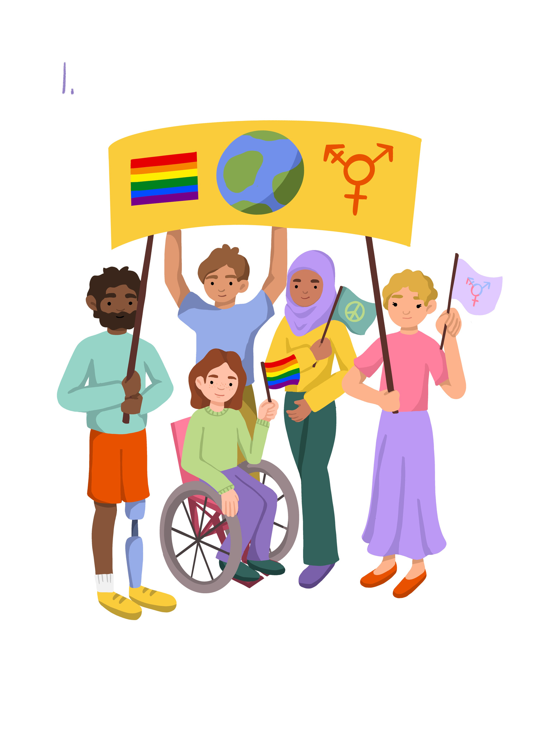
Inclusion and Diversity
Lesson 2

Slide 2

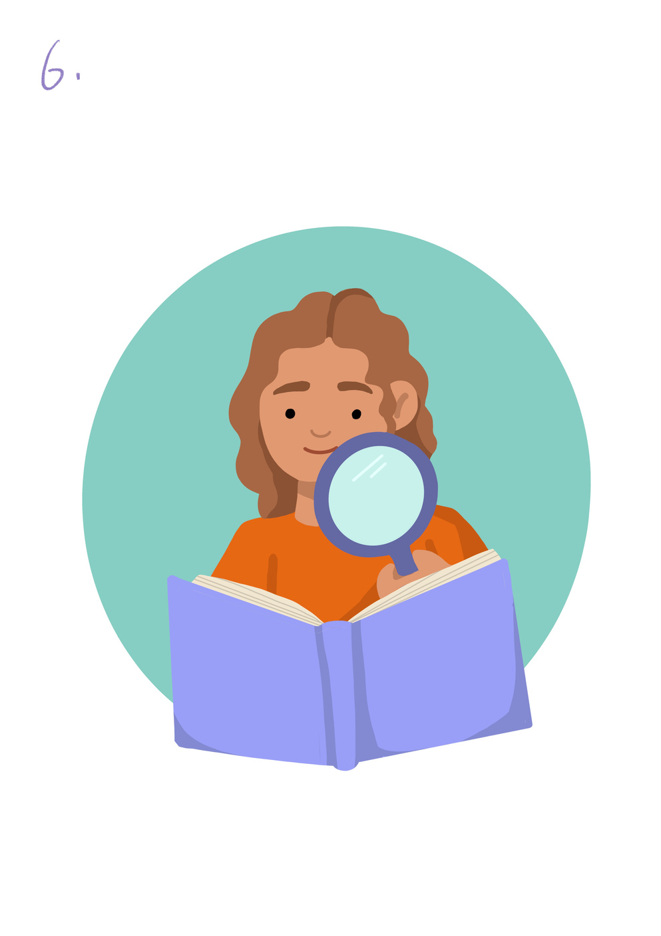
Learning Objective To understand that diversity is present outside in the natural world. | Skills Objectives
Outcome: Young people are learning to see diversity in the natural world by looking at the shapes, colours, sizes and textures of vegetables of the same variety and through animals and their habitats. | Outcome: Young people are learning to see diversity in the natural world by looking at the shapes, colours, sizes and textures of vegetables of the same variety and through animals and their habitats.
Problem-Solving - When solving problems, I can identify questions to resolve the issue.
 | National Curriculum: Science Identify and name a variety of common animals including fish, amphibians, reptiles, birds and mammals (Year 1) Identify that most living things live in habitats to which they are suited and describe how different habitats provide for the basic needs of different kinds of animals and plants, and how they depend on each other (Year 2)

Slide 3
What Diversity can we see outside?
Notes:
Introduction: The aim of the session is for pupils to learn the term diversity and explore what it means. In the way we plan this session, pupils can start by exploring 'diversity' in terms of our physical features and where we come from. The term 'diversity' can be looked at in relation to 'ethnicity'. You can start by asking pupils if they know how many ethnicities do we have in our schools? Explain that ethnicities can be about the country someone comes from, but also the culture, or a particular faith.

Slide 4
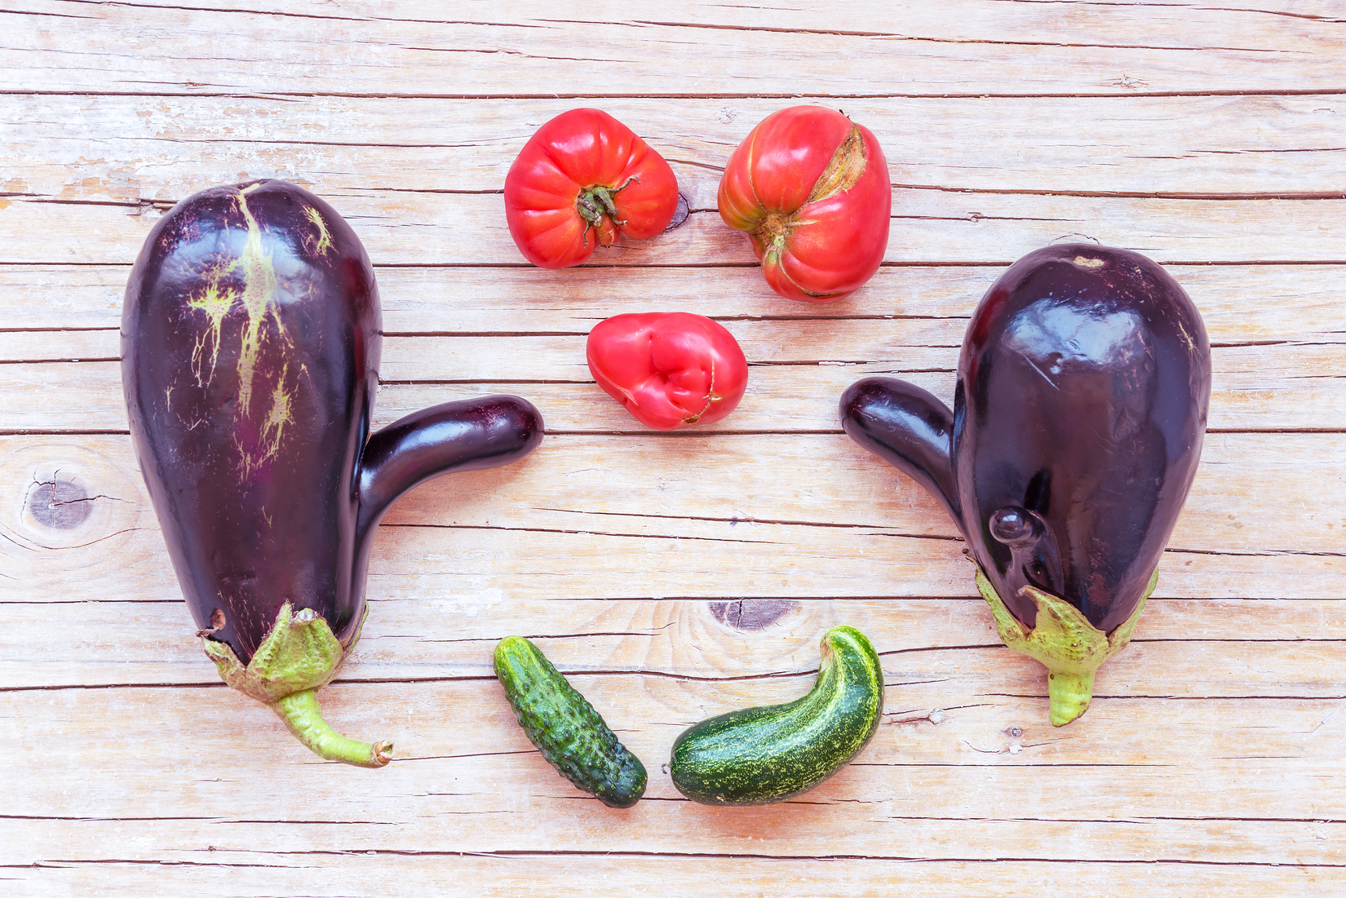
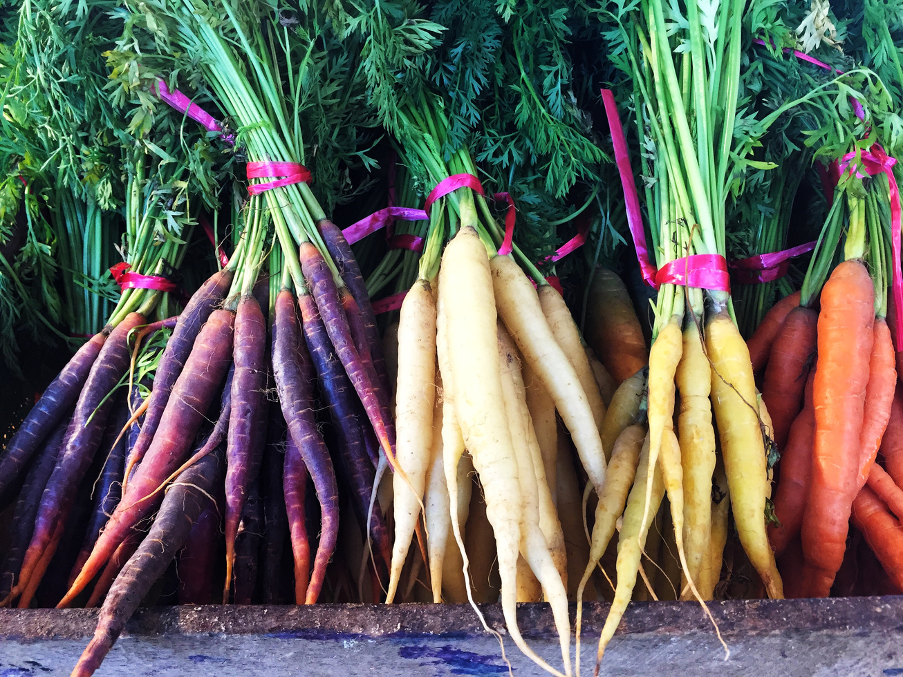
Exploring diversity is vegetables
Notes:
Remind pupils diversity means differences.

Slide 5
By working in pairs, pupils should record
  Name of vegetable
  size/length (use a ruler for this)
  colour, shape, texture
  taste (some could be tasted such as carrots and peppers, the teacher could prepare some bits for children to try)
  any recipe it is used for and what other vegetables are mixed with it.
Notes:
pupils will become experts at describing different vegetables by measuring, touching and grouping them. In the circle, you can share some of the vegetables and ask pupils to start feeling them and passing them around. Can they think of adjectives to describe those wonky vegetables?
Give them some time to explore what you have brought and then come up together with a list of words that can be used to describe them. Make a list on a flip chart/ whiteboard. .

Slide 6
'What diversity have you found in vegetables?'
Notes:
When pupils have completed their tables, gather up the resources and do a plenary. Ask pupils to share interesting facts they have learnt, and things they have liked/ disliked. Share some questions such as:
'What diversity have you found in vegetables?'
'Can you think of other ways diversity can be seen in plants/animals?'
Share the plenary from the slides that give examples of diversity found in animals and their habitats. Ask pupils if they would like to research further about the diversity found in habitats?

