Slide 1
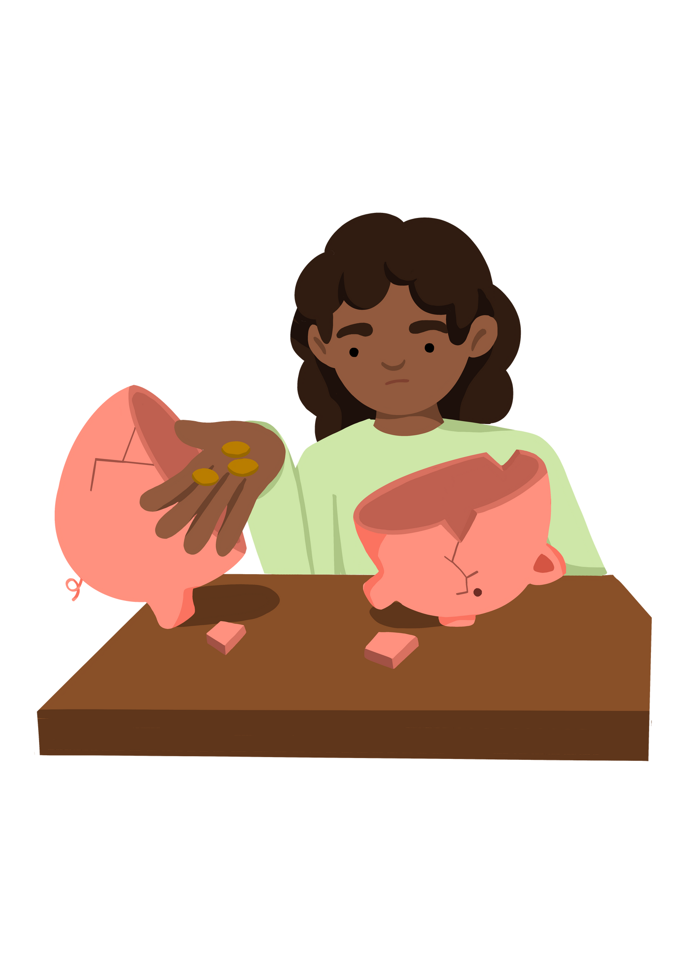

Key Stage 1
What can someone in poverty person need?
Lesson 2
Notes:
Put the pupils in groups.
A3 Sheets of paper - Pens.
The objective of this activity is for the teams to remember as many items on the two slides as they can.
They can look at them in any order, however, they must only look at each slide twice and for a minute at a time (adjust this accordingly for your class).
The teams must not write anything down when the slides are being shown.
Discussion points:
After one view, encourage your teams to think strategically & discuss these points:
How can we work as a team to remember all the items?
Are there any methods we can use to remember all the items?
When the activity is complete, ask them:
What type of communication was used in attempting to solve the problem?
Did we communicate well as a team? Why? Why not?

Slide 2



Learning Objective To explain what a poor person might need. | Skills Objectives
Teamwork - I can show confidence in working with others.
Communication - I can participate in discussions, debates and presentations.
 | National Curriculum: PSHE to know that people and living things have rights (rights and responsibilities)
Notes:
Put the pupils in groups.
A3 Sheets of paper - Pens.
The objective of this activity is for the teams to remember as many items on the two slides as they can.
They can look at them in any order, however, they must only look at each slide twice and for a minute at a time (adjust this accordingly for your class).
The teams must not write anything down when the slides are being shown.
Discussion points:
After one view, encourage your teams to think strategically & discuss these points:
How can we work as a team to remember all the items?
Are there any methods we can use to remember all the items?
When the activity is complete, ask them:
What type of communication was used in attempting to solve the problem?
Did we communicate well as a team? Why? Why not?

Slide 3
Activity 2
Enquiry question: What does a poor person need?
Learning objective: To be able to identify what a poor person might need.
Notes:
Put the pupils in groups.
A3 Sheets of paper - Pens.
The objective of this activity is for the teams to remember as many items on the two slides as they can.
They can look at them in any order, however, they must only look at each slide twice and for a minute at a time (adjust this accordingly for your class).
The teams must not write anything down when the slides are being shown.
Discussion points:
After one view, encourage your teams to think strategically & discuss these points:
How can we work as a team to remember all the items?
Are there any methods we can use to remember all the items?
When the activity is complete, ask them:
What type of communication was used in attempting to solve the problem?
Did we communicate well as a team? Why? Why not?

Slide 4
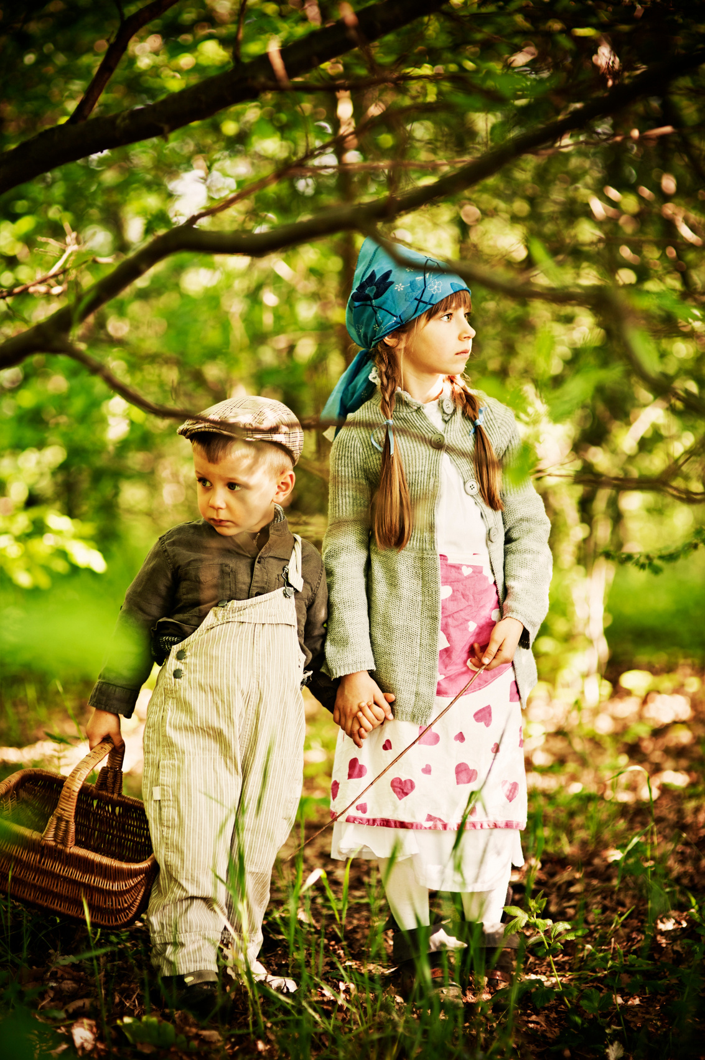

Hansel and Gretel
Listen to the part of the story describing the poverty experienced by the family of Hansel and Gretel.
What do you think their parents feel like or worry about?
Notes:
Put the pupils in groups.
A3 Sheets of paper - Pens.
The objective of this activity is for the teams to remember as many items on the two slides as they can.
They can look at them in any order, however, they must only look at each slide twice and for a minute at a time (adjust this accordingly for your class).
The teams must not write anything down when the slides are being shown.
Discussion points:
After one view, encourage your teams to think strategically & discuss these points:
How can we work as a team to remember all the items?
Are there any methods we can use to remember all the items?
When the activity is complete, ask them:
What type of communication was used in attempting to solve the problem?
Did we communicate well as a team? Why? Why not?

Slide 5








Find items a poor person might need and explain why.
Notes:
Put the pupils in groups.
A3 Sheets of paper - Pens.
The objective of this activity is for the teams to remember as many items on the two slides as they can.
They can look at them in any order, however, they must only look at each slide twice and for a minute at a time (adjust this accordingly for your class).
The teams must not write anything down when the slides are being shown.
Discussion points:
After one view, encourage your teams to think strategically & discuss these points:
How can we work as a team to remember all the items?
Are there any methods we can use to remember all the items?
When the activity is complete, ask them:
What type of communication was used in attempting to solve the problem?
Did we communicate well as a team? Why? Why not?

Slide 6

Hansel and Gretel are on a mission. They've heard there is a poor old lady in a nearby town. They have decided to bring some items to her, but they are not sure what to take?
Can you help them?
Notes:
Put the pupils in groups.
A3 Sheets of paper - Pens.
The objective of this activity is for the teams to remember as many items on the two slides as they can.
They can look at them in any order, however, they must only look at each slide twice and for a minute at a time (adjust this accordingly for your class).
The teams must not write anything down when the slides are being shown.
Discussion points:
After one view, encourage your teams to think strategically & discuss these points:
How can we work as a team to remember all the items?
Are there any methods we can use to remember all the items?
When the activity is complete, ask them:
What type of communication was used in attempting to solve the problem?
Did we communicate well as a team? Why? Why not?

Slide 7


With your partners, discuss which items Hansel and Gretel should put in their basket to help the poor lady.
Notes:
Put the pupils in groups.
A3 Sheets of paper - Pens.
The objective of this activity is for the teams to remember as many items on the two slides as they can.
They can look at them in any order, however, they must only look at each slide twice and for a minute at a time (adjust this accordingly for your class).
The teams must not write anything down when the slides are being shown.
Discussion points:
After one view, encourage your teams to think strategically & discuss these points:
How can we work as a team to remember all the items?
Are there any methods we can use to remember all the items?
When the activity is complete, ask them:
What type of communication was used in attempting to solve the problem?
Did we communicate well as a team? Why? Why not?

Slide 8




















Which item did you choose and why?
Notes:
Put the pupils in groups.
A3 Sheets of paper - Pens.
The objective of this activity is for the teams to remember as many items on the two slides as they can.
They can look at them in any order, however, they must only look at each slide twice and for a minute at a time (adjust this accordingly for your class).
The teams must not write anything down when the slides are being shown.
Discussion points:
After one view, encourage your teams to think strategically & discuss these points:
How can we work as a team to remember all the items?
Are there any methods we can use to remember all the items?
When the activity is complete, ask them:
What type of communication was used in attempting to solve the problem?
Did we communicate well as a team? Why? Why not?

Slide 9

What have you found out about poverty during your discussions?
Have you found the answers to your previous questions?
What value Hansel and Gretel have shown by helping the poor lady?
Notes:
Put the pupils in groups.
A3 Sheets of paper - Pens.
The objective of this activity is for the teams to remember as many items on the two slides as they can.
They can look at them in any order, however, they must only look at each slide twice and for a minute at a time (adjust this accordingly for your class).
The teams must not write anything down when the slides are being shown.
Discussion points:
After one view, encourage your teams to think strategically & discuss these points:
How can we work as a team to remember all the items?
Are there any methods we can use to remember all the items?
When the activity is complete, ask them:
What type of communication was used in attempting to solve the problem?
Did we communicate well as a team? Why? Why not?

