Slide 1

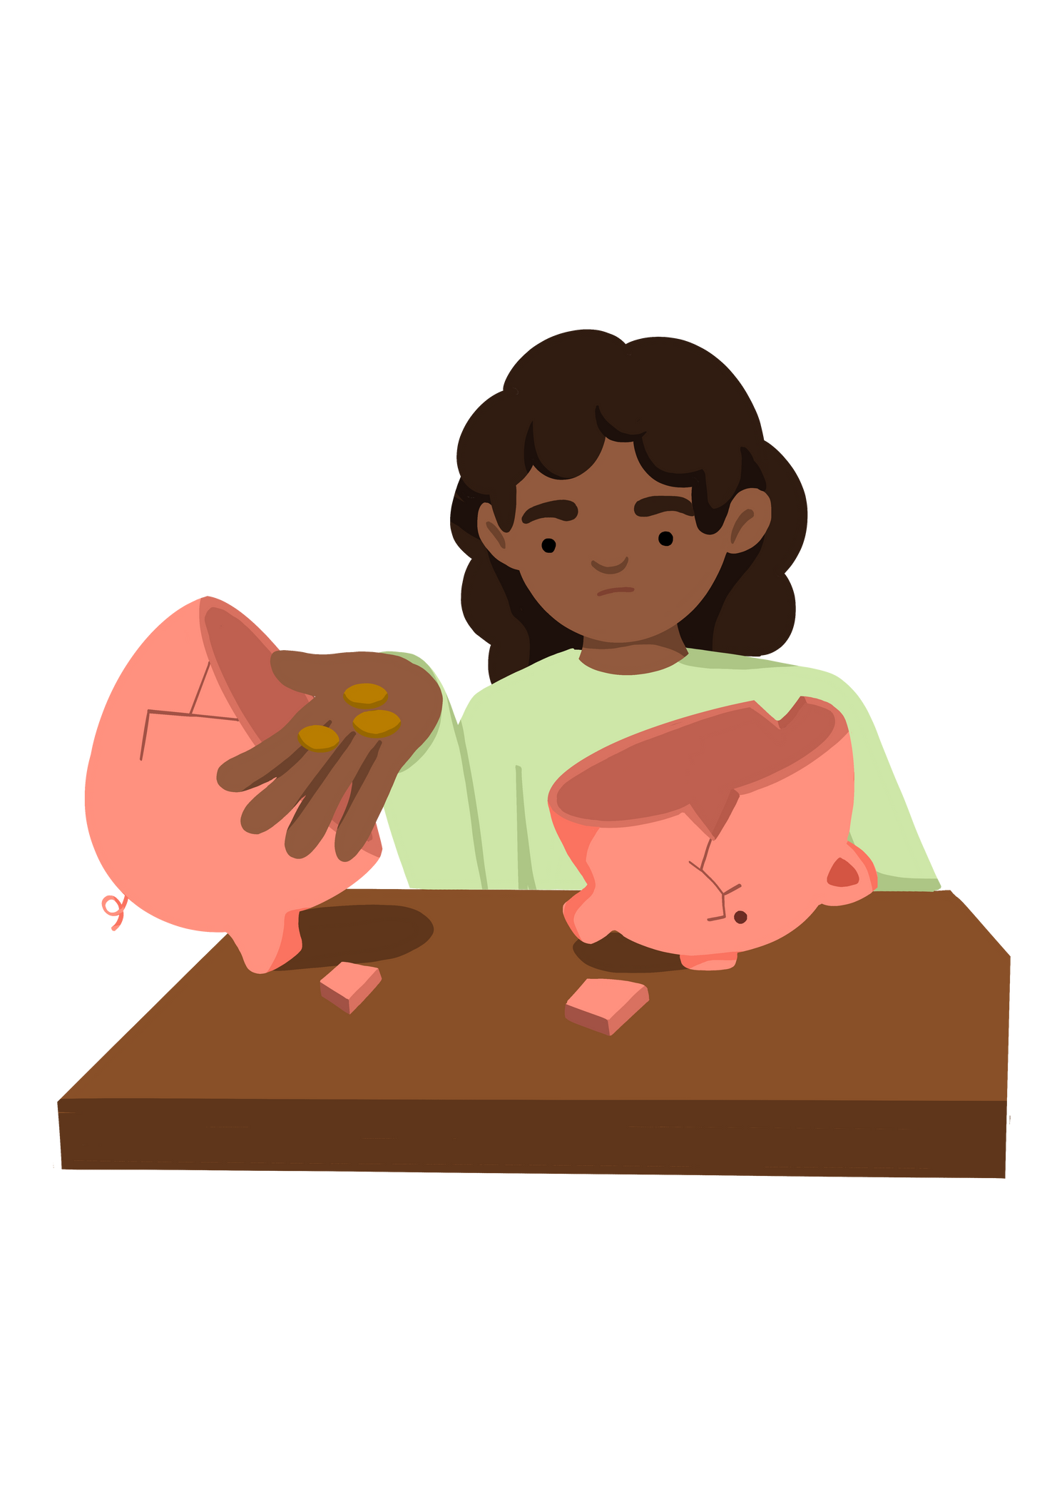
Understand the Meaning of Poverty
Notes:
Put the pupils in groups.
A3 Sheets of paper - Pens.
The objective of this activity is for the teams to remember as many items on the two slides as they can.
They can look at them in any order, however, they must only look at each slide twice and for a minute at a time (adjust this accordingly for your class).
The teams must not write anything down when the slides are being shown.
Discussion points:
After one view, encourage your teams to think strategically & discuss these points:
How can we work as a team to remember all the items?
Are there any methods we can use to remember all the items?
When the activity is complete, ask them:
What type of communication was used in attempting to solve the problem?
Did we communicate well as a team? Why? Why not?

Slide 2



Understand the Meaning of Poverty
Lesson Objectives | Lesson Objectives | Skills Objectives
Young people to understand the meaning of poverty. | Young people to understand the meaning of poverty. | I can recognise and develop empathy skills. When solving problems, I can carry out the research needed to back my viewpoints.
 | National Curriculum: Citizenship, PSHE, English, IT
Notes:
Put the pupils in groups.
A3 Sheets of paper - Pens.
The objective of this activity is for the teams to remember as many items on the two slides as they can.
They can look at them in any order, however, they must only look at each slide twice and for a minute at a time (adjust this accordingly for your class).
The teams must not write anything down when the slides are being shown.
Discussion points:
After one view, encourage your teams to think strategically & discuss these points:
How can we work as a team to remember all the items?
Are there any methods we can use to remember all the items?
When the activity is complete, ask them:
What type of communication was used in attempting to solve the problem?
Did we communicate well as a team? Why? Why not?

Slide 3
Listening Vs Hearing
Hearing is the process of perceiving sound.
Listening is paying attention to what is being said.
Notes:
Put the pupils in groups.
A3 Sheets of paper - Pens.
The objective of this activity is for the teams to remember as many items on the two slides as they can.
They can look at them in any order, however, they must only look at each slide twice and for a minute at a time (adjust this accordingly for your class).
The teams must not write anything down when the slides are being shown.
Discussion points:
After one view, encourage your teams to think strategically & discuss these points:
How can we work as a team to remember all the items?
Are there any methods we can use to remember all the items?
When the activity is complete, ask them:
What type of communication was used in attempting to solve the problem?
Did we communicate well as a team? Why? Why not?

Slide 4

Notes:
Put the pupils in groups.
A3 Sheets of paper - Pens.
The objective of this activity is for the teams to remember as many items on the two slides as they can.
They can look at them in any order, however, they must only look at each slide twice and for a minute at a time (adjust this accordingly for your class).
The teams must not write anything down when the slides are being shown.
Discussion points:
After one view, encourage your teams to think strategically & discuss these points:
How can we work as a team to remember all the items?
Are there any methods we can use to remember all the items?
When the activity is complete, ask them:
What type of communication was used in attempting to solve the problem?
Did we communicate well as a team? Why? Why not?

Slide 5



What is poverty?
Notes:
Put the pupils in groups.
A3 Sheets of paper - Pens.
The objective of this activity is for the teams to remember as many items on the two slides as they can.
They can look at them in any order, however, they must only look at each slide twice and for a minute at a time (adjust this accordingly for your class).
The teams must not write anything down when the slides are being shown.
Discussion points:
After one view, encourage your teams to think strategically & discuss these points:
How can we work as a team to remember all the items?
Are there any methods we can use to remember all the items?
When the activity is complete, ask them:
What type of communication was used in attempting to solve the problem?
Did we communicate well as a team? Why? Why not?

Slide 6
"Poverty affects millions of people in the UK. Poverty means not being able to heat your home, pay your rent, or buy the essentials for your children. It means waking up every day facing insecurity, uncertainty, and impossible decisions about money facing insecurity, uncertainty, and impossible decisions about money every day. It means facing marginalisation – and even discrimination – because of your financial circumstances. The constant stress it causes can lead to problems that deprive people of the chance to play a full part in society”
https://www.jrf.org.uk/our-work/what-is-poverty
Notes:
Put the pupils in groups.
A3 Sheets of paper - Pens.
The objective of this activity is for the teams to remember as many items on the two slides as they can.
They can look at them in any order, however, they must only look at each slide twice and for a minute at a time (adjust this accordingly for your class).
The teams must not write anything down when the slides are being shown.
Discussion points:
After one view, encourage your teams to think strategically & discuss these points:
How can we work as a team to remember all the items?
Are there any methods we can use to remember all the items?
When the activity is complete, ask them:
What type of communication was used in attempting to solve the problem?
Did we communicate well as a team? Why? Why not?

Slide 7
"Poverty entails more than the lack of income and productive resources to ensure sustainable livelihoods. Its manifestations include hunger and malnutrition, limited access to education and other basic services, social discrimination, exclusion, and the lack of participation in decision-making."
https://www.un.org/en/global-issues/ending-poverty
Notes:
Put the pupils in groups.
A3 Sheets of paper - Pens.
The objective of this activity is for the teams to remember as many items on the two slides as they can.
They can look at them in any order, however, they must only look at each slide twice and for a minute at a time (adjust this accordingly for your class).
The teams must not write anything down when the slides are being shown.
Discussion points:
After one view, encourage your teams to think strategically & discuss these points:
How can we work as a team to remember all the items?
Are there any methods we can use to remember all the items?
When the activity is complete, ask them:
What type of communication was used in attempting to solve the problem?
Did we communicate well as a team? Why? Why not?

Slide 8

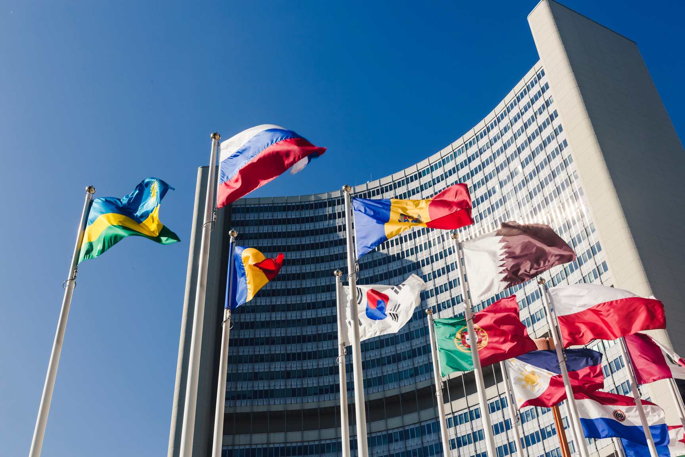


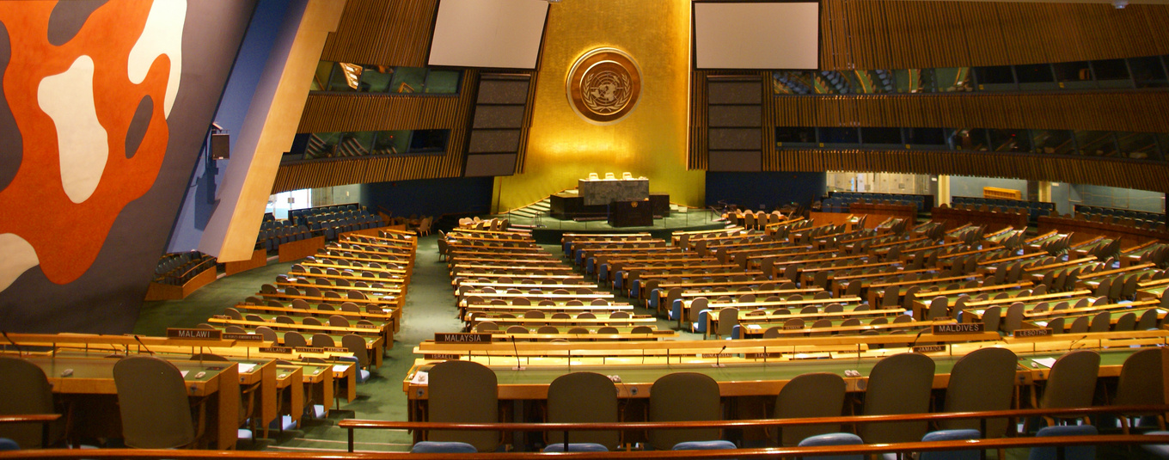
Notes:
Do you recognise any of these images?

Slide 9
United Nations
World War I ended 11th November 1918
World War II lasted from 1st September 1939 - 2nd September 1945
United Nations was established on 24th October 1945
Notes:
Put the pupils in groups.
A3 Sheets of paper - Pens.
The objective of this activity is for the teams to remember as many items on the two slides as they can.
They can look at them in any order, however, they must only look at each slide twice and for a minute at a time (adjust this accordingly for your class).
The teams must not write anything down when the slides are being shown.
Discussion points:
After one view, encourage your teams to think strategically & discuss these points:
How can we work as a team to remember all the items?
Are there any methods we can use to remember all the items?
When the activity is complete, ask them:
What type of communication was used in attempting to solve the problem?
Did we communicate well as a team? Why? Why not?

Slide 10


Notes:
The UN has 17 goals with targets it wants to achieve by 2030 - These include goal no 1 No Poverty and Goal no 2 Zero Hunger.

Slide 11
Investigate the role of the United Nations in reducing poverty.
Using your communication skills: Present your findings.
Notes:
Put the pupils in groups.
A3 Sheets of paper - Pens.
The objective of this activity is for the teams to remember as many items on the two slides as they can.
They can look at them in any order, however, they must only look at each slide twice and for a minute at a time (adjust this accordingly for your class).
The teams must not write anything down when the slides are being shown.
Discussion points:
After one view, encourage your teams to think strategically & discuss these points:
How can we work as a team to remember all the items?
Are there any methods we can use to remember all the items?
When the activity is complete, ask them:
What type of communication was used in attempting to solve the problem?
Did we communicate well as a team? Why? Why not?

