Slide 1
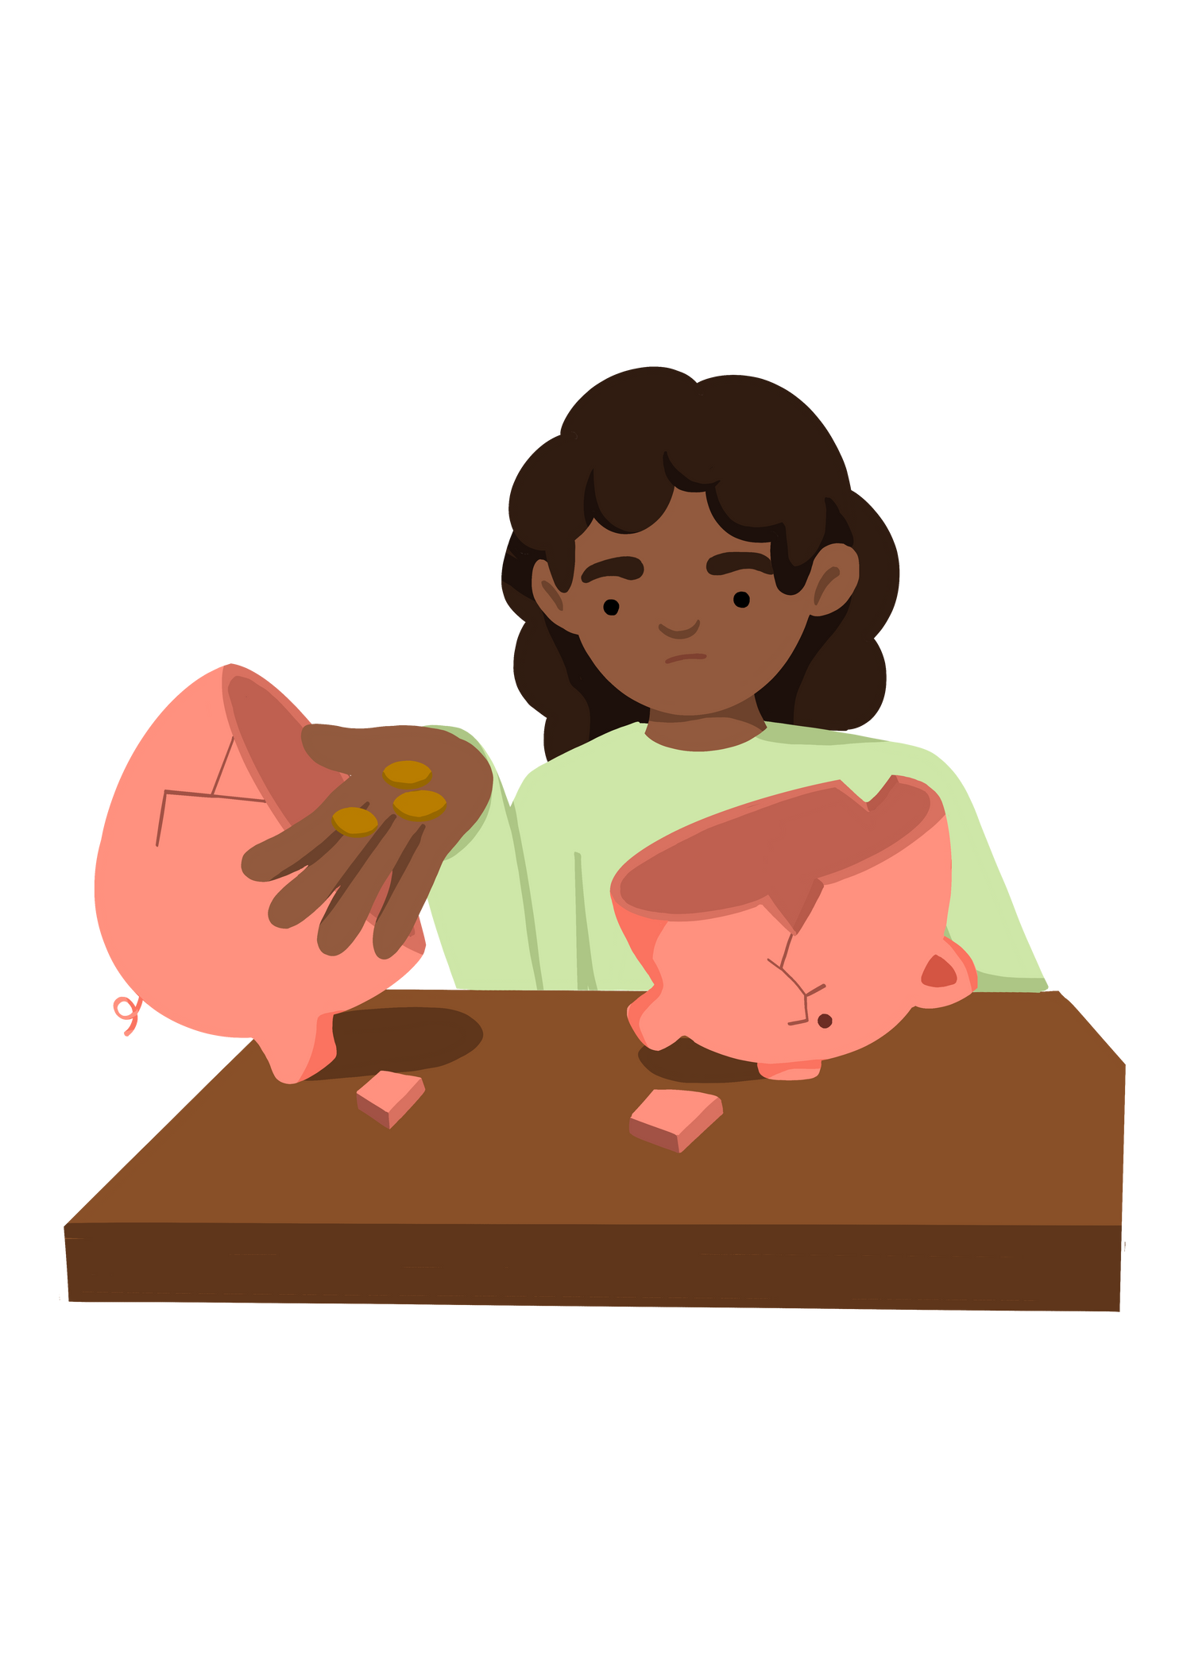
Key Stage 2
'What is poverty?'
Lesson 1
Notes:
Put the pupils in groups.
A3 Sheets of paper - Pens.
The objective of this activity is for the teams to remember as many items on the two slides as they can.
They can look at them in any order, however, they must only look at each slide twice and for a minute at a time (adjust this accordingly for your class).
The teams must not write anything down when the slides are being shown.
Discussion points:
After one view, encourage your teams to think strategically & discuss these points:
How can we work as a team to remember all the items?
Are there any methods we can use to remember all the items?
When the activity is complete, ask them:
What type of communication was used in attempting to solve the problem?
Did we communicate well as a team? Why? Why not?

Slide 2




Lesson 1 - What is Poverty?
Learning Objective To be able to explain what poverty is and how it manifests | Skills Objective
Problem-Solving - When solving problems, young people can carry out the research needed to back their viewpoints
Communication - Young people can participate in discussions, debates and presentations
 | National Curriculum: PSHE
Notes:
Put the pupils in groups.
A3 Sheets of paper - Pens.
The objective of this activity is for the teams to remember as many items on the two slides as they can.
They can look at them in any order, however, they must only look at each slide twice and for a minute at a time (adjust this accordingly for your class).
The teams must not write anything down when the slides are being shown.
Discussion points:
After one view, encourage your teams to think strategically & discuss these points:
How can we work as a team to remember all the items?
Are there any methods we can use to remember all the items?
When the activity is complete, ask them:
What type of communication was used in attempting to solve the problem?
Did we communicate well as a team? Why? Why not?

Slide 3
Definition of poverty
Poverty is a state of precarity, which means not having enough money and resources to live on. The level of precarity can vary, but when a family is facing a situation of precarity, it also affects their children.
Notes:
Put the pupils in groups.
A3 Sheets of paper - Pens.
The objective of this activity is for the teams to remember as many items on the two slides as they can.
They can look at them in any order, however, they must only look at each slide twice and for a minute at a time (adjust this accordingly for your class).
The teams must not write anything down when the slides are being shown.
Discussion points:
After one view, encourage your teams to think strategically & discuss these points:
How can we work as a team to remember all the items?
Are there any methods we can use to remember all the items?
When the activity is complete, ask them:
What type of communication was used in attempting to solve the problem?
Did we communicate well as a team? Why? Why not?

Slide 4

With your partners, consider how children can be affected if their families are facing precarity?
Notes:
Put the pupils in groups.
A3 Sheets of paper - Pens.
The objective of this activity is for the teams to remember as many items on the two slides as they can.
They can look at them in any order, however, they must only look at each slide twice and for a minute at a time (adjust this accordingly for your class).
The teams must not write anything down when the slides are being shown.
Discussion points:
After one view, encourage your teams to think strategically & discuss these points:
How can we work as a team to remember all the items?
Are there any methods we can use to remember all the items?
When the activity is complete, ask them:
What type of communication was used in attempting to solve the problem?
Did we communicate well as a team? Why? Why not?

Slide 5

Between 2021-22 there were 3.9 million children experiencing poverty in school.
There can be different reasons why people are experiencing poverty. This can be caused by the rising living costs, low pay, insecure work or lack of sufficient working hours.
For children, it can mean that they are worried about their family situations and unwell when they come to school.
This can affect their concentration to class and how they learn.
Notes:
Put the pupils in groups.
A3 Sheets of paper - Pens.
The objective of this activity is for the teams to remember as many items on the two slides as they can.
They can look at them in any order, however, they must only look at each slide twice and for a minute at a time (adjust this accordingly for your class).
The teams must not write anything down when the slides are being shown.
Discussion points:
After one view, encourage your teams to think strategically & discuss these points:
How can we work as a team to remember all the items?
Are there any methods we can use to remember all the items?
When the activity is complete, ask them:
What type of communication was used in attempting to solve the problem?
Did we communicate well as a team? Why? Why not?

Slide 6
Many children may not be sure about what they are experiencing. This is why we can help them by ensuring certain things are easily accessible in school such as:
  food and water
  resources to use
  access to more learning and after school clubs
  a safe place to talk with a trusted adult
STOP and THINK: Does your school provide the above list of opportunities for all children?
Notes:
Put the pupils in groups.
A3 Sheets of paper - Pens.
The objective of this activity is for the teams to remember as many items on the two slides as they can.
They can look at them in any order, however, they must only look at each slide twice and for a minute at a time (adjust this accordingly for your class).
The teams must not write anything down when the slides are being shown.
Discussion points:
After one view, encourage your teams to think strategically & discuss these points:
How can we work as a team to remember all the items?
Are there any methods we can use to remember all the items?
When the activity is complete, ask them:
What type of communication was used in attempting to solve the problem?
Did we communicate well as a team? Why? Why not?

Slide 7

Research
Today you are going to carry out a research on poverty. Using safe searches on the internet, research facts to answer the questions below. You can do this with a partner:
What is poverty?
Who can suffer from poverty?
How many children are suffering from poverty in the UK or the world?
What is the UN convention of the rights of a child?
Notes:
Put the pupils in groups.
A3 Sheets of paper - Pens.
The objective of this activity is for the teams to remember as many items on the two slides as they can.
They can look at them in any order, however, they must only look at each slide twice and for a minute at a time (adjust this accordingly for your class).
The teams must not write anything down when the slides are being shown.
Discussion points:
After one view, encourage your teams to think strategically & discuss these points:
How can we work as a team to remember all the items?
Are there any methods we can use to remember all the items?
When the activity is complete, ask them:
What type of communication was used in attempting to solve the problem?
Did we communicate well as a team? Why? Why not?

Slide 8

PAUSE and CONSIDER
'What child's rights are endangered when a child is suffering from poverty?'
Notes:
Put the pupils in groups.
A3 Sheets of paper - Pens.
The objective of this activity is for the teams to remember as many items on the two slides as they can.
They can look at them in any order, however, they must only look at each slide twice and for a minute at a time (adjust this accordingly for your class).
The teams must not write anything down when the slides are being shown.
Discussion points:
After one view, encourage your teams to think strategically & discuss these points:
How can we work as a team to remember all the items?
Are there any methods we can use to remember all the items?
When the activity is complete, ask them:
What type of communication was used in attempting to solve the problem?
Did we communicate well as a team? Why? Why not?

