Slide 1
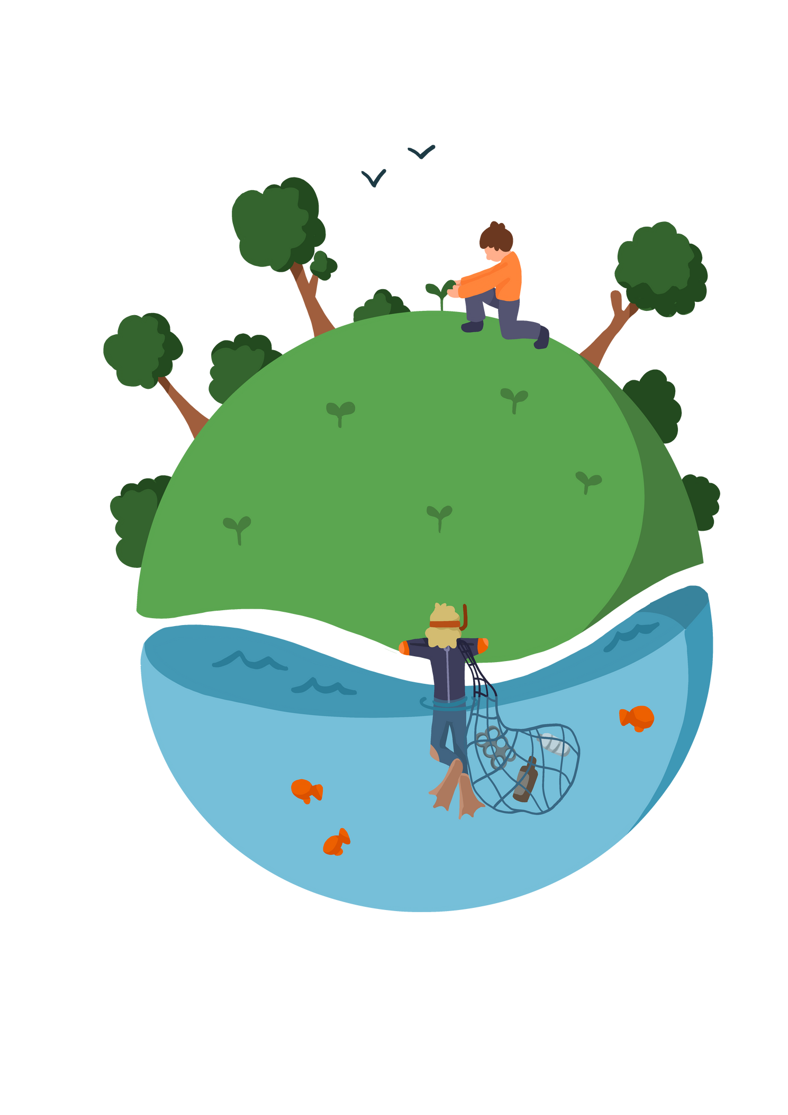
'What Biodiversity is Found in Antarctica?'

Slide 2




Learning Objective
To be able to describe the biodiversity found in Antarctica.
Skills Objectives
  Young people can carry out effective research
  Young people can present their ideas with great impact and clarity
 | National Curriculum: Geography describe and understand key aspects of physical geography, including climate zones, biomes, and the water cycle.

Slide 3
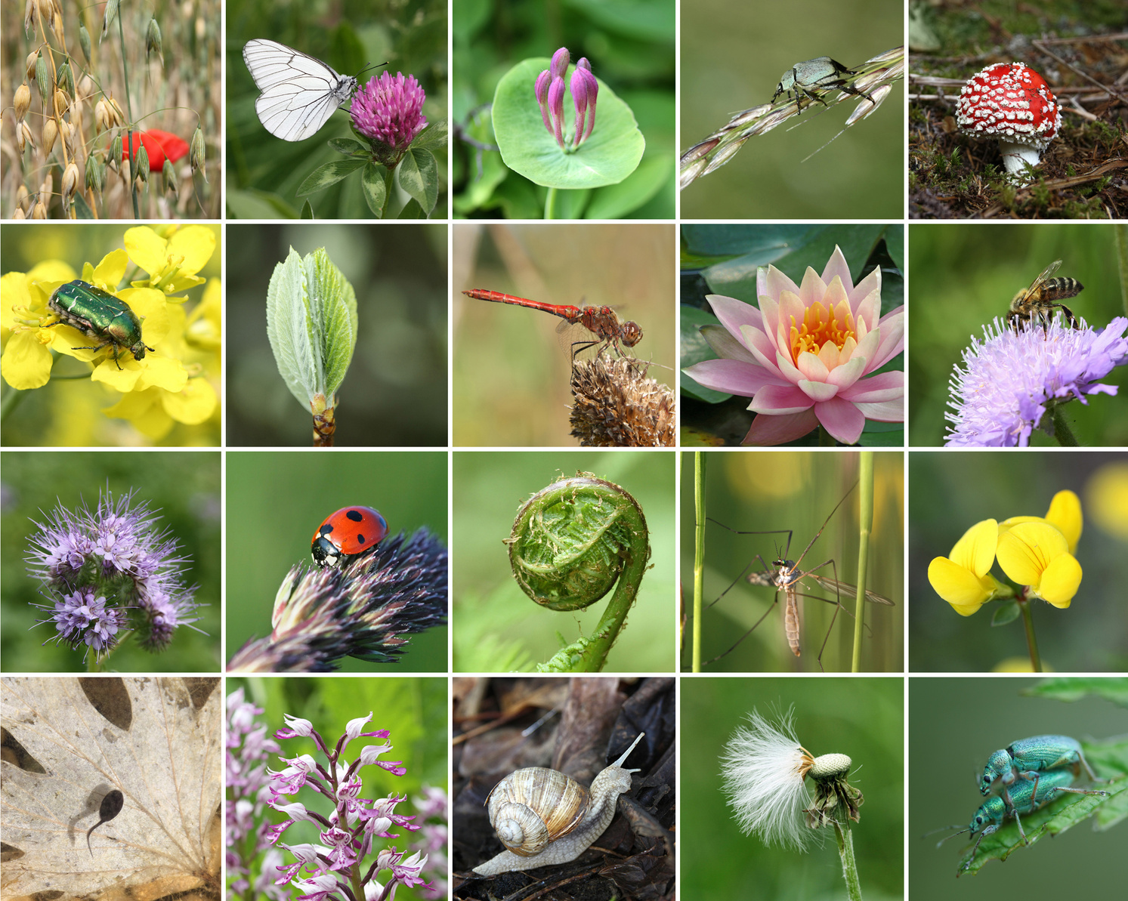
What is biodiversity?

Slide 4
'What biodiversity is found in Antarctica?'

Slide 5
Present your work on a mind map with illustrations.
  The biome of Antarctica.
  Finding out about the land and sea mammals living in Antarctica.
  Learning about the Antarctic food chain.

