Slide 1
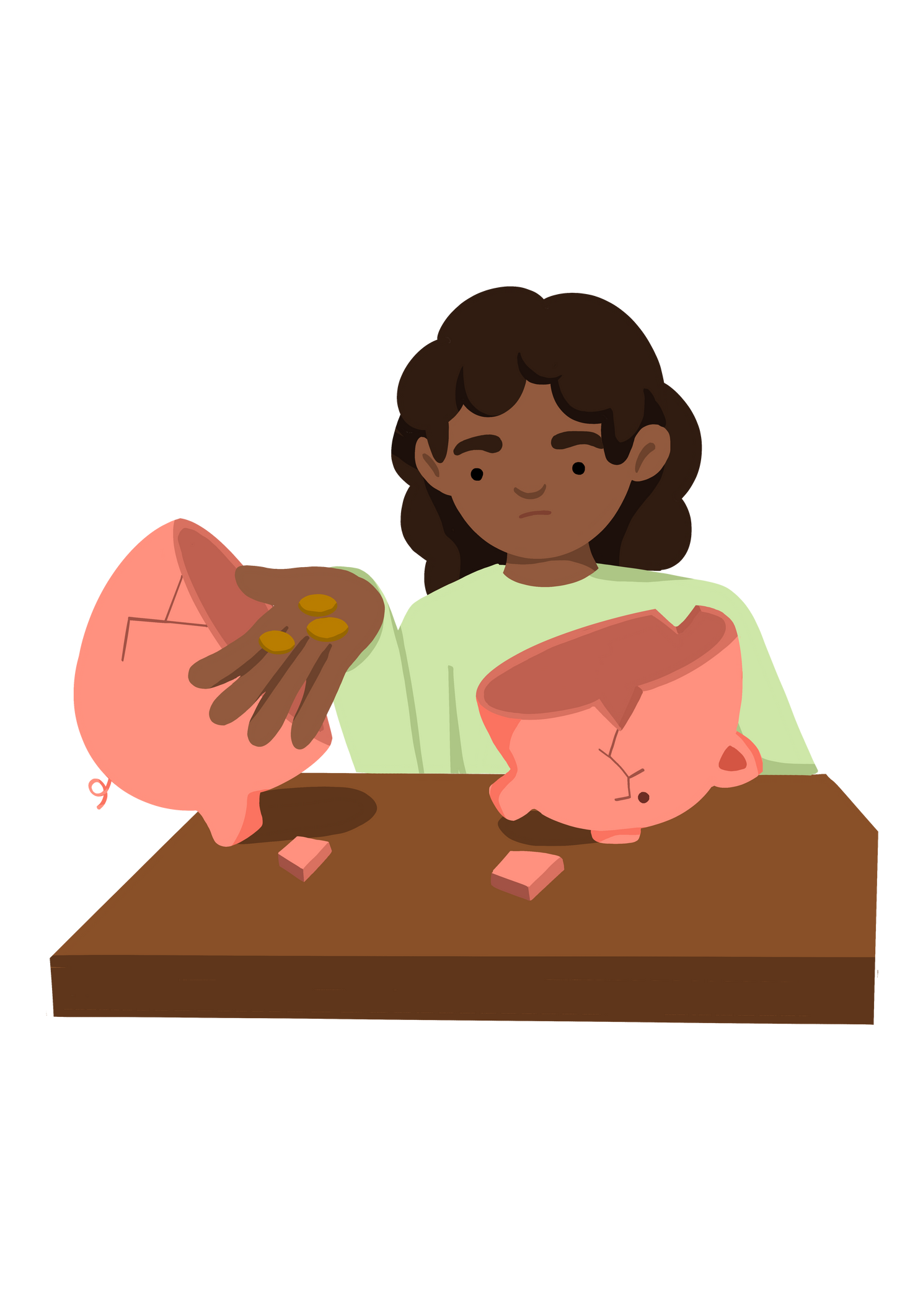
Key Stage 1
What does poverty mean
Lesson 1
Notes:
Put the pupils in groups.
A3 Sheets of paper - Pens.
The objective of this activity is for the teams to remember as many items on the two slides as they can.
They can look at them in any order, however, they must only look at each slide twice and for a minute at a time (adjust this accordingly for your class).
The teams must not write anything down when the slides are being shown.
Discussion points:
After one view, encourage your teams to think strategically & discuss these points:
How can we work as a team to remember all the items?
Are there any methods we can use to remember all the items?
When the activity is complete, ask them:
What type of communication was used in attempting to solve the problem?
Did we communicate well as a team? Why? Why not?

Slide 2


Lesson 1 - What Does It Mean To Be Poor? | Lesson 1 - What Does It Mean To Be Poor?
Learning Objective To demonstrate an understanding of the term 'poverty' | Skills Objectives
Communication - I can plan what I need to share.
 | National Curriculum: PSHE
Notes:
Put the pupils in groups.
A3 Sheets of paper - Pens.
The objective of this activity is for the teams to remember as many items on the two slides as they can.
They can look at them in any order, however, they must only look at each slide twice and for a minute at a time (adjust this accordingly for your class).
The teams must not write anything down when the slides are being shown.
Discussion points:
After one view, encourage your teams to think strategically & discuss these points:
How can we work as a team to remember all the items?
Are there any methods we can use to remember all the items?
When the activity is complete, ask them:
What type of communication was used in attempting to solve the problem?
Did we communicate well as a team? Why? Why not?

Slide 3
Enquiry question: What does it mean to be affected by poverty?
Learning objective: To learn about the word 'poverty' and ask questions about it.
Notes:
Put the pupils in groups.
A3 Sheets of paper - Pens.
The objective of this activity is for the teams to remember as many items on the two slides as they can.
They can look at them in any order, however, they must only look at each slide twice and for a minute at a time (adjust this accordingly for your class).
The teams must not write anything down when the slides are being shown.
Discussion points:
After one view, encourage your teams to think strategically & discuss these points:
How can we work as a team to remember all the items?
Are there any methods we can use to remember all the items?
When the activity is complete, ask them:
What type of communication was used in attempting to solve the problem?
Did we communicate well as a team? Why? Why not?

Slide 4

Key language
stepmother
Hansel and Gretel
being poor
pebbles
gold and diamonds
hut
Notes:
Put the pupils in groups.
A3 Sheets of paper - Pens.
The objective of this activity is for the teams to remember as many items on the two slides as they can.
They can look at them in any order, however, they must only look at each slide twice and for a minute at a time (adjust this accordingly for your class).
The teams must not write anything down when the slides are being shown.
Discussion points:
After one view, encourage your teams to think strategically & discuss these points:
How can we work as a team to remember all the items?
Are there any methods we can use to remember all the items?
When the activity is complete, ask them:
What type of communication was used in attempting to solve the problem?
Did we communicate well as a team? Why? Why not?

Slide 5

CLICK HERE to access the story of Hansel and Gretel
Notes:
Put the pupils in groups.
A3 Sheets of paper - Pens.
The objective of this activity is for the teams to remember as many items on the two slides as they can.
They can look at them in any order, however, they must only look at each slide twice and for a minute at a time (adjust this accordingly for your class).
The teams must not write anything down when the slides are being shown.
Discussion points:
After one view, encourage your teams to think strategically & discuss these points:
How can we work as a team to remember all the items?
Are there any methods we can use to remember all the items?
When the activity is complete, ask them:
What type of communication was used in attempting to solve the problem?
Did we communicate well as a team? Why? Why not?

Slide 6
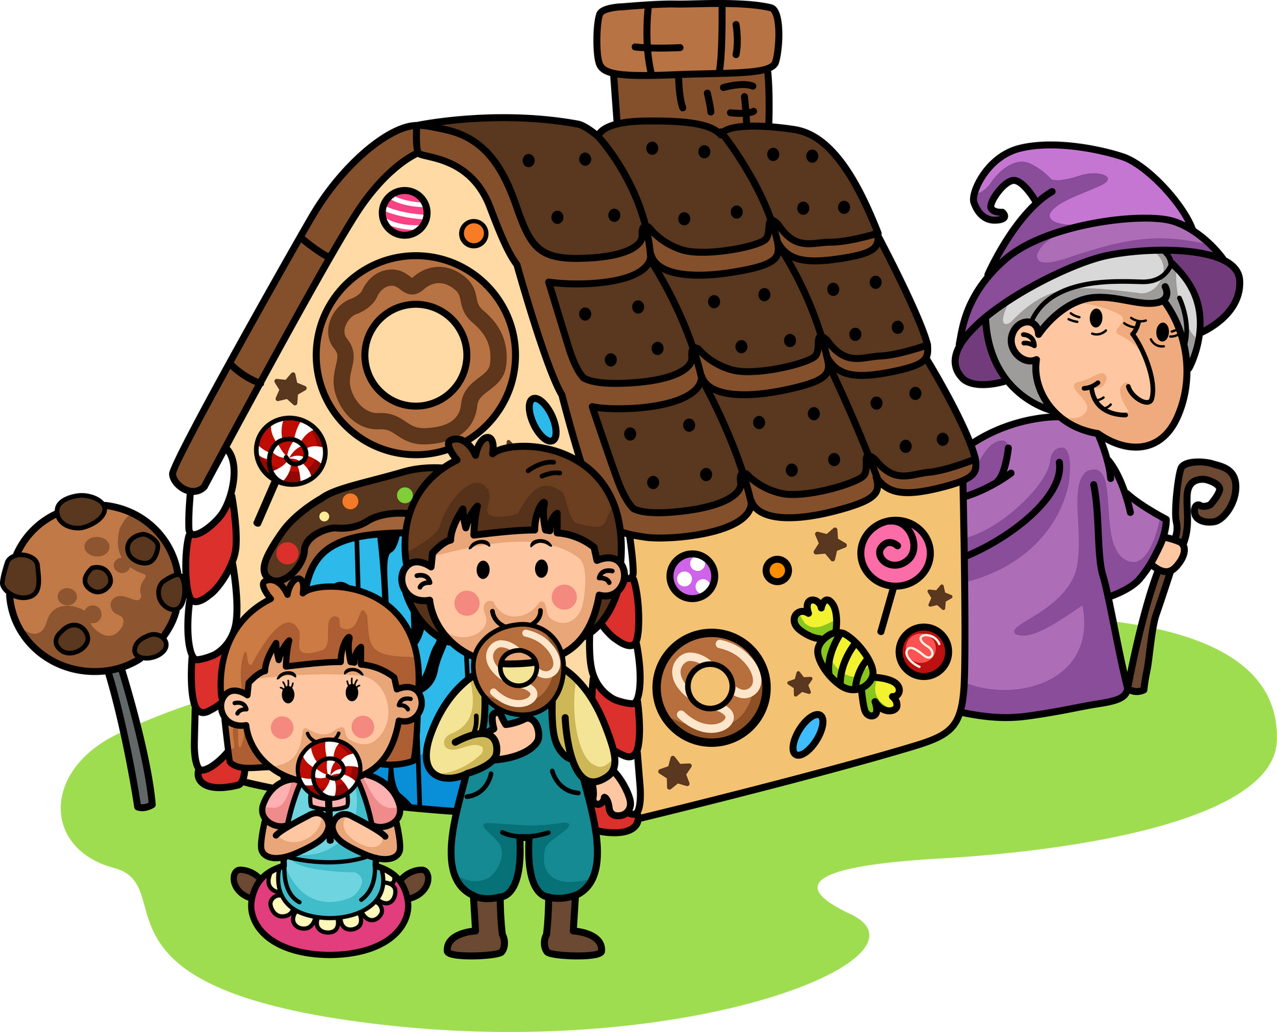
Think about the story:
'Who was 'poor' in the story?
What tells you that those character are poor?'
Notes:
Put the pupils in groups.
A3 Sheets of paper - Pens.
The objective of this activity is for the teams to remember as many items on the two slides as they can.
They can look at them in any order, however, they must only look at each slide twice and for a minute at a time (adjust this accordingly for your class).
The teams must not write anything down when the slides are being shown.
Discussion points:
After one view, encourage your teams to think strategically & discuss these points:
How can we work as a team to remember all the items?
Are there any methods we can use to remember all the items?
When the activity is complete, ask them:
What type of communication was used in attempting to solve the problem?
Did we communicate well as a team? Why? Why not?

Slide 7


With the help of a partner, write down a question on a post-it note about something you may wonder about poverty.
Your teacher will hang your question in the classroom for you to think about it in the next sessions and work out how you can answer it.

