Slide 1
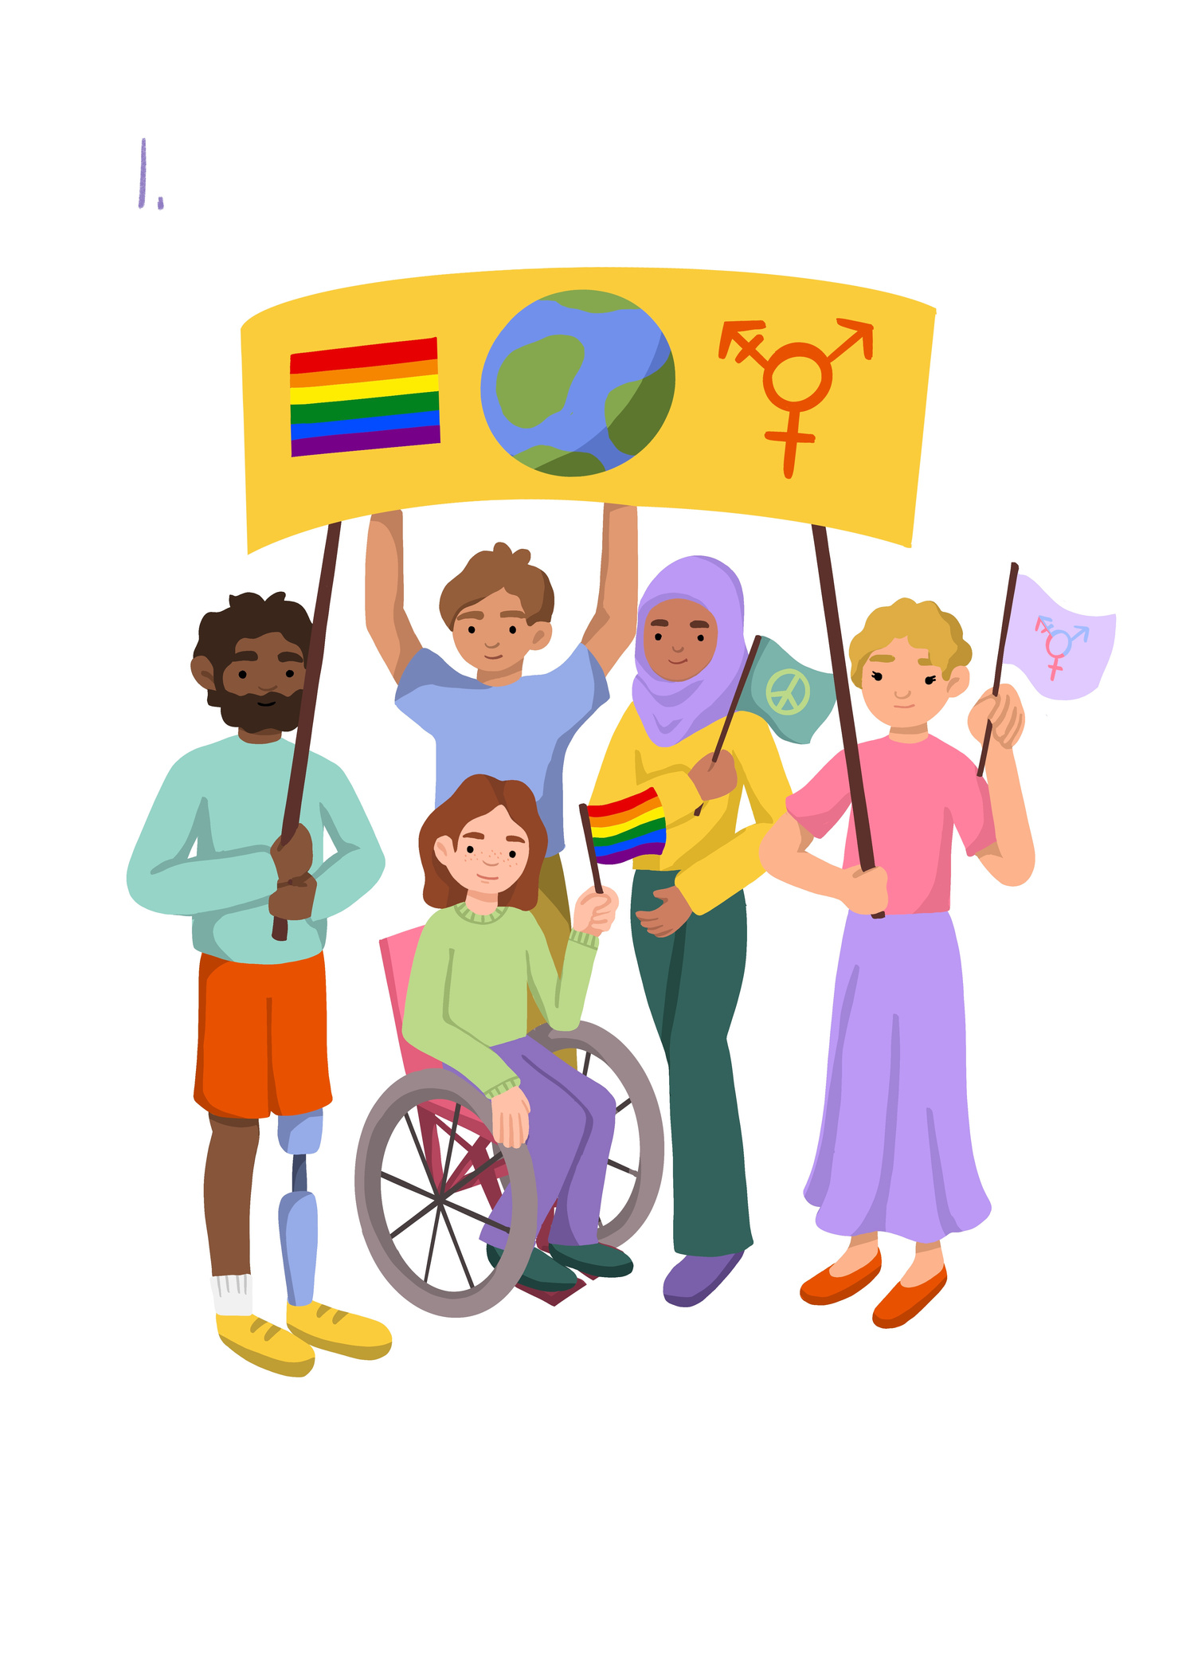
Inclusion and Diversity
Lesson 1

Slide 2
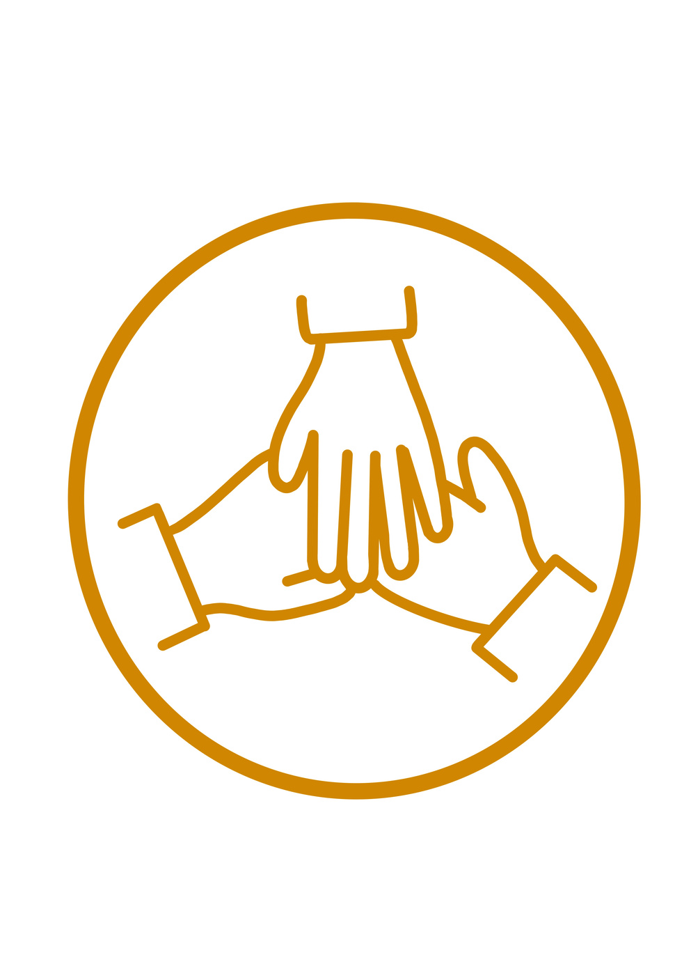

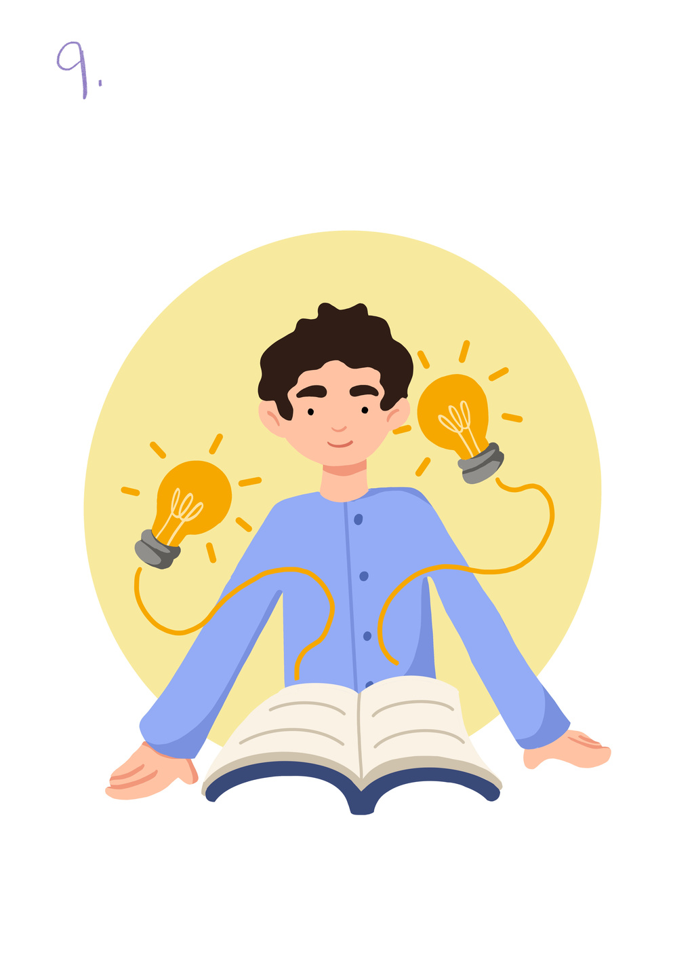
Learning objective To understand that diversity can be seen and expressed through a person. | Skills Objective
Teamwork - I can work with others.
Communication - I can take part in a discussion, debates and presentations.
Outcomes: Young people Pupils are learning to observe diversity through our physical features and mediums of expression (e.g., art, music, etc.) They develop a sense of what diversity is and why it is good. | Outcomes: Young people Pupils are learning to observe diversity through our physical features and mediums of expression (e.g., art, music, etc.) They develop a sense of what diversity is and why it is good.
 | National Curriculum Science Identify, name, draw and label the basic parts of the human body and say which part of the body is associated with each sense. (Year 1) PSHE Identify similarities and differences between people and their families (Year 1), cultures (Year 2)

Slide 3
What is Diversity?
Notes:
Introduction: The aim of the session is for pupils to learn the term diversity and explore what it means. In the way we plan this session, pupils can start by exploring 'diversity' in terms of our physical features and where we come from. The term 'diversity' can be looked at in relation to 'ethnicity'. You can start by asking pupils if they know how many ethnicities do we have in our schools? Explain that ethnicities can be about the country someone comes from, but also the culture, or a particular faith.

Slide 4
What does Ethnicity mean?
Notes:
Introduction: The aim of the session is for pupils to learn the term diversity and explore what it means. In the way we plan this session, pupils can start by exploring 'diversity' in terms of our physical features and where we come from. The term 'diversity' can be looked at in relation to 'ethnicity'. You can start by asking pupils if they know how many ethnicities do we have in our schools? Explain that ethnicities can be about the country someone comes from, but also the culture, or a particular faith.

Slide 5

Notes:
Introduction: The session aims for pupils to learn the term diversity and explore what it means. In the way we plan this session, pupils can start by exploring 'diversity' regarding our physical features and where we come from. The term 'diversity' can be looked at in relation to 'ethnicity'. You can start by asking pupils if they know how many ethnicities do we have in our schools? Explain that ethnicities can be about the country someone comes from and the culture of a particular faith.

Slide 6
Draw a family picture/self-portrait or the people important in their lives/ friends and what makes them diverse.
Notes:
To see how we are all different and the same. .

Slide 7
Let's share our work
Notes:
The class teacher could share a picture of their family or people that are important to them highlighting the diversity.

