Slide 1
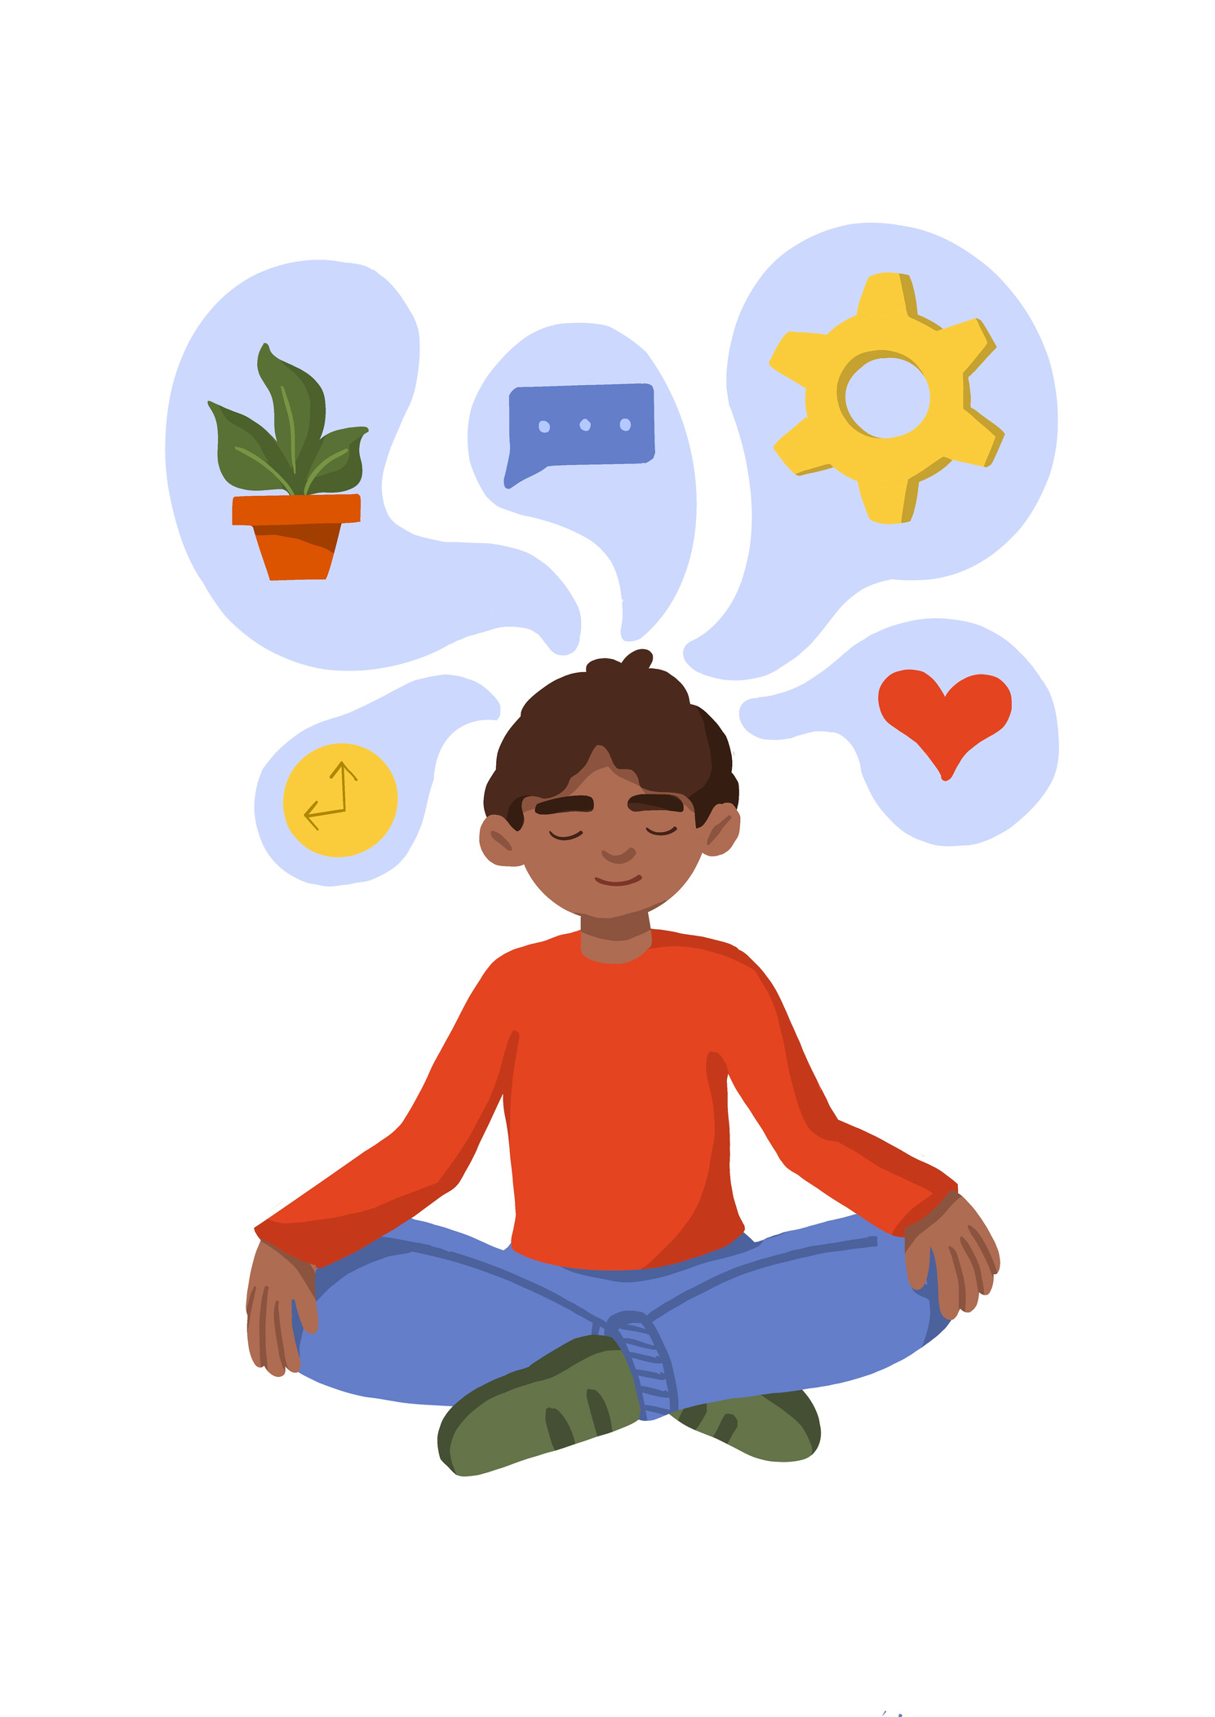
“Promise me you’ll always remember: you’re braver than you believe and stronger than you seem, and smarter than you think.”
Christopher Robin.

Slide 2
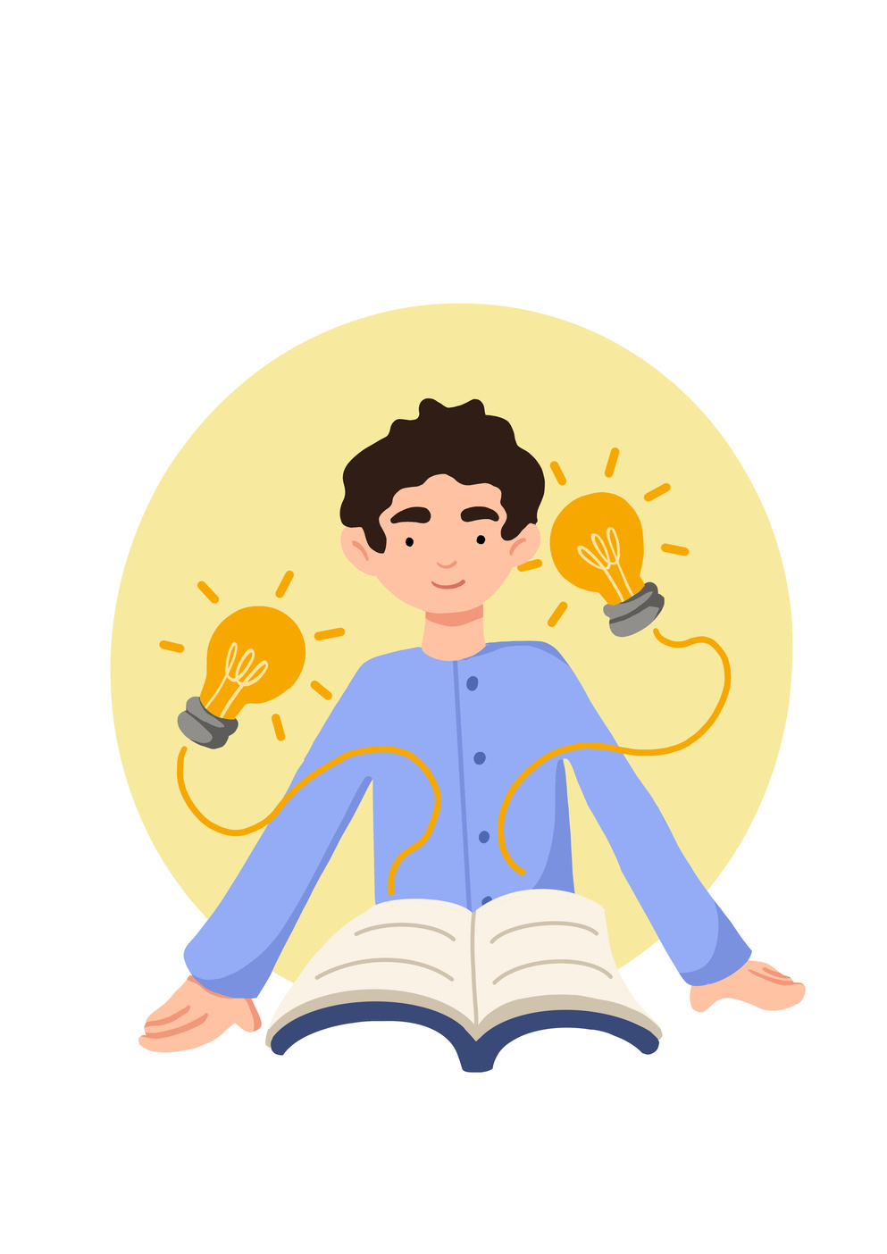



Lesson Objectives
To demonstrate an understanding of mental health and well-being. Identity mental health issues in others and yourself. (your best self)
 | Curriculum Link: PSHE, Citizenship

Slide 3
Skills Objectives
I can understand the importance of body language when presenting. I can deliver and speak with personal confidence I can listen to others and take their ideas on board
 | Curriculum Link: PSHE, Citizenship

Slide 4
Mental Health: Mental health is a set of malleable skills and beliefs which impact our thoughts, feelings and behaviour in relation to our social and emotional functioning.
Wellbeing: A positive sense of well-being which enables an individual to be able to function in society and meet the demands of everyday life.
Notes:
Before sharing the quotes ask pupils to tell you what they think mental health and wellbeing are.

Slide 5


Slide 6
What was going on with Sasha?
What was happening with Adnre'?
How did Sasha and Andre look after their mental health?
What are the differences between everyday feelings and overwhelming feelings?
What are some self-care strategies that we can use to deal with everyday feelings, what does Sasha do? does it work?
How are the feelings that André is experiencing different? What does André do to manage these feelings?
What advice does André get from Sasha and his Head of Year?
What are some other things André could do?
What can you do if you are worried about a friend?

Slide 7
What causes mental health issues?
  difficult or stressful life events
  your relationships with the people around you
  the care and support you get at home and school
  your physical health – how much sleep you get, what you eat and drink, if you take drugs or alcohol, and if you have any health problems
  your environment – housing conditions, how you are treated by others, money problems
  being able to recognise and communicate your emotions.

Slide 8
  Exam pressures. The overwhelming pressure and number of exams can have a significant effect on students’ mental health.
  The modern technological world. Young people now spend much more time indoors online rather than outside. A game of football in the park is being replaced by online games. Furthermore, young people are at a number of risks online, including exposure to upsetting content and cyberbullying, which will all affect their mental health.
  Growing social media. Social media platforms are evolving and growing in popularity daily. Sites such as Instagram produce feelings of inadequacy as teens compare themselves and their lives to those of their peers. Social media also leads to reduced communication skills and reduced human interaction with friends.
  LGBTQ+. Students who identify as being LGBTQ+ often find it difficult to tell their friends and family about themselves.
  COVID-19. The pandemic has completely changed young people’s lives, disrupting school and their daily routines. Worrying about their safety, being unable to see friends and family, and fears about their futures have contributed to an increase in child mental health problems, from anxiety to agoraphobia and PTSD.
Notes:
Pupils need to understand what sustainability means. before giving them the definitions ask pupils to suggest what they think sustainability means.

Slide 9
Everyday Feelings: come and go and are a normal reaction to what is happening in our lives. They are always changing and don't usually hand around too long.
Overwhelming feelings: hang around for a long time, change the way we feel and behave and may stop us from doing what we want to in life.

Slide 10
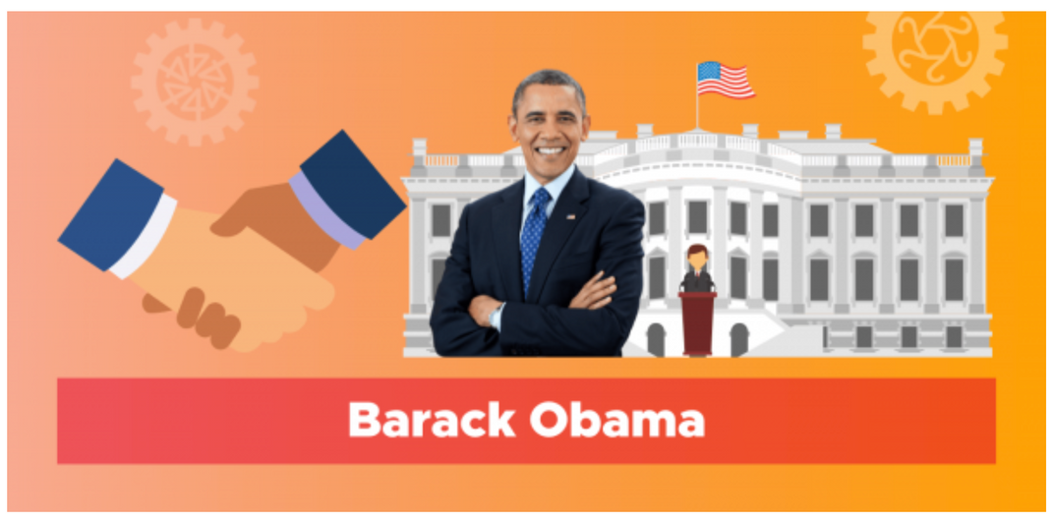

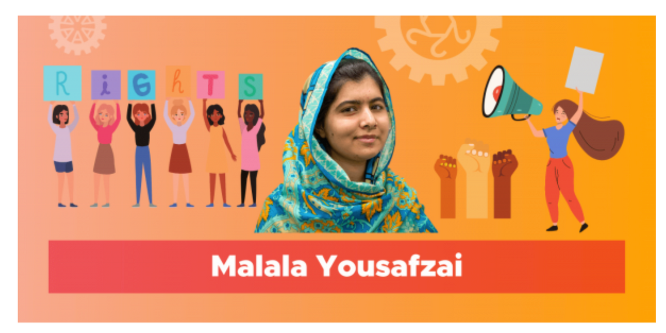
What do they have in common?
Notes:
Pupils understand that we all face obstacles which will become a barrier to achieving our hopes, goals, and dreams,
How did they overcome overcame problems greater than yours to achieve greatness as you would like?
2. Serena Williams
Serena Williams is a professional tennis player and an influential athlete. She has made a name for herself through her determination, modesty, and strength. Serena is an inspiring role model, not only to children but also to adults. After a series of losses and defeats throughout her career, and even failing to defend her winning titles, Serena made up for her losses by never giving up. She sets a clear example of why we should always encourage and motivate our children to adopt a positive mindset and attitude, so that they believe in themselves, overcome setbacks, and strive to do their best. Serena continues to inspire people around the world, in sports, the community, and culture.
3. Barack Obama
Barack Obama, who served as the 44th president of the United States and the first African-American president, has become a worldwide inspiration. His resilience, intelligence, and leadership has inspired many around the world. Obama is motivational through his words and actions, which have positively impacted children and adults. Like many others, Obama faced setbacks during his time as president but despite these difficulties, he continued to positively influence others as the resilient leader he is, and lead an entire nation towards success. Barack Obama continues to inspire others to strive for success today.

Slide 11

  Van Gogh only sold one painting during his lifetime. ...
  Stephen King's first novel was rejected 30 times. King's books have sold over 350 million copies and have been made into countless major motion pictures.
  Thomas Edison failed 1,000 times before creating the lightbulb.
  Albert Einstein. Einstein didn't speak at all for the first three years of his life. He went on to become Nobel Prize winning physicist; who created special and general relativity, a major contributor to quantum mechanics, statesman. He couldn't get a job in physics for two years after graduation. Worked as assistant patent examiner, passed over for promotion until he "fully mastered machine technology".
Can you think of anyone you know that has overcome obstacles?
Notes:
ask pupils to think about people around them that have overcome obstacles to succeed.
Pupils need to understand that mental health can be affected when they feel things are not going well.
Its essential we are able to overcome this by looking after our well being.

Slide 12
My ‘best self'
Think about a time you felt that you got something wrong, things didn’t immediately work out or you were generally having a hard time. This could include times such as falling out with friends, not achieving as well as they expected in exams or sports etc. Or you might have experienced losses or changes in your family that felt overwhelming at the time, but now feel that they can cope with.
  What feelings did you experience on each occasion? How do they compare?
  What did you learn about yourself when things went wrong?
  If they had a similar experience now, what would they do differently?
  How do you think, feel and act when being your ‘best selves?
  Is it easier or more difficult to be our ‘best selves’ during challenging times?
  Think of a ‘top tip’ they would give to another young person to help them be their ‘best selves?

Slide 13
Think about times when you felt your ‘best selves. This could be at school, at home, with extended family, with their friends, when doing sport, music or a hobby, when helping or volunteering – or all of these.
On a piece of paper draw your selves at your best.
What are you doing?
Who are they with?
Where are they?
Encourage them to add thought bubbles, speech bubbles and feeling words to their picture. Let them know their best self is always there – even when it seems things are not going their way.

Slide 14

What will you change?

Slide 15
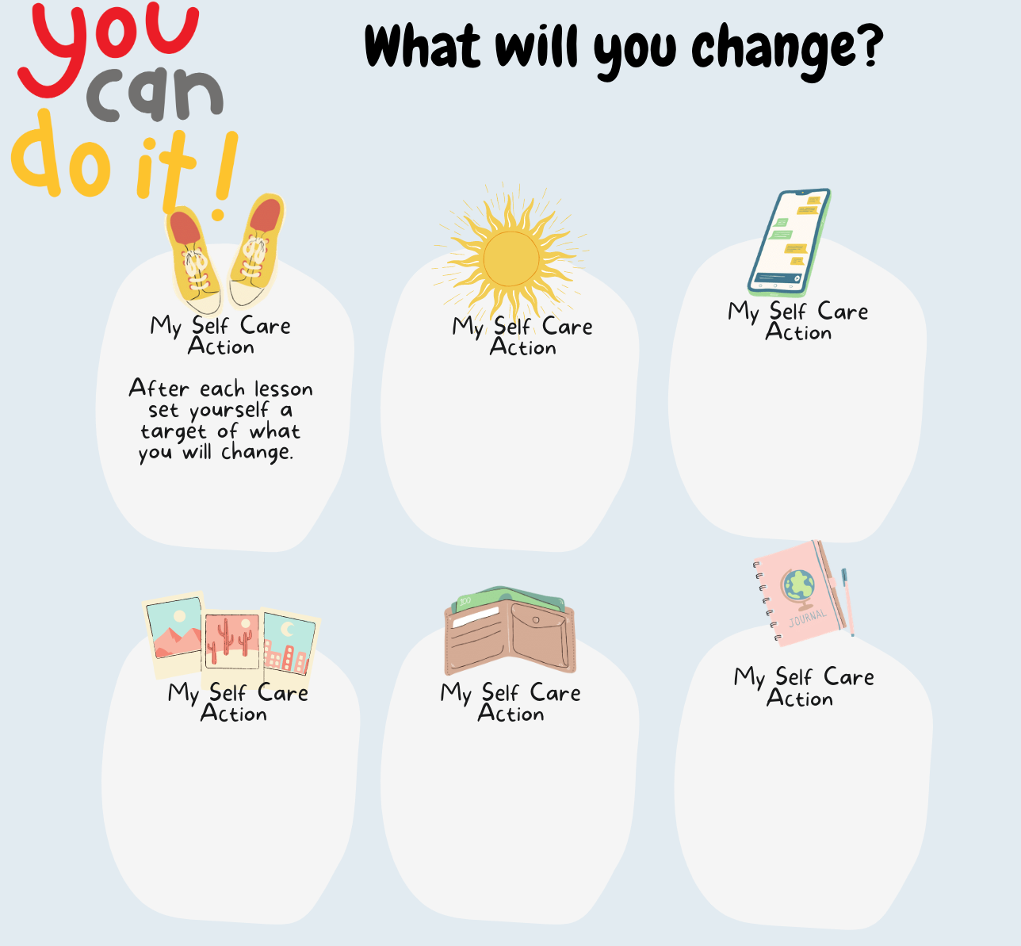

Slide 16
Know whom in school they should speak to if they are worried about their own or someone else’s mental wellbeing or ability to control their emotions (including issues arising online).
In our school, you can talk to............................................................

Slide 17

childline.org.uk - 0800 1111 (free 24hr) confidential listening
samaritans.org - 116 123 (free 24 hr) confidential listening
studentsagainstdepression.org - resources to move away from depression
youngminds.org.uk - mental health info and guidance
youthaccess.org.uk - young people’s info, advice and counselling
themix.org.uk - essential support for under 25s
If you have a mental health crisis and don't know whom to contact, call NHS 111. Call 111, free from any phone, 24 hours a day, seven days a week, and speak to a highly trained adviser supported by healthcare professionals.

Slide 18
Let us focus on our well-being:
"A positive sense of well-being enables an individual to be able to function in society
and meet the demands of everyday life."
Notes:
How do we create that sense of well-being that will enable us to function in everyday life?
What can we do when we come across an obstacle?

Slide 19
Having good well-being can help you to:
  feel and express a range of emotions
  have confidence and positive self-esteem
  have good relationships with others
  enjoy the world around you
  cope with stress and adapt when things change.
Good well-being doesn't mean you'll always be happy. It's normal to feel sad, angry, or low sometimes. But if you have poor well-being for a long time you might start to find things more difficult to cope with. www.mind.org.uk

Slide 20


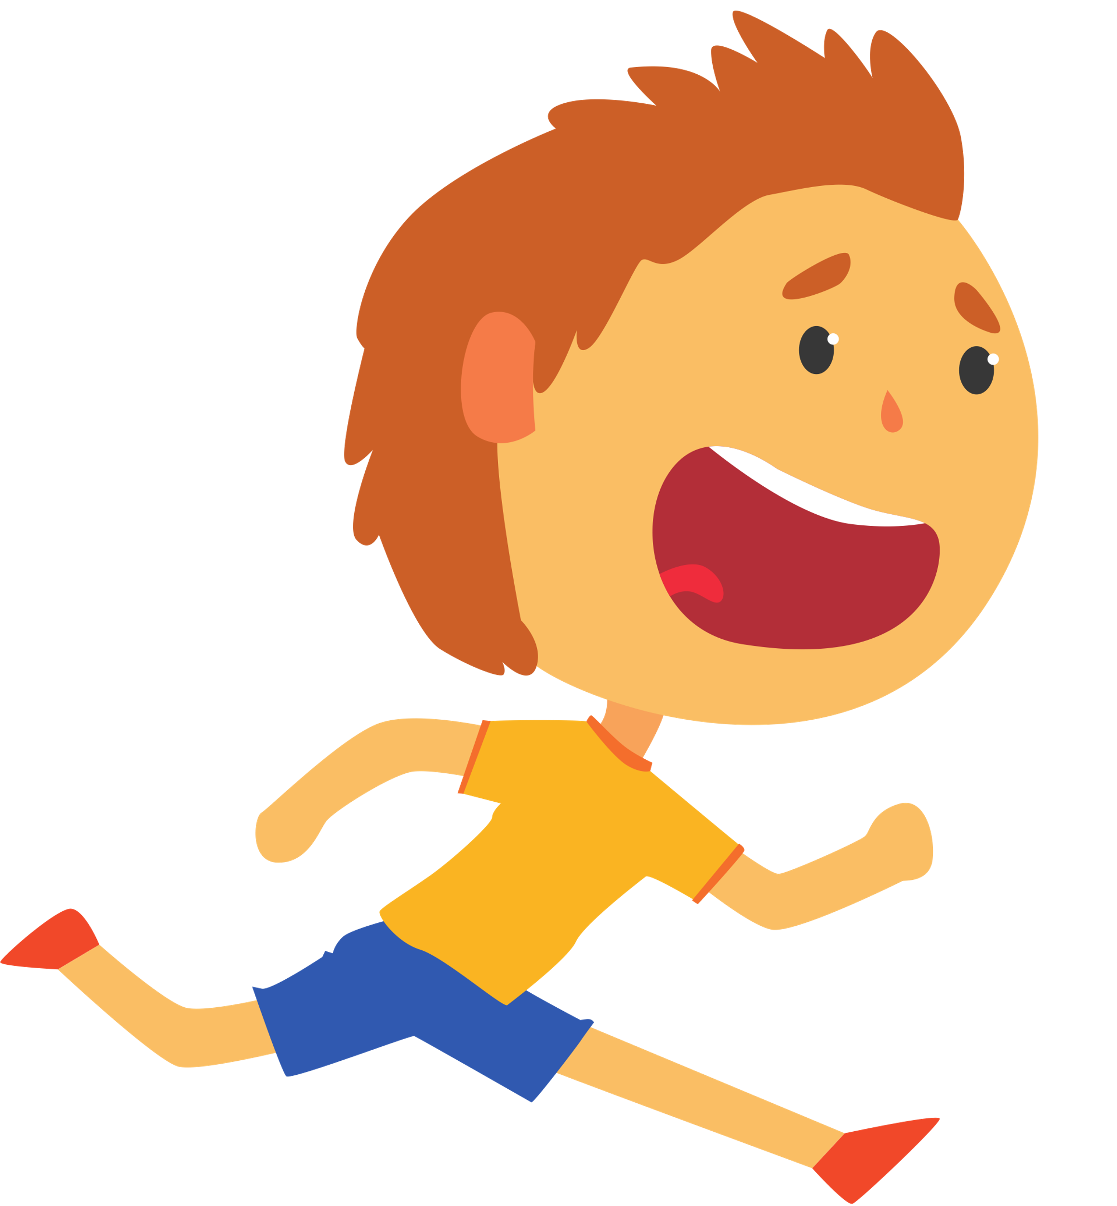

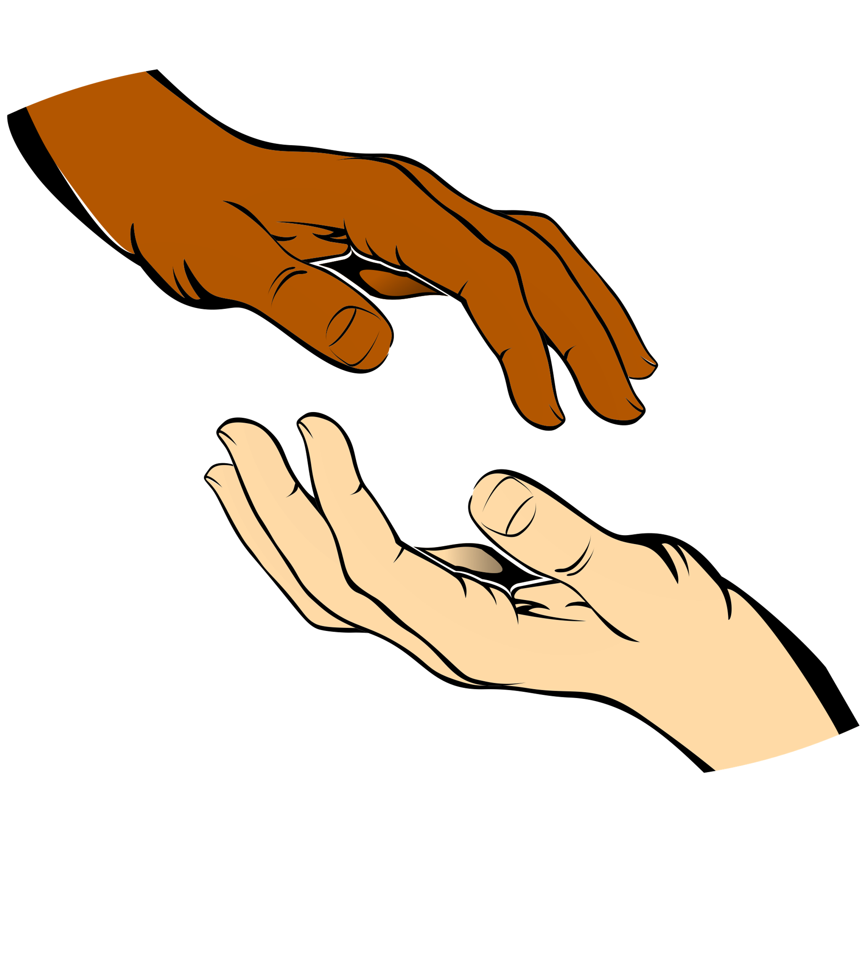


5 steps you can take to improve Mental health and Well-being
Connecting with
people
Being physically
active
Learning new
skills.
Giving to others.
Mindfulness

Slide 21
Learning new skills. Research shows that learning new skills can also improve your mental well-being by:
  boosting self-confidence and raising self-esteem
  helping you to build a sense of purpose
  helping you to connect with others

Slide 22
Learn a new skill...
Notes:
3min video to learn how to breathe.

Slide 23
What will you change?
Notes:
Pupils need to understand what sustainability means. before giving them the definitions ask pupils to suggest what they think sustainability means.

Slide 24
Know whom in school they should speak to if they are worried about their own or someone else’s mental wellbeing or ability to control their emotions (including issues arising online).
Please add details of whom to contact in school if they are concerned about themselves or others.
Notes:
Pupils need to understand what sustainability means. before giving them the definitions ask pupils to suggest what they think sustainability means.

Slide 25
childline.org.uk - 0800 1111 (free 24hr) confidential listening
samaritans.org - 116 123 (free 24 hr) confidential listening
studentsagainstdepression.org - resources to move away from depression
youngminds.org.uk - mental health info and guidance
youthaccess.org.uk - young people’s info, advice and counselling
themix.org.uk - essential support for under 25s
If you have a mental health crisis and don't know whom to contact, call NHS 111. Call 111, free from any phone, 24 hours a day, seven days a week, and speak to a highly trained adviser supported by healthcare professionals.
Notes:
Pupils need to understand what sustainability means. before giving them the definitions ask pupils to suggest what they think sustainability means.

