Slide 1

Lesson 3: Understand the consequences of imbalances in the diet, including obesity, starvation and deficiency diseases (Science, PSHE)

Slide 2



Learning Objective:
  Pupils to understand the meaning of malnutrition and the impact .
 | Curriculum Link: PSHE, Science

Slide 3
Skills Objective:
  Using Problem-Solving skills, I am able to think creatively about solutions, identify multiple options, assess and learn from potential options, create better solutions and decide on a final answer.
 | Curriculum Link: PSHE, Science

Slide 4
What Does Malnutrition Mean?

Slide 5
“Malnutrition is a serious condition when your diet does not contain enough nutrients. (NHS)

Slide 6
“Malnutrition refers to deficiencies, excesses or imbalances in a person’s energy intake and nutrients. (WHO)

Slide 7
Causes of malnutrition
  Poor quality of diet.
  Poor Maternal Health.
  Socioeconomic Status.
  War and Conflict

Slide 8
Causes of malnutrition
  Largely due to manmade conflicts (Ukraine and Russian War)
  Climate changes
  Economic downturns
  COVID-19 could double the number of people at risk of suffering acute hunger by the end of 2020.

Slide 9
Where do you think most people experiencing malnutrition are located?

Slide 10
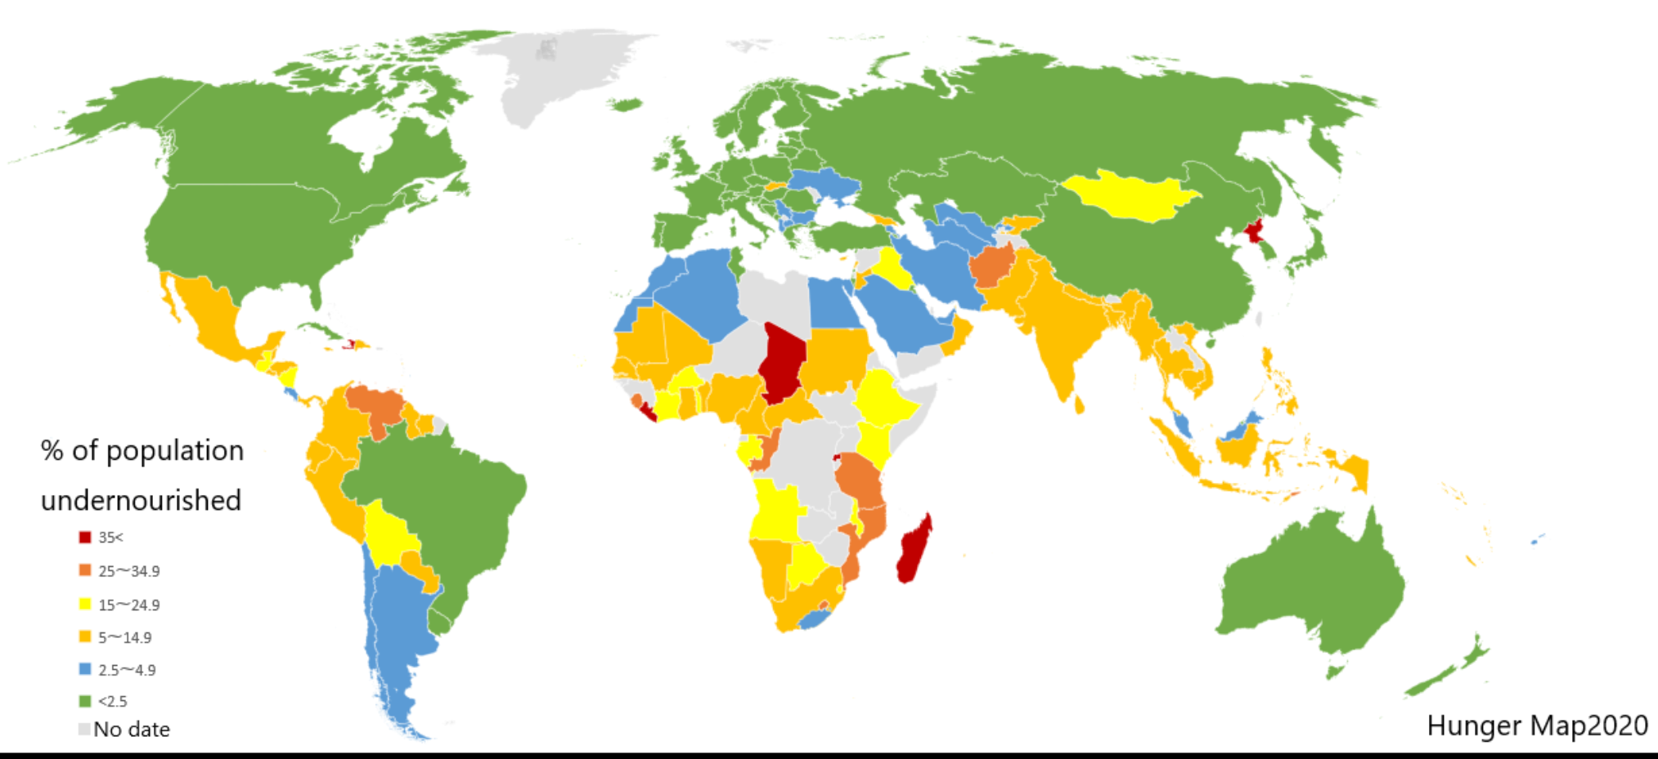
The percentage of the population affected by undernutrition by country, according to United Nations statistics from 201

Slide 11
Eating a healthy, balanced diet is the best way to prevent malnutrition:
  Preventing malnutrition
  Eating fruit and vegetables.
  Starchy foods, such as rice, pasta, bread and potatoes.
  Milk and dairy foods.
  Meat, fish, eggs and beans and other non-dairy sources of protein.

Slide 12
What is the solution?

Slide 13
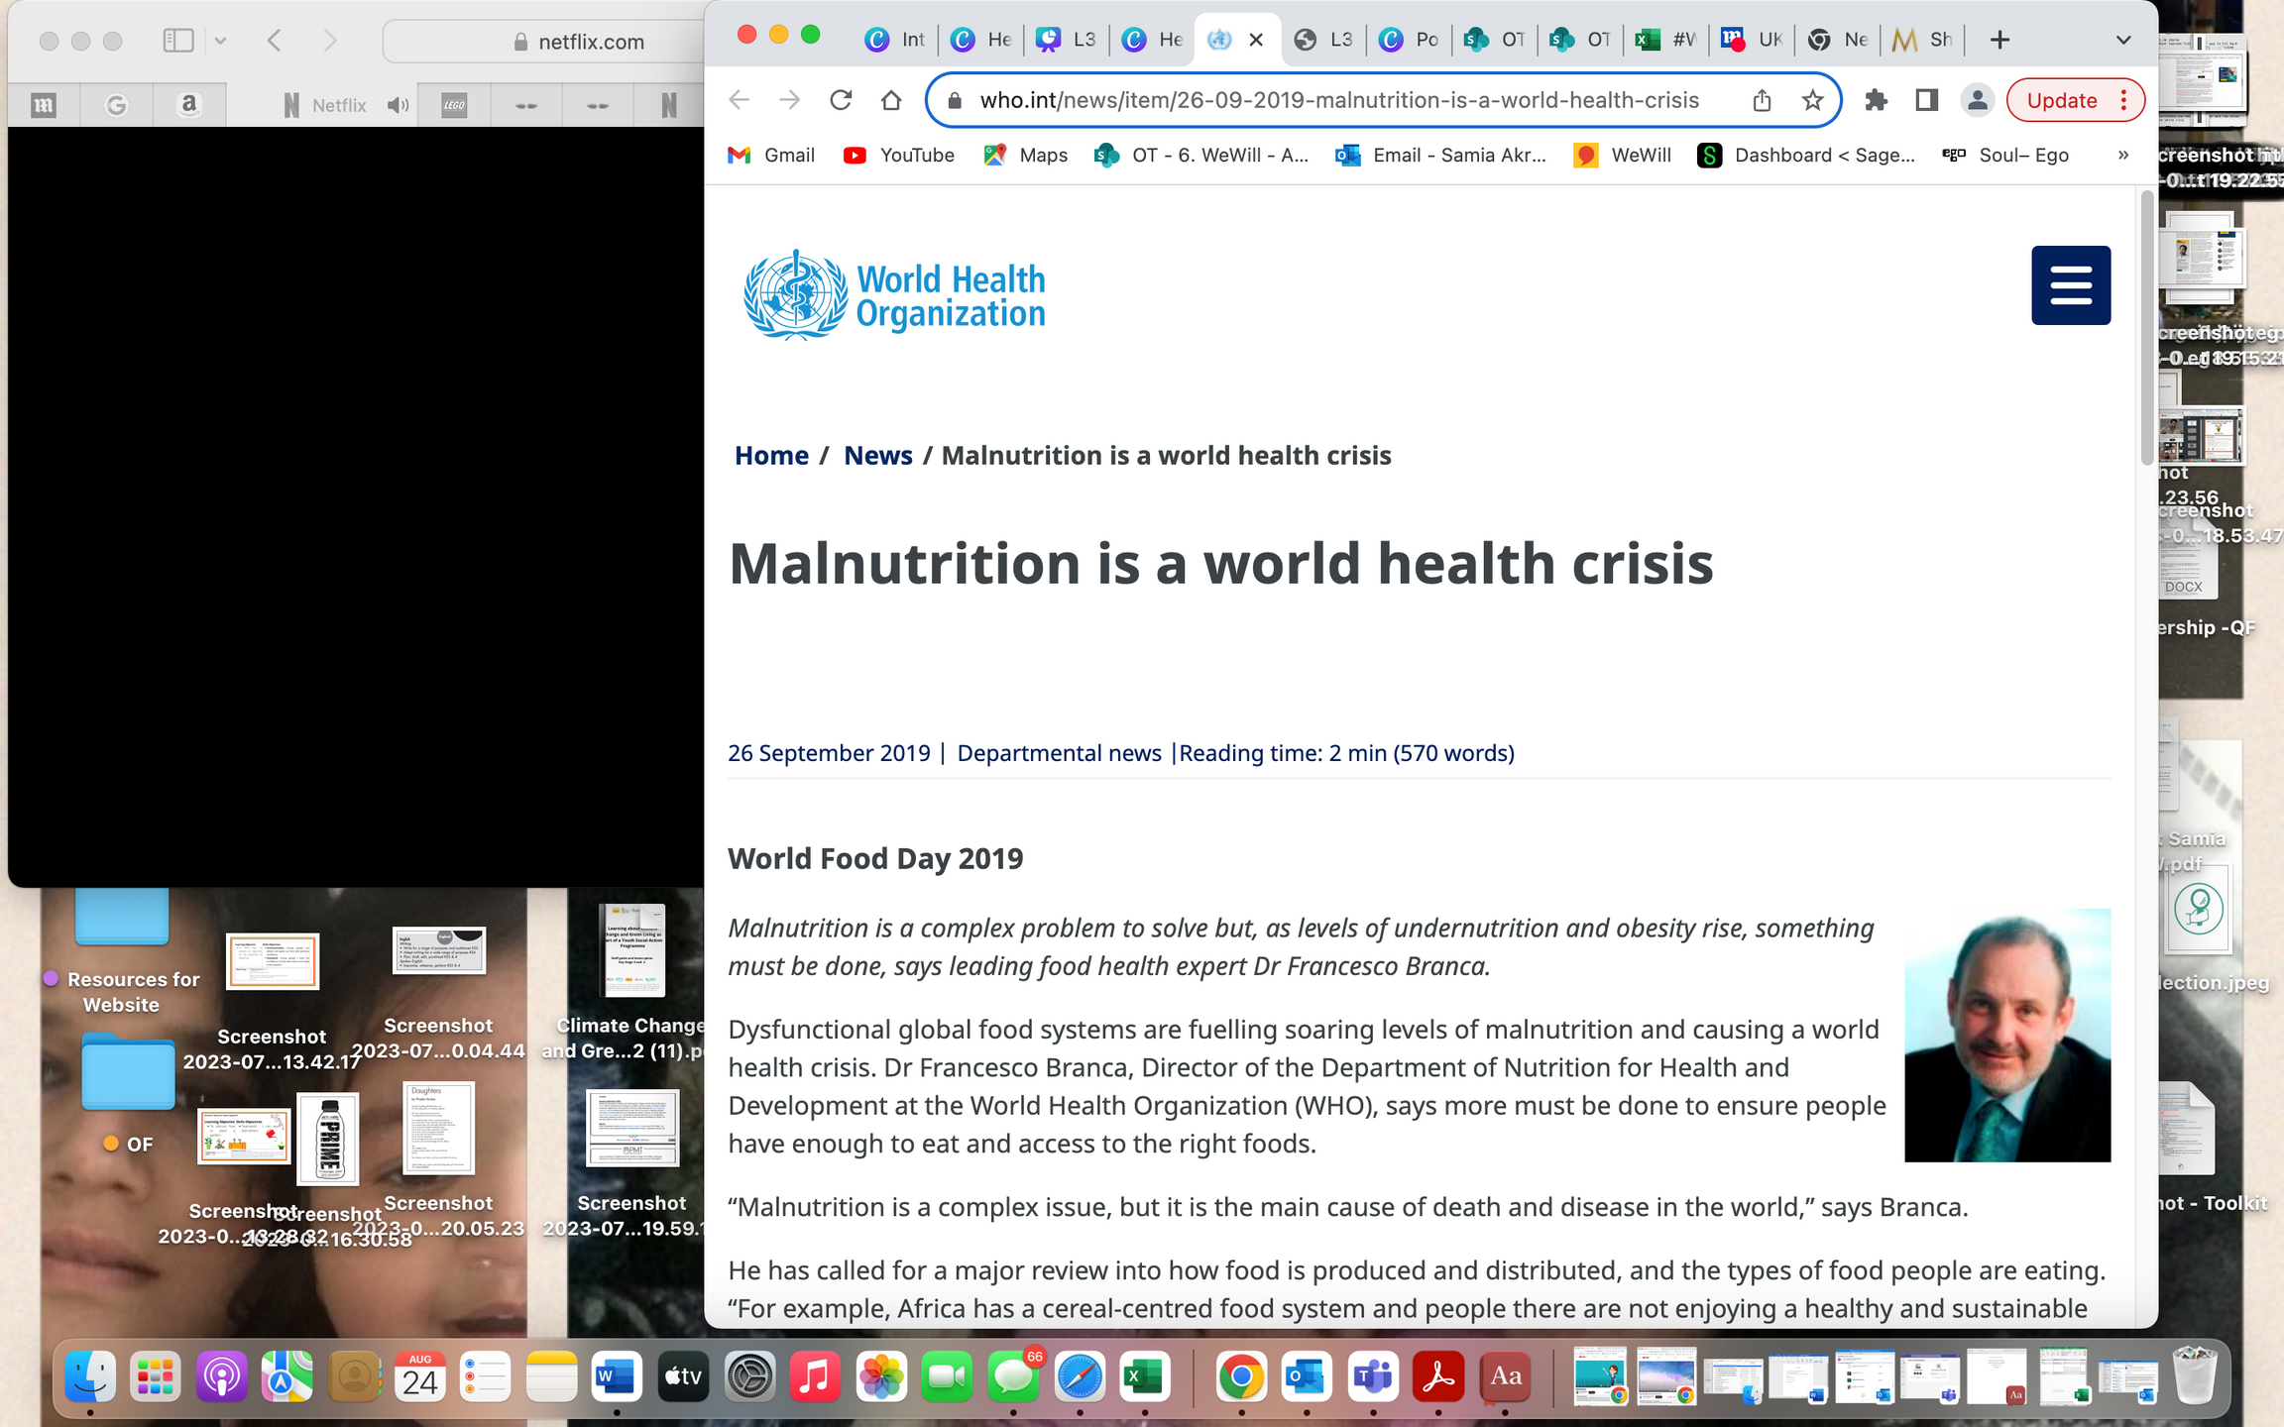

Slide 14
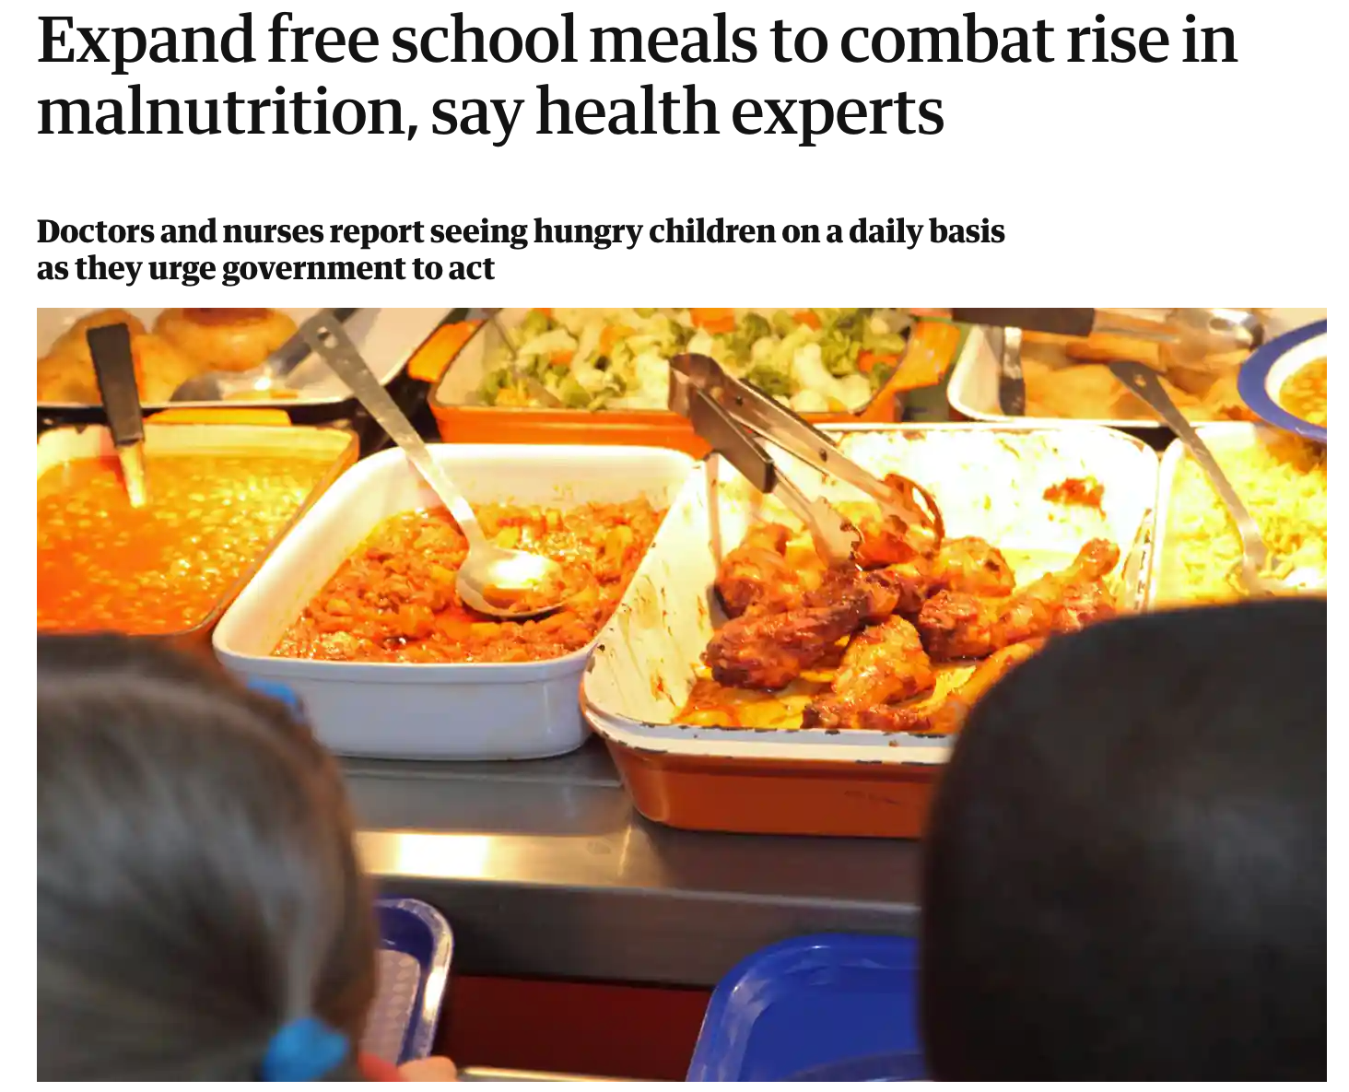

Slide 15
What is the solution?

