Slide 1
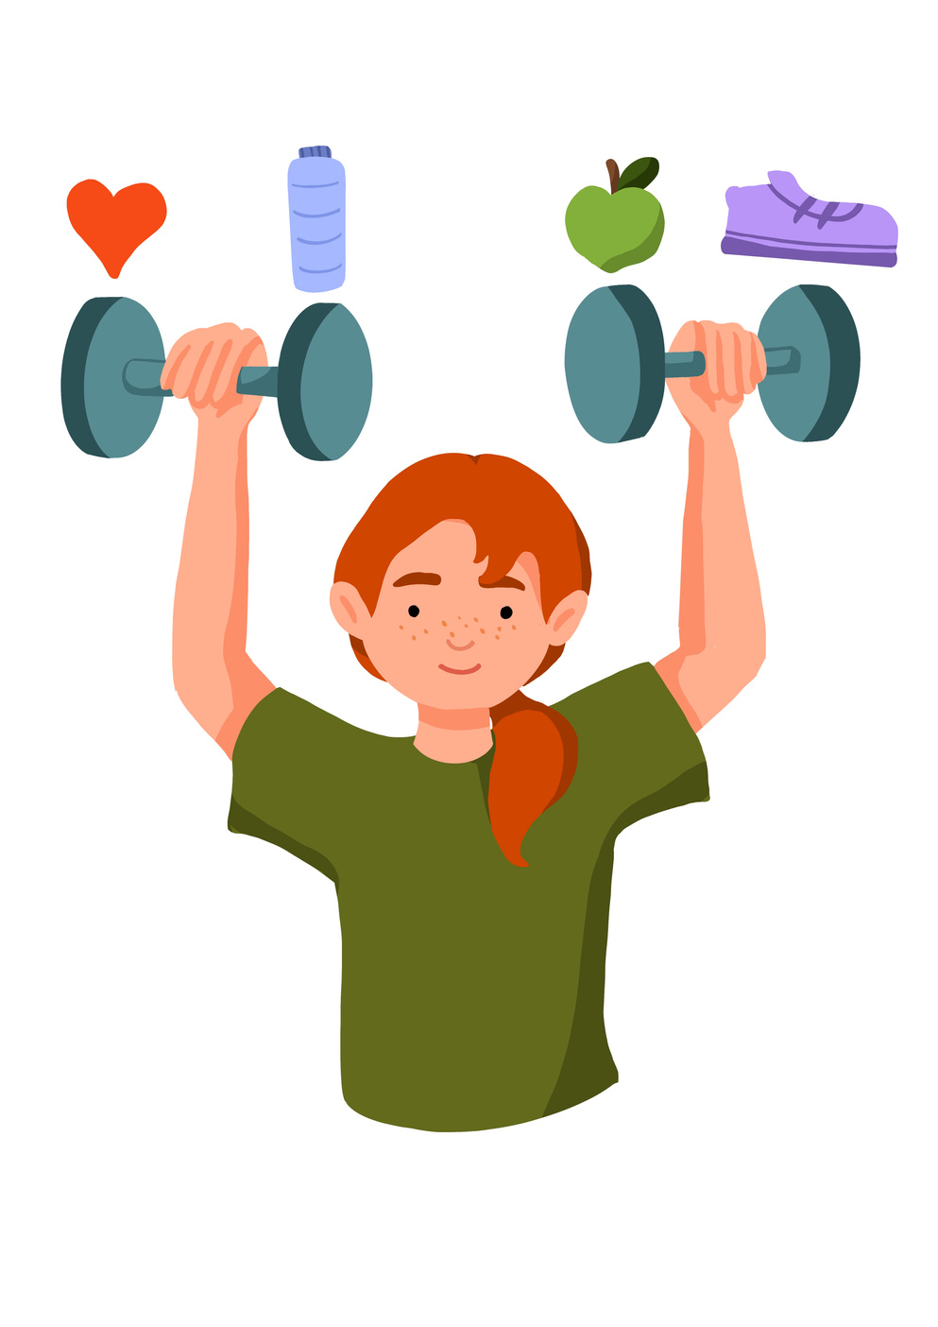
Lesson 2: How can we make healthy food choices? (Science, PSHE)
Healthy Habits

Slide 2



Learning Objective:
  Understand the content of a healthy human diet: carbohydrates, lipids (fats and oils), proteins, vitamins, minerals, dietary fibre and water, and why each is needed
  Explore how they can make healthy food choices every day and encourage others to do the same.
  Raise awareness about healthy food choices for themselves, their family and their community
  calculations of energy requirements in a healthy daily diet
 | Curriculum Link: PSHE, Science

Slide 3
Skills Objective:
  Understand the content of a healthy human diet: carbohydrates, lipids (fats and oils), proteins, vitamins, minerals, dietary fibre and water, and why each is needed
  Explore how they can make healthy food choices every day and encourage others to do the same.
  Raise awareness about healthy food choices for themselves, their family and their community
  calculations of energy requirements in a healthy daily diet
 | Curriculum Link: PSHE, Science

Slide 4
What makes a healthy plate?

Slide 5
How can you help people in their families and community make healthy choices about the food they eat?

Slide 6
1. Create a colour code for foods in the school cafeteria. The colours could correspond to a traffic light;
  green means healthy,
  yellow means eat in moderation,
  and red means ‘ to be consumed only sometimes’.

Slide 7
2. Create a series of advertisements to raise awareness about the importance of eating healthy foods every day and how they provide bodies with energy to function, grow and develop.

Slide 8
3. Invite a local chef to the school to show how they prepare healthy food items using a recipe. Have students create their own recipes that have a variety of healthy and delicious food items.

Slide 9
Create a cookbook.
Healthy eating posters to display around the school and at home.

