Slide 1

Lesson 1: Who influences our food choices?
Healthy Habits

Slide 2



Learning Objectives:
  Understand that many factors influence our food choices, including family, friends, media and the environment
  Explore how these influences affect their own food choices
  Investigate how advertisements and other media can influence our food choices
 | Curriculum Link: PSHE, Citizenship

Slide 3
Skills Objectives:
  Understand that many factors influence our food choices, including family, friends, media and the environment.
  Explore how these influences affect their own food choices.
  Investigate how advertisements and other media can influence our food choices
 | Curriculum Link: PSHE, Citizenship

Slide 4
“When I choose My food, When someone chooses for me”
When we go out for a meal.
School Days
When I
When we
When we
When I

Slide 5


Slide 7
Why do you decide to buy certain foods?

Slide 8
Why do you decide to buy certain foods?
Something you have seen your friends eat
Social Media
Special Offers
Money
Recommended by family

Slide 9

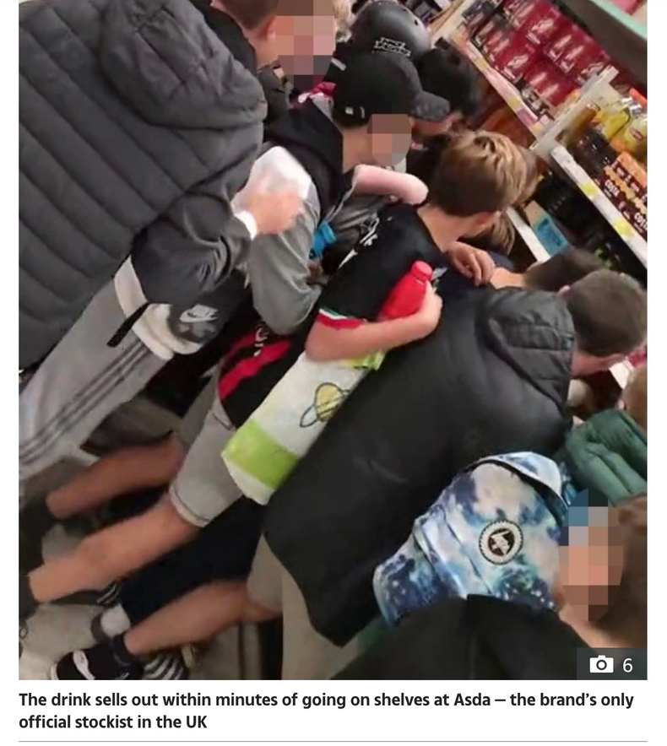

Did you buy the prime drink?
Why?

Slide 10
Investigate how advertisements and other media can influence our food choices.
Choose your favourite food advert

Slide 11
Choose your favourite food advert
  Reflect on some unhealthy food advertisements and how they influence our choices.
  What language is used?
  What kind of music and images are used?
  Do you think it is correct to present these foods as good for you, even when they are not?

