Slide 1
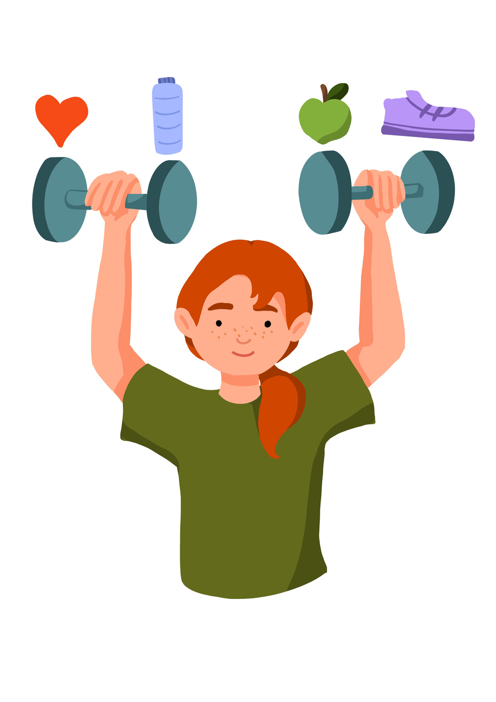
“Promise me you’ll always remember: you’re braver than you believe and stronger than you seem, and smarter than you think.”
Christopher Robin.

Slide 2


Learning Objective To identify the role of energy in my body. | Skills Objectives
Outcomes: They can explain what they need to do to be healthy and how this helps them have energy. | Outcomes: They can explain what they need to do to be healthy and how this helps them have energy.
Using effective communication, I can link the different factors affecting my health
 | National Curriculum: Science Describe the importance of exercise, eating the right amounts of different types of food, and hygiene

Slide 3

Lets Yoga!
Notes:
We have yellow for happiness, blue for sadness, red for anger, black for fear and green for calm.
This book explains how our mind can fill with different emotions and how each emotion can be self-identified, and ‘put away. The book uses colours to make the emotions visual,

Slide 4
Teacher guidance
Session 1 (30-40 minutes)
The teacher proposes 2-3 healthy recipes for children to decide between. Pupils could read it together and create an ingredients/shopping list over the session. Note that a raw recipe might be more appropriate for a year 1 group (e.g., fruit salad) as chopping and mixing already requires many fine motor skills. A year 2 group could attempt a cooked meal with extra supervision to manipulate utensils (e.g., cooking soups).
Notes:
Encourage pupils to add the food to the group they belong to.

Slide 5
Teacher guidance
Session 2 (a whole day or half a day in a small group)
Organise the session over a day where children can be taken in small groups out of the class to take part in the cooking. Before starting the cooking activity, a risk assessment will need to be carried out. Considering when the food will be served will also need to be done in advance. If preparing a raw recipe, session three might need to occur on the same day or the day after if food cannot be kept in the fridge for more than 24 hours. Refer to food hygiene guidelines if unsure.

Slide 6
Teacher guidance
Session 3
Organise a session where pupils can serve the food to their family/visitors. Pupils could write invitations for this and forward them to their families. Children should have an opportunity to reflect on their progress and the impact of the work they have produced.

