Slide 1

Healthy Habits
Lesson 3- KS2
“Tis easier to prevent bad habits than to break them.” – Benjamin Franklin

Slide 2

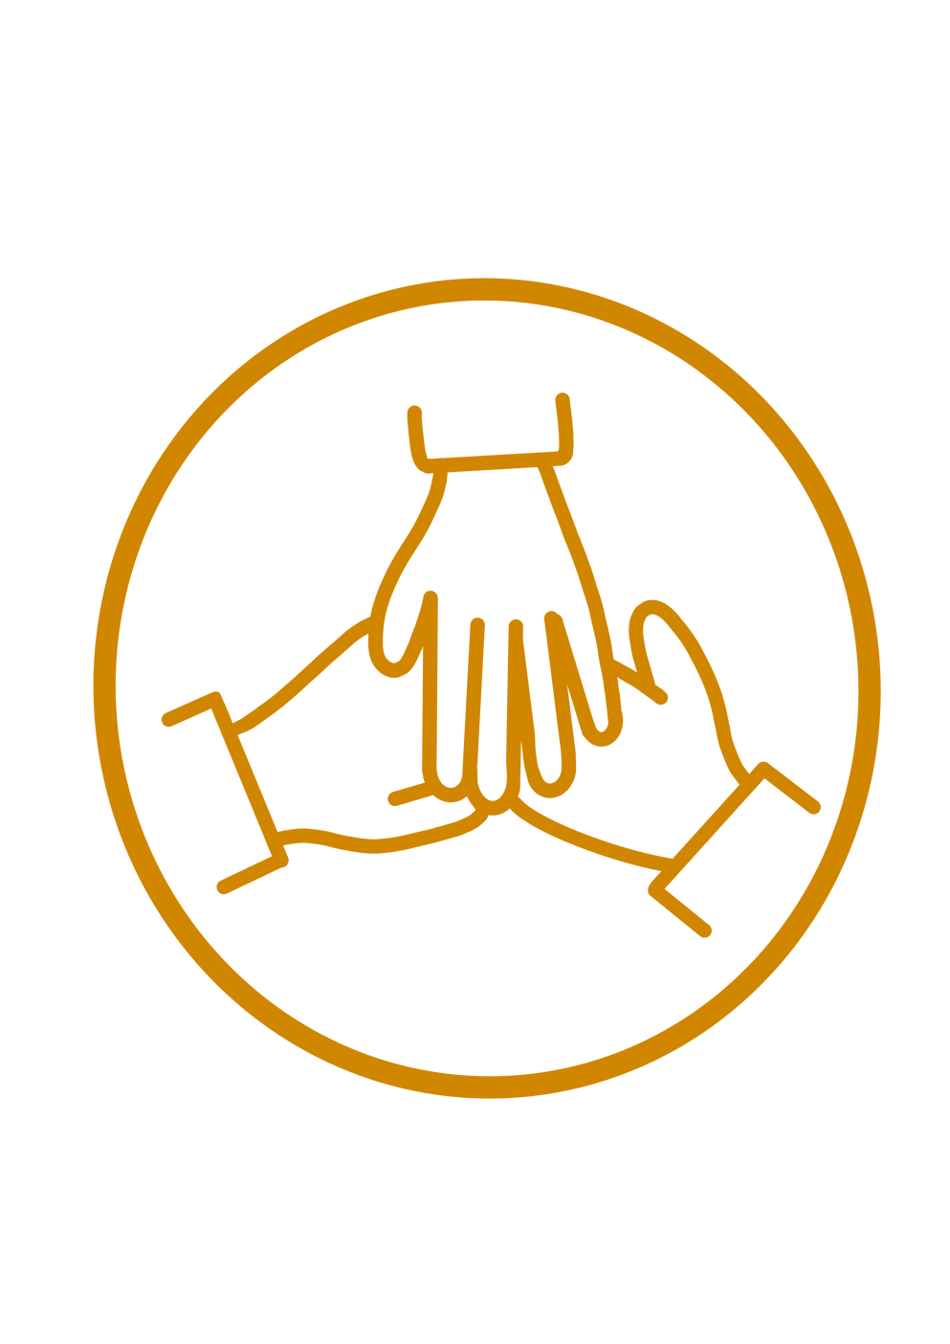
Activity 3: How can I take action about my health?
Learning Objective To create a charter on health. |  | Skills Objectives Problem-Solving - Young people can follow an argument, identify different points of view, and distinguish facts from opinions. Team Work - Young people can actively create positive energy and atmosphere during the project.

Slide 3
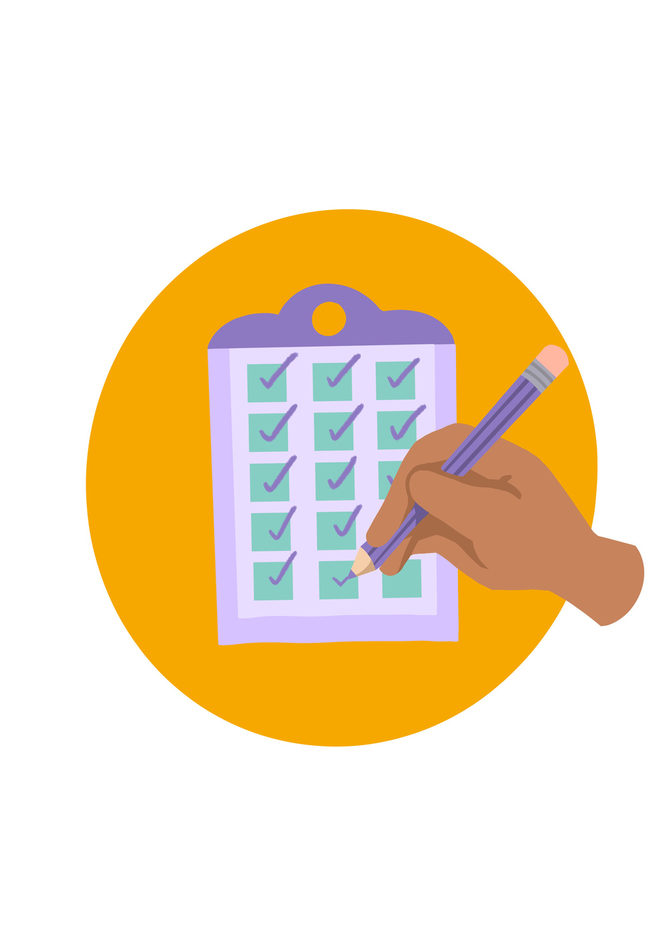
Produce a charter on aspects of health that are important to you. Example next slide:
The charter will be used to ensure your school is healthy.
#WeWill Stage: | National Curriculum: English (spoken language) Maintain attention and participate actively in collaborative conversations, staying on topic and initiating and responding to comment
Notes:
We have yellow for happiness, blue for sadness, red for anger, black for fear and green for calm.
This book explains how our mind can fill with different emotions and how each emotion can be self-identified, and ‘put away. The book uses colours to make the emotions visual,

Slide 4
The Harmony Project defines health at three levels (personal – community – world health)
Notes:
We have yellow for happiness, blue for sadness, red for anger, black for fear and green for calm.
This book explains how our mind can fill with different emotions and how each emotion can be self-identified, and ‘put away. The book uses colours to make the emotions visual,

Slide 5
The Harmony Project defines health at three levels (personal – community – world health)
My Health – I am well when:
When I am valued​
When I learn new things​
When I stand up for what I believe in​
When I realise my potential​
When I care for others​
When I am creative and imaginative​
When I connect to nature​
When I have time to think, reflect/pray
Notes:
We have yellow for happiness, blue for sadness, red for anger, black for fear and green for calm.
This book explains how our mind can fill with different emotions and how each emotion can be self-identified, and ‘put away. The book uses colours to make the emotions visual,

Slide 6
The Harmony Project defines health at three levels (personal – community – world health)
Our Health – my team is well when:
When everyone has a say​
When we break down a big challenge into smaller tasks​
When we have good communication​
When we show leadership to guide the team to its goal​
When everyone enjoys the experience​
When we find the right pace​
When we see the need and respond to it
Notes:
We have yellow for happiness, blue for sadness, red for anger, black for fear and green for calm.
This book explains how our mind can fill with different emotions and how each emotion can be self-identified, and ‘put away. The book uses colours to make the emotions visual,

Slide 7
The Harmony Project defines health at three levels (personal – community – world health)
Planetary health – the world will be well when:
When we have happy, healthy communities. ​
When we are fair and value everyone.​
When we live in peace. ​
When all our energy and water are clean.​
When there is no waste or pollution. ​
When food and farming are organic.​
When the biodiversity of nature thrives.​
When we all grow as leaders.
Notes:
We have yellow for happiness, blue for sadness, red for anger, black for fear and green for calm.
This book explains how our mind can fill with different emotions and how each emotion can be self-identified, and ‘put away. The book uses colours to make the emotions visual,

Slide 8
Our Pledge.................
Notes:
We have yellow for happiness, blue for sadness, red for anger, black for fear and green for calm.
This book explains how our mind can fill with different emotions and how each emotion can be self-identified, and ‘put away. The book uses colours to make the emotions visual,

