Slide 1
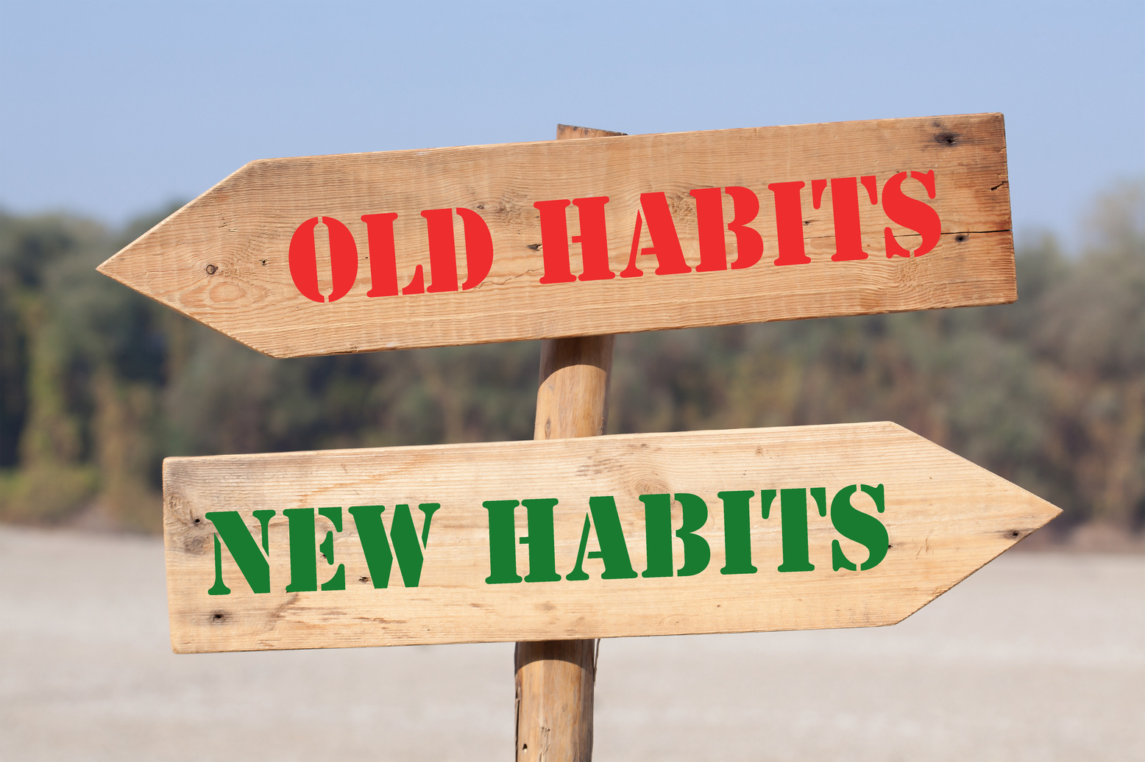
Healthy Habits
Lesson 2 - KS2
“95% of everything you do is the result of habit.” – Aristotle

Slide 2



Learning Objective To explain the role of physical activity and nutrition in physical and emotional health |  | Skills Objective Young people can recognise what might affect them and ask for help When solving problems, young people can identify the questions to resolve the issue
#WeWill Stage | National Curriculum: Science Healthy and balanced nutrition

Slide 3
Identifying a connection between our physical and mental health. For example, exercise can have a positive effect on mental health because it interacts with dopamine levels in the brain, which are responsible for transmitting messages in the brain, learning, and keeping motivation levels up.
Notes:
We have yellow for happiness, blue for sadness, red for anger, black for fear and green for calm.
This book explains how our mind can fill with different emotions and how each emotion can be self-identified, and ‘put away. The book uses colours to make the emotions visual,

Slide 4
Look at the nutritional value of foods we buy, the quality of fruits and vegetables and the role of seasons in making fruits and vegetables nutritionally rich.
Notes:
We have yellow for happiness, blue for sadness, red for anger, black for fear and green for calm.
This book explains how our mind can fill with different emotions and how each emotion can be self-identified, and ‘put away. The book uses colours to make the emotions visual,

Slide 5
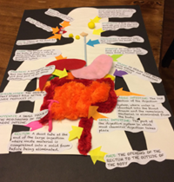
The functioning of our immune system as interconnected to our microbiome is another example of a healthy system.
Notes:
We have yellow for happiness, blue for sadness, red for anger, black for fear and green for calm.
This book explains how our mind can fill with different emotions and how each emotion can be self-identified, and ‘put away. The book uses colours to make the emotions visual,

Slide 6

Notes:
We have yellow for happiness, blue for sadness, red for anger, black for fear and green for calm.
This book explains how our mind can fill with different emotions and how each emotion can be self-identified, and ‘put away. The book uses colours to make the emotions visual,

