Slide 1

Healthy Habits
Lesson 1 - KS2
“Motivation is what gets you started. Habit is what keeps you going.” – Jim Ryun

Slide 2



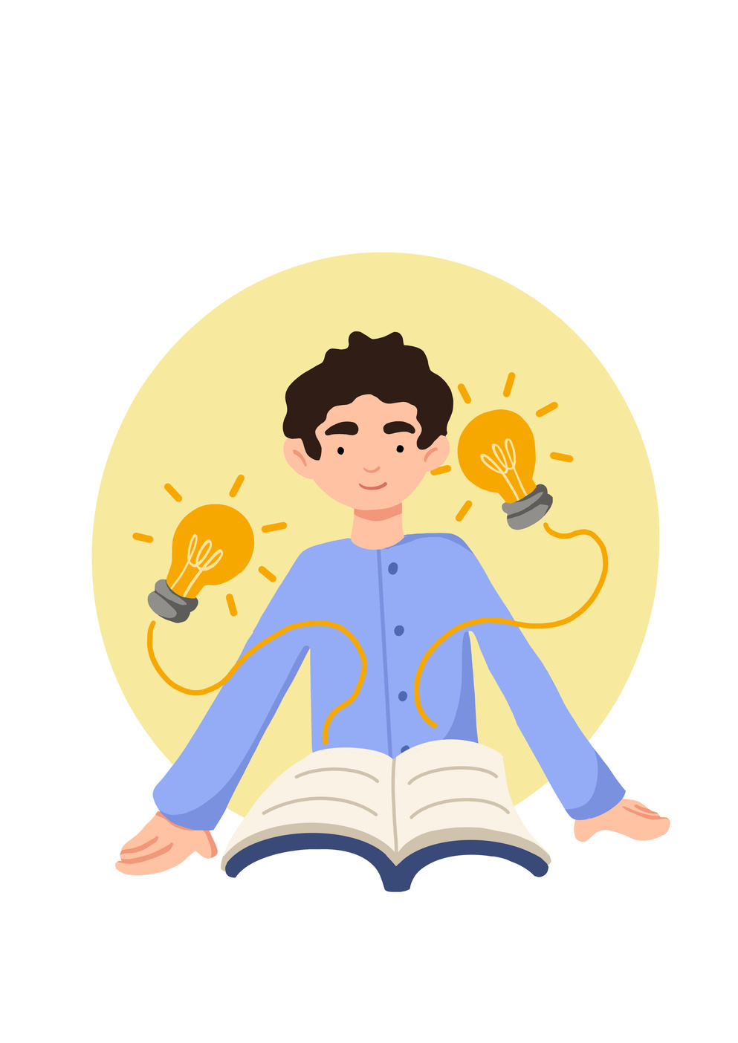
Learning Objective To understand how health systems function and define what health is |  | Skills Objectives Young people can participate in discussions, debates and presentations Young people can work with others
#WeWill Stage | National Curriculum: PSHE Mental and physical health. Science Healthy and balanced nutrition

Slide 3

Lets Yoga!
Notes:
We have yellow for happiness, blue for sadness, red for anger, black for fear and green for calm.
This book explains how our mind can fill with different emotions and how each emotion can be self-identified, and ‘put away. The book uses colours to make the emotions visual,

Slide 4



Factors impacting health
Less Sugar
Healthy Diet
Exercise
Drinking
Water
Sleep
Notes:
This first session introduces pupils to health as a state of balance and constant interaction between us and the outside world. Maintaining this balance in us is how we stay healthy and help others stay healthy too.
The class will need to review all the different factors impacting health that they have explored through previous learning (healthy diet, drinking water, sleep, exercise) to define health at the end.
The teacher could start the session by filling a mind map with factors interacting with our health. Pupils can participate orally when doing this. Then explain that our body is a healthy system where different elements are working together in balance to give us good health.

Slide 5
Notes:
During the session, the teacher should aim to give children opportunities to explore different what a healthy system is. This could be done by studying the water cycle, organic food cycle or bees and pollination. Pupils will look at how each of these systems is important for our health and the system's health. Refer to the presentation slides here. Practitioners should consider what the prior knowledge of the pupils is when making connections in the lesson.

Slide 6
Notes:
During the session, the teacher should aim to give children opportunities to explore different what a healthy system is. This could be done by studying the water cycle, organic food cycle or bees and pollination. Pupils will look at how each of these systems is important for our health and the system's health. Refer to the presentation slides here. Practitioners should consider what the prior knowledge of the pupils is when making connections in the lesson.

Slide 7
Notes:
During the session, the teacher should aim to give children opportunities to explore different what a healthy system is. This could be done by studying the water cycle, organic food cycle or bees and pollination. Pupils will look at how each of these systems is important for our health and the system's health. Refer to the presentation slides here. Practitioners should consider what the prior knowledge of the pupils is when making connections in the lesson.

Slide 8
How are each of these systems important for our health?
Notes:
During the session, the teacher should aim to give children opportunities to explore different what a healthy system is. This could be done by studying the water cycle, organic food cycle or bees and pollination. Pupils will look at how each of these systems is important for our health and the system's health. Refer to the presentation slides here. Practitioners should consider what the prior knowledge of the pupils is when making connections in the lesson.

