Slide 1

“Promise me you’ll always remember: you’re braver than you believe and stronger than you seem, and smarter than you think.”
Christopher Robin.

Slide 2

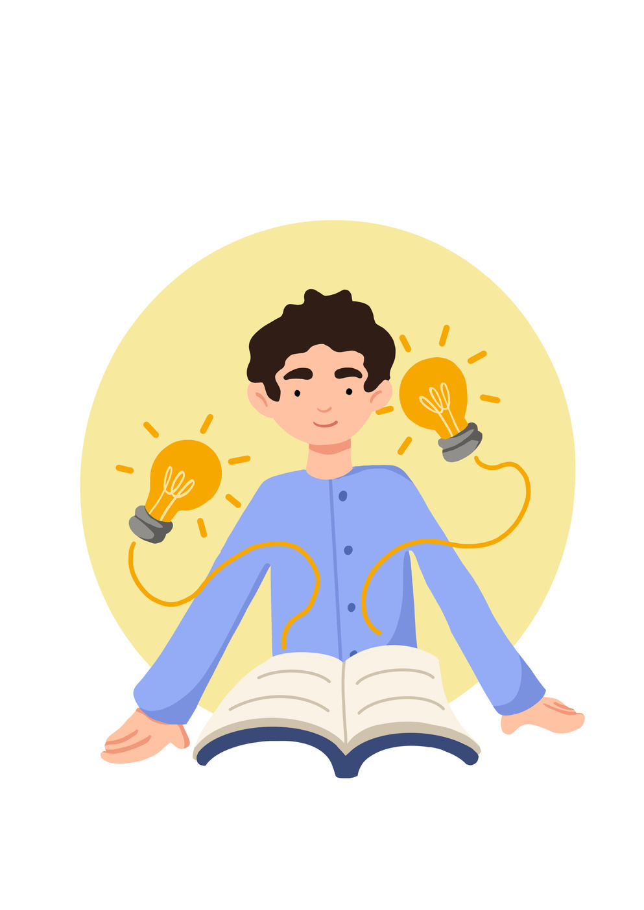
Learning Objective To demonstrate the benefit of participating in a group mindfulness session. | Skills Objective
I can work with others in the local community and help with Youth Social Action
 | National Curriculum: PSHE Name and identify feelings English (spoken language) Use relevant strategies to build vocabulary

Slide 3

‘The Color Monster’ by Ana Llenas.
Yellow for happiness,
Blue for sadness,
Red for anger,
Black for fear,
Green for calm.
Notes:
We have yellow for happiness, blue for sadness, red for anger, black for fear and green for calm.
This book explains how our mind can fill with different emotions and how each emotion can be self-identified, and ‘put away. The book uses colours to make the emotions visual,

Slide 4




Open your hands out, imagine:
In your left hand you have a strawberry
and in your right hand, a candle.
First, smell the strawberry, then blow out the candle
This will make you breathe in and out.
Repeat this 3-5 times.

Slide 5
Do a mindful colouring activity from your passport.

Slide 6
Know whom in school they should speak to if they are worried about their own or someone else’s mental wellbeing or ability to control their emotions (including issues arising online).
In our school, you can talk to............................................................ (please include pictures)

Slide 7

What will you change?

Slide 8

childline.org.uk - 0800 1111 (free 24hr) confidential listening
samaritans.org - 116 123 (free 24 hr) confidential listening
studentsagainstdepression.org - resources to move away from depression
youngminds.org.uk - mental health info and guidance
youthaccess.org.uk - young people’s info, advice and counselling
themix.org.uk - essential support for under 25s
If you have a mental health crisis and don't know whom to contact, call NHS 111. Call 111, free from any phone, 24 hours a day, seven days a week, and speak to a highly trained adviser supported by healthcare professionals.

